Slide 1
ADOT Major Projects
Notes:
Introduce myself, Marcy and Cynthia

Slide 2

I-10 Kino to Country Club is the 1st project from the I-10/SR 210 Environmental Impact Study
The Largest ADOT Major Project in Southern AZ
Began in June of 2025
Will improve safety and efficiency of this important Tucson Highway

Slide 3
The project includes:
Reconstructing I-10 to include three general purpose lanes in each direction between milepost 262 (east of Park Avenue) and Alvernon Way
Reconstructing the traffic interchange at I-10 and Kino Parkway
Constructing a new traffic interchange at I-10 and Country Club Road
Removing the traffic interchange at Palo Verde Road and I-10
Constructing a new I-10 westbound entrance ramp from Alvernon Way
Constructing an I-10 undercrossing to connect the North and South Kino Sports Complex
Notes:
The project will improve a 15-mile section of State Route 347 between Interstate 10 and the City of Maricopa. This project corridor runs through Maricopa and Pinal counties and is primarily located within the Gila River Indian Community.

Slide 4
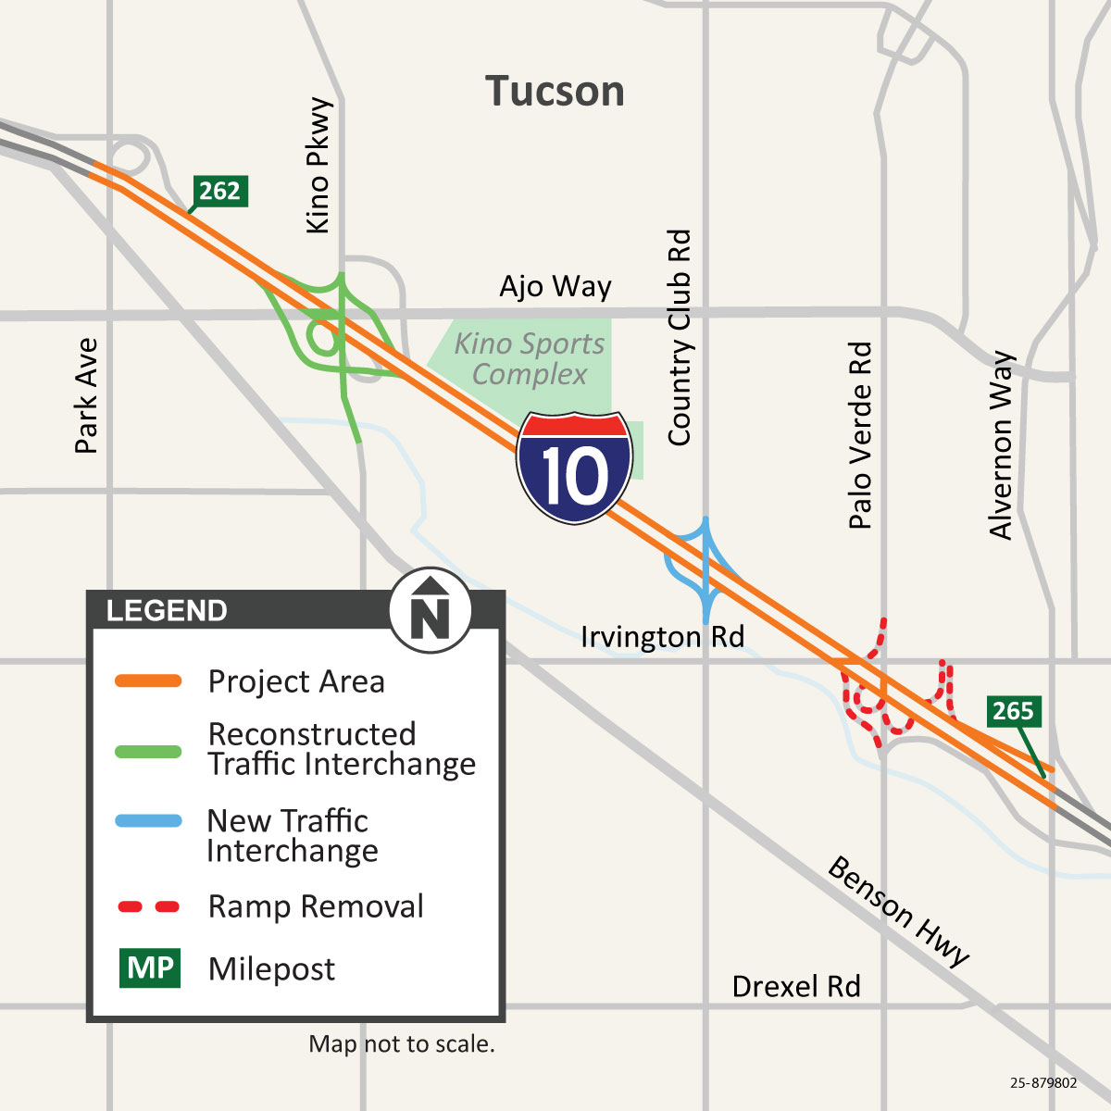
Notes:
The project will improve a 15-mile section of State Route 347 between Interstate 10 and the City of Maricopa. This project corridor runs through Maricopa and Pinal counties and is primarily located within the Gila River Indian Community.

Slide 5
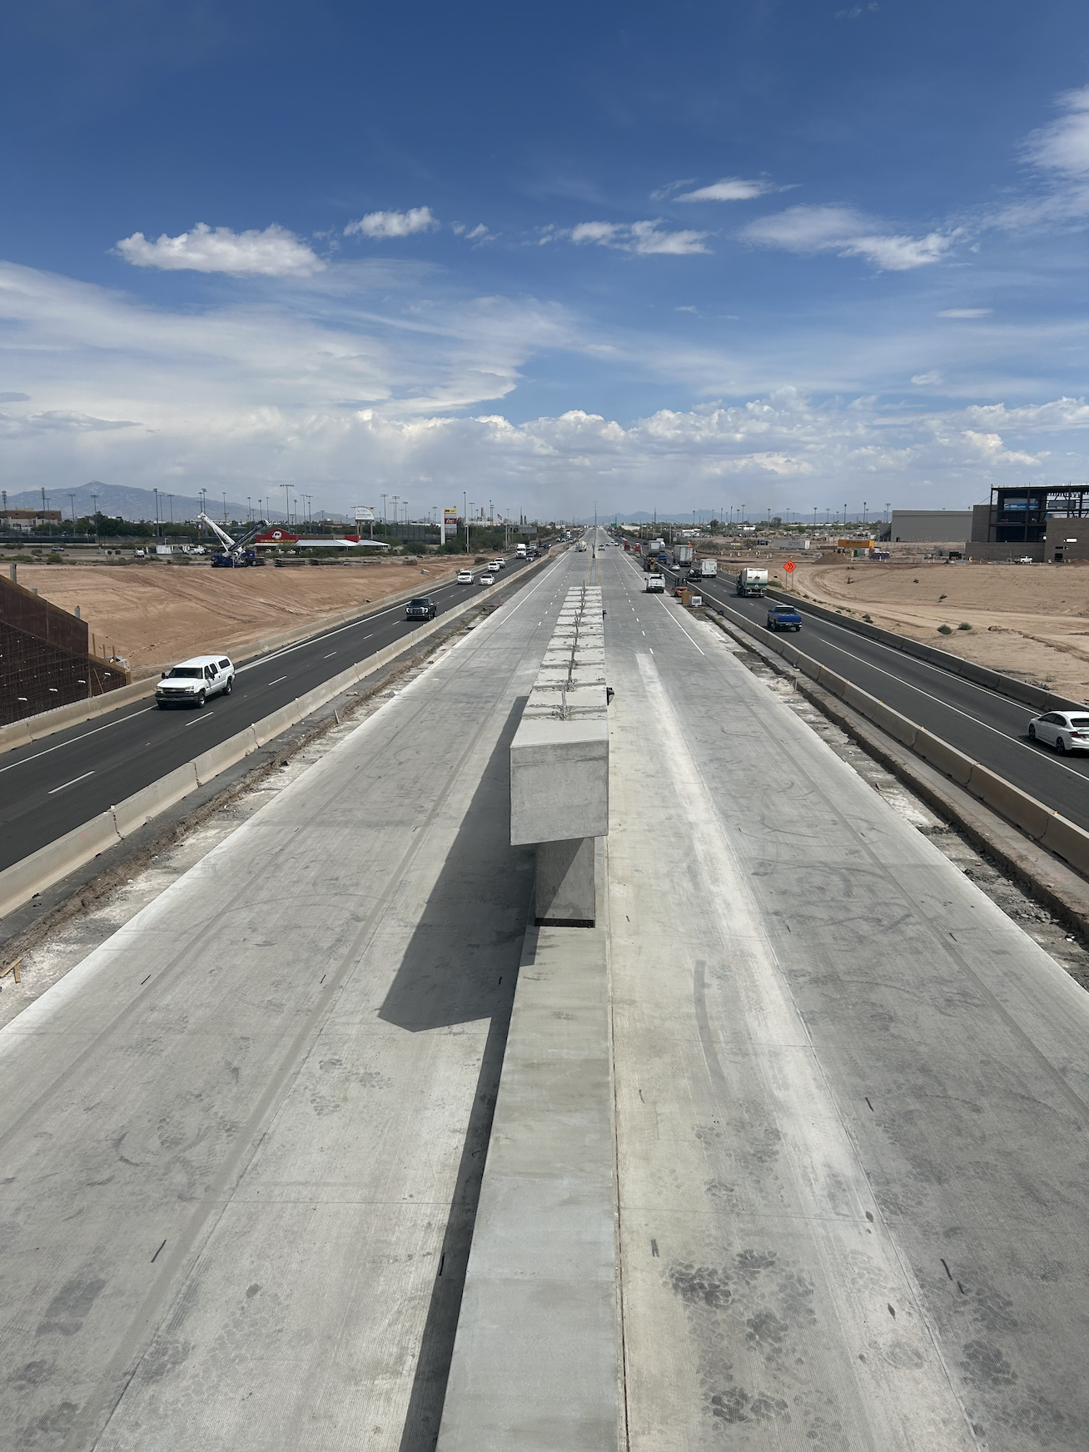
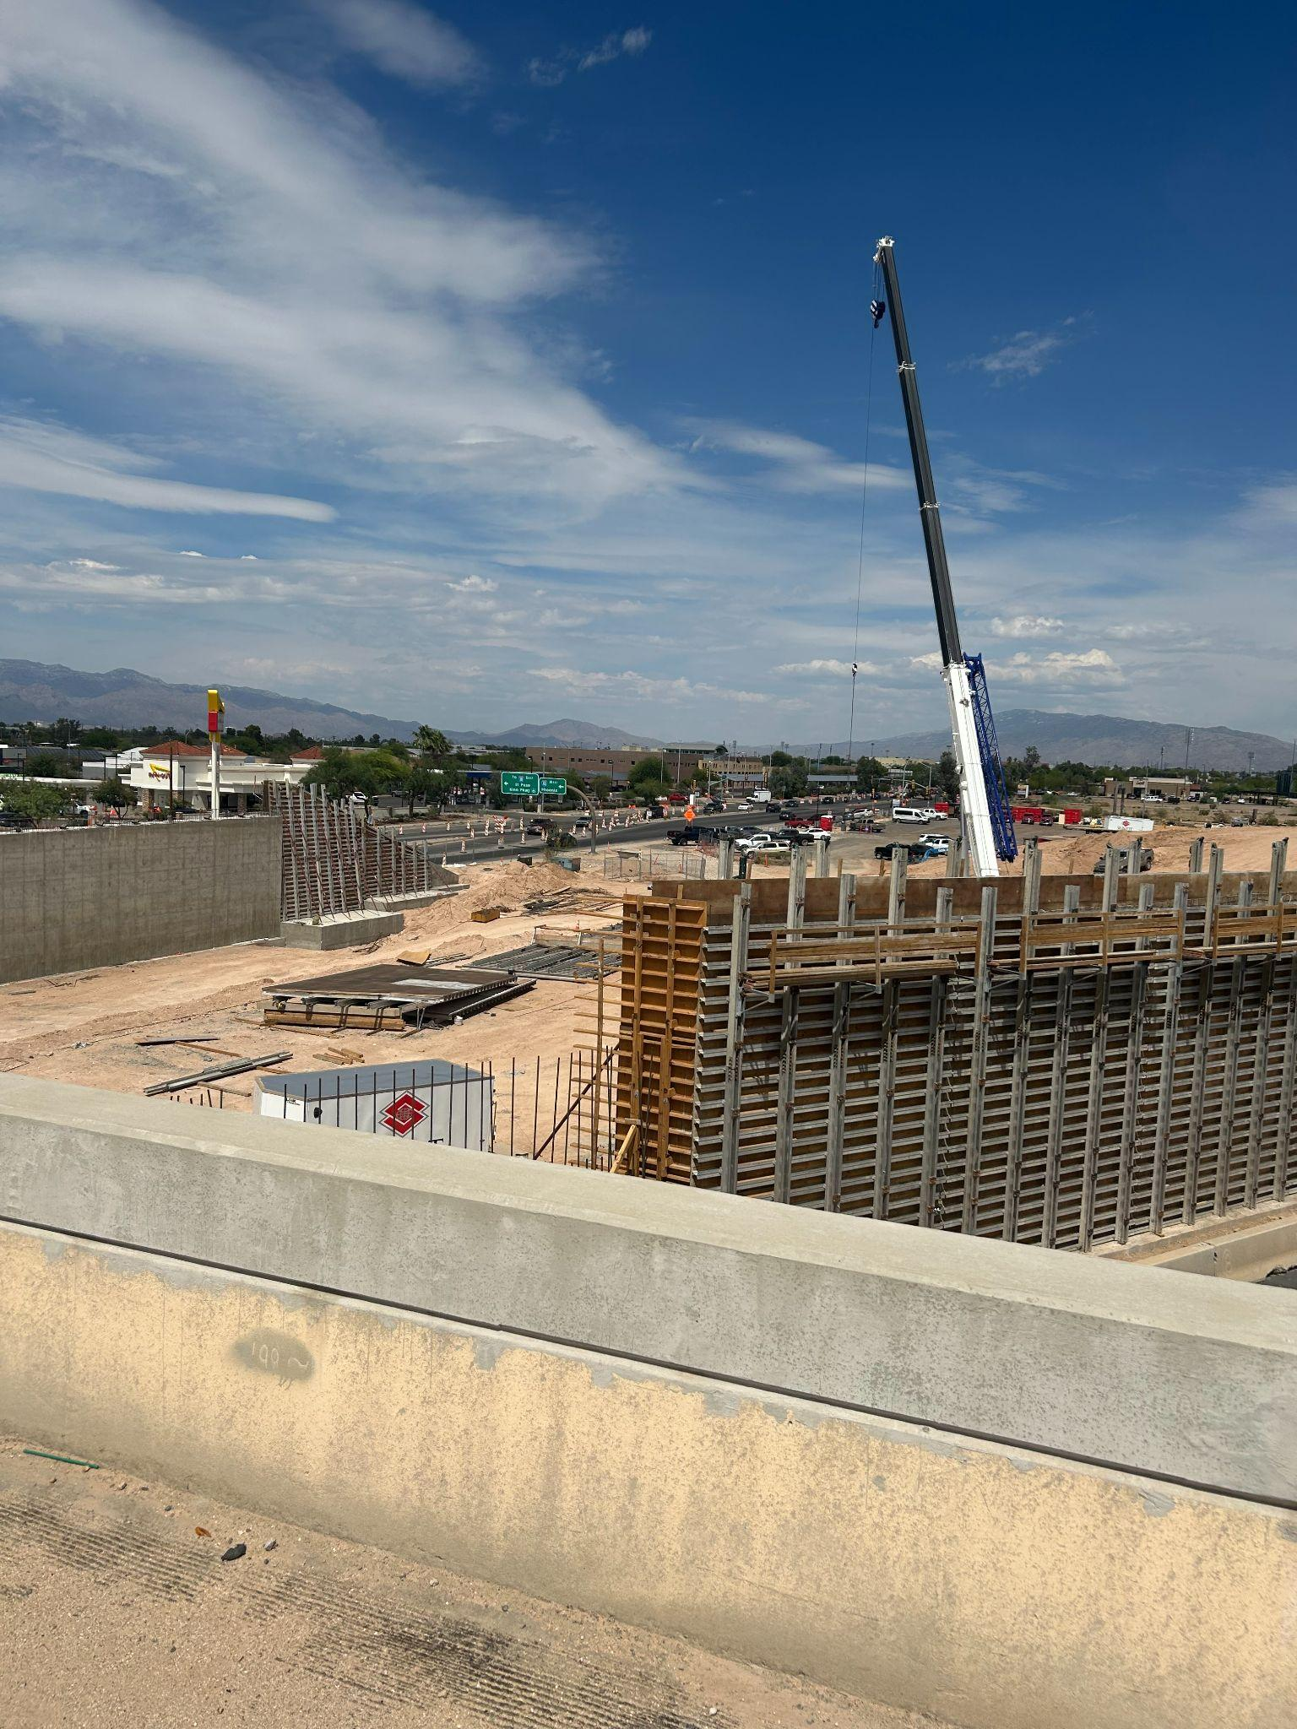
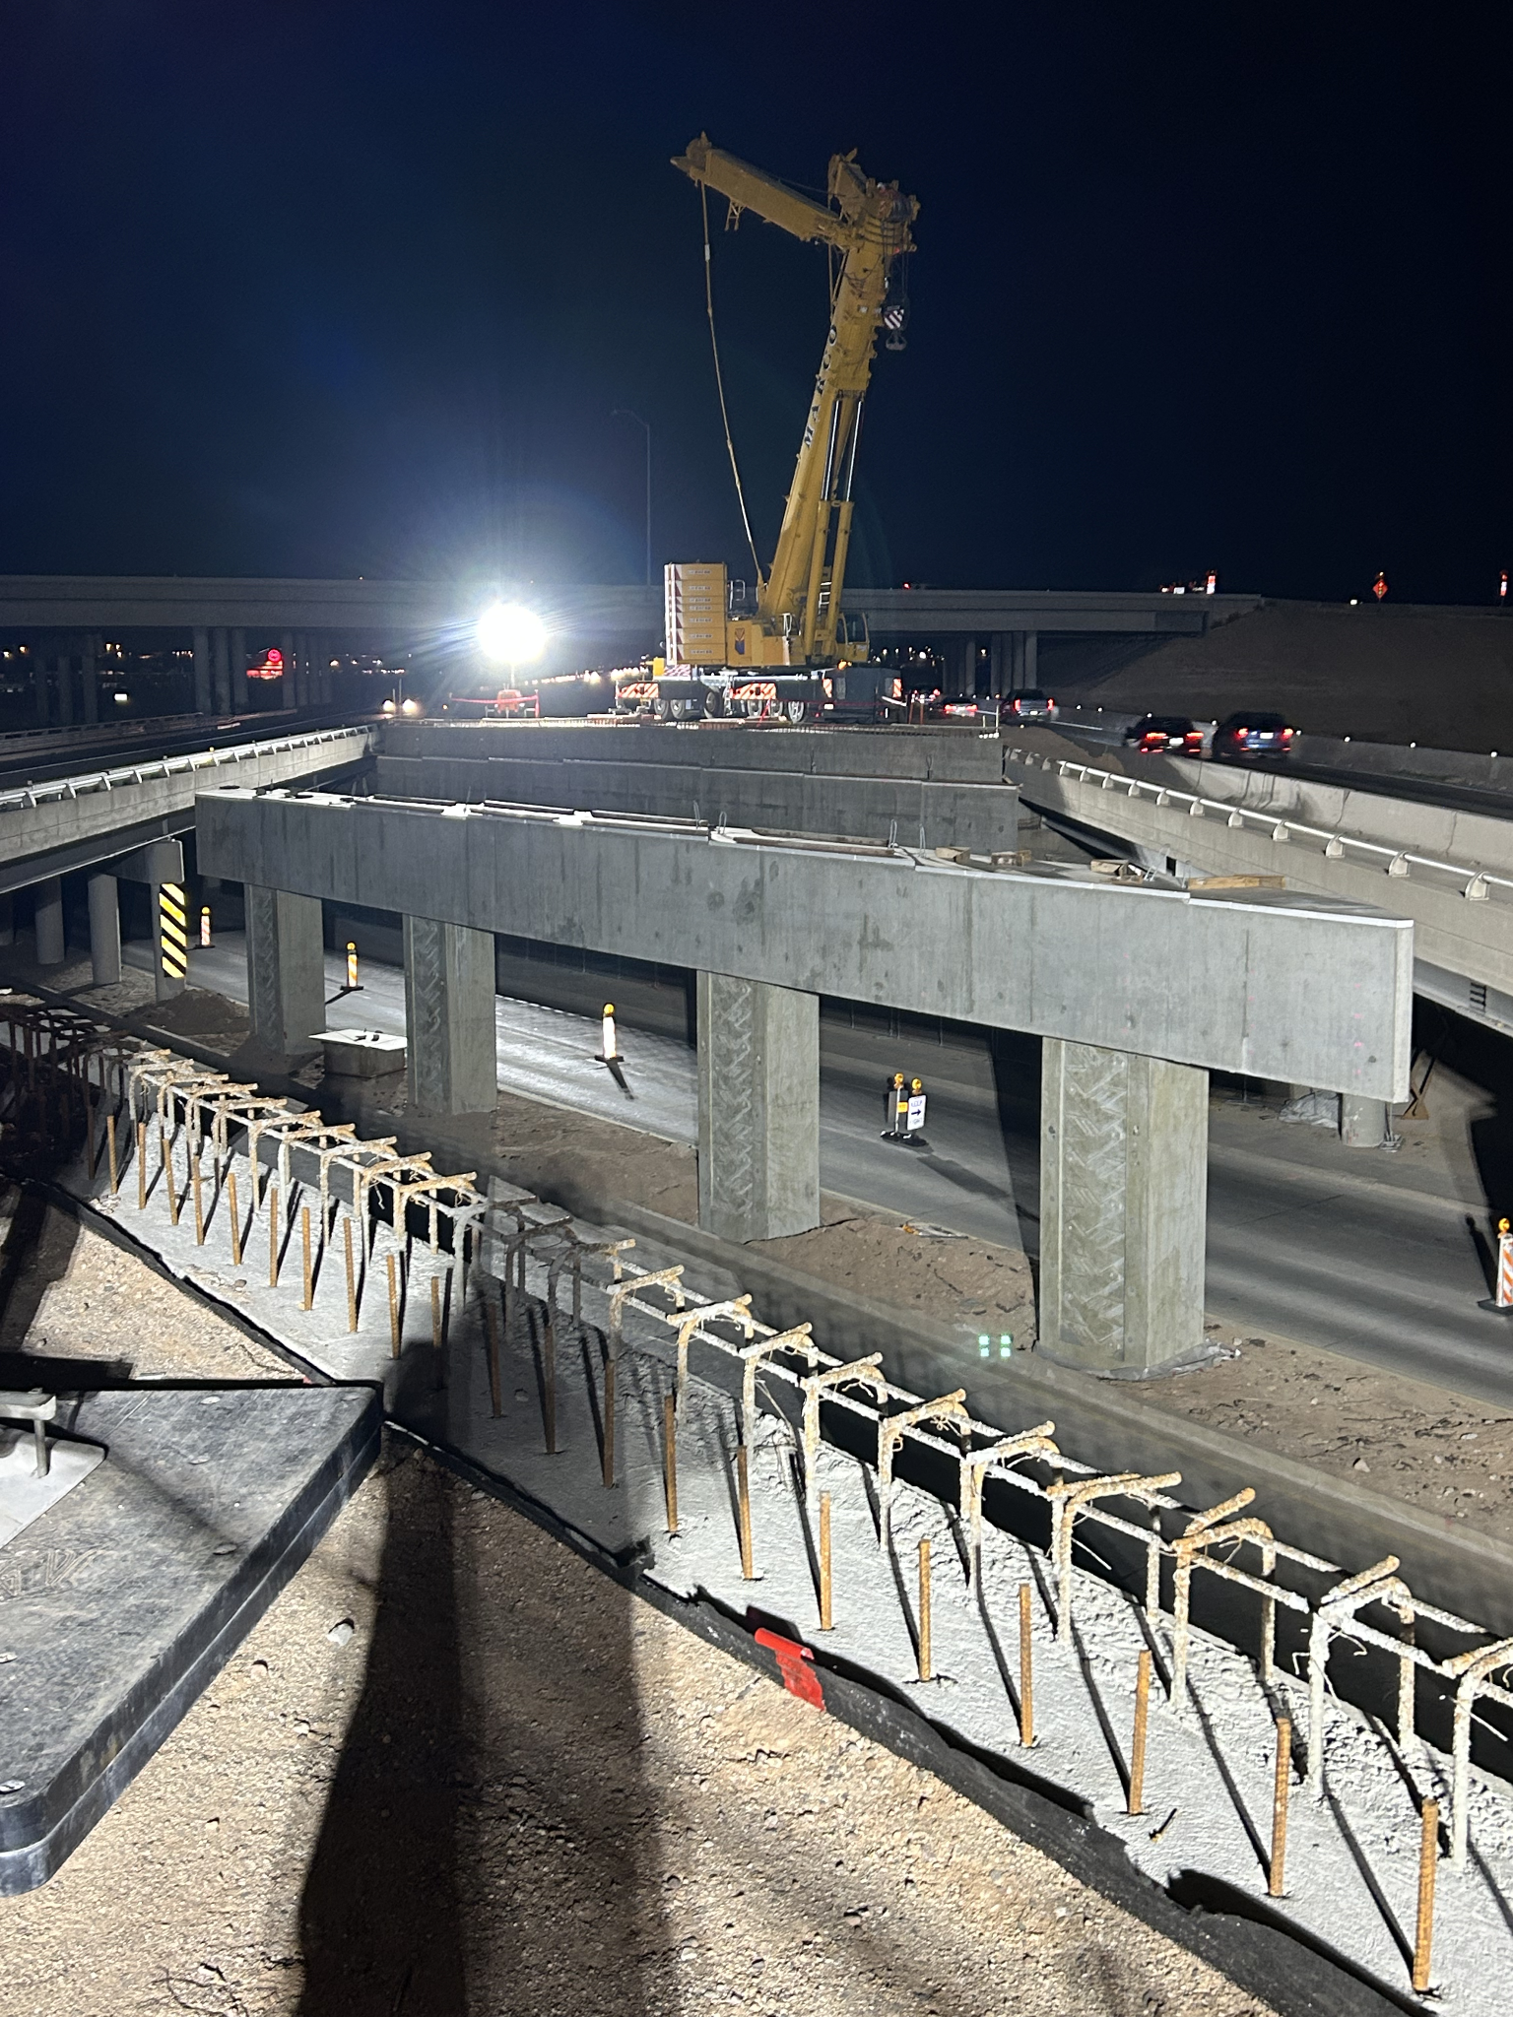

Slide 6
Biggest Challenges of the I-10 Kino to Country Club Project
Very busy highway
Lane restrictions only at night
Reconstructing Kino Parkway Interchange without closing it
Closing Palo Verde at I-10
Building a brand new Interchange at Country Club
  Residents very close by/Noise

Slide 7
Biggest Wins of the I-10 Kino to Country Club Project
New Country Club Interchange by end of year
Improved Kino Parkway Interchange
Much more efficient travel
Kino Gateway neighborhood changed ingress/egress
Amazing progress in 1 year

Slide 8
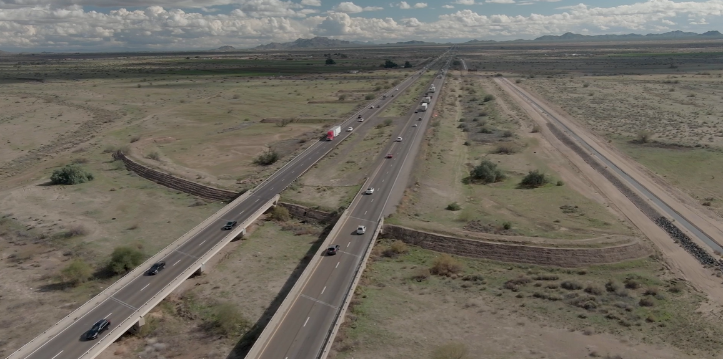
I-10 Wild Horse Pass Corridor Project
www.I-10wildhorsepasscorridor.com
Notes:
Moving on to the I-10 Wild Horse Pass Corridor Project
The I-10 Wild Horse Pass Corridor Project runs along 26 miles of I-10 in both directions from the Chandler area down to just north of Casa Grande to connect to I-10 where it is already 3 lanes in both directions.
Throughout the entire project corridor, crews will be adding an additional travel lane in both directions
The total cost of the project is just under $1 billion.
The reason this project is being done is to help reduce the traffic congestion and travel times through this stretch of I-10 as well as create a safer driving experience for motorists.
Throughout the corridor, crews will be installing freeway management systems equipment, such as freeway cameras, overhead digital message boards and wrong way detection systems………all to enhance safety for motorists.

Slide 9
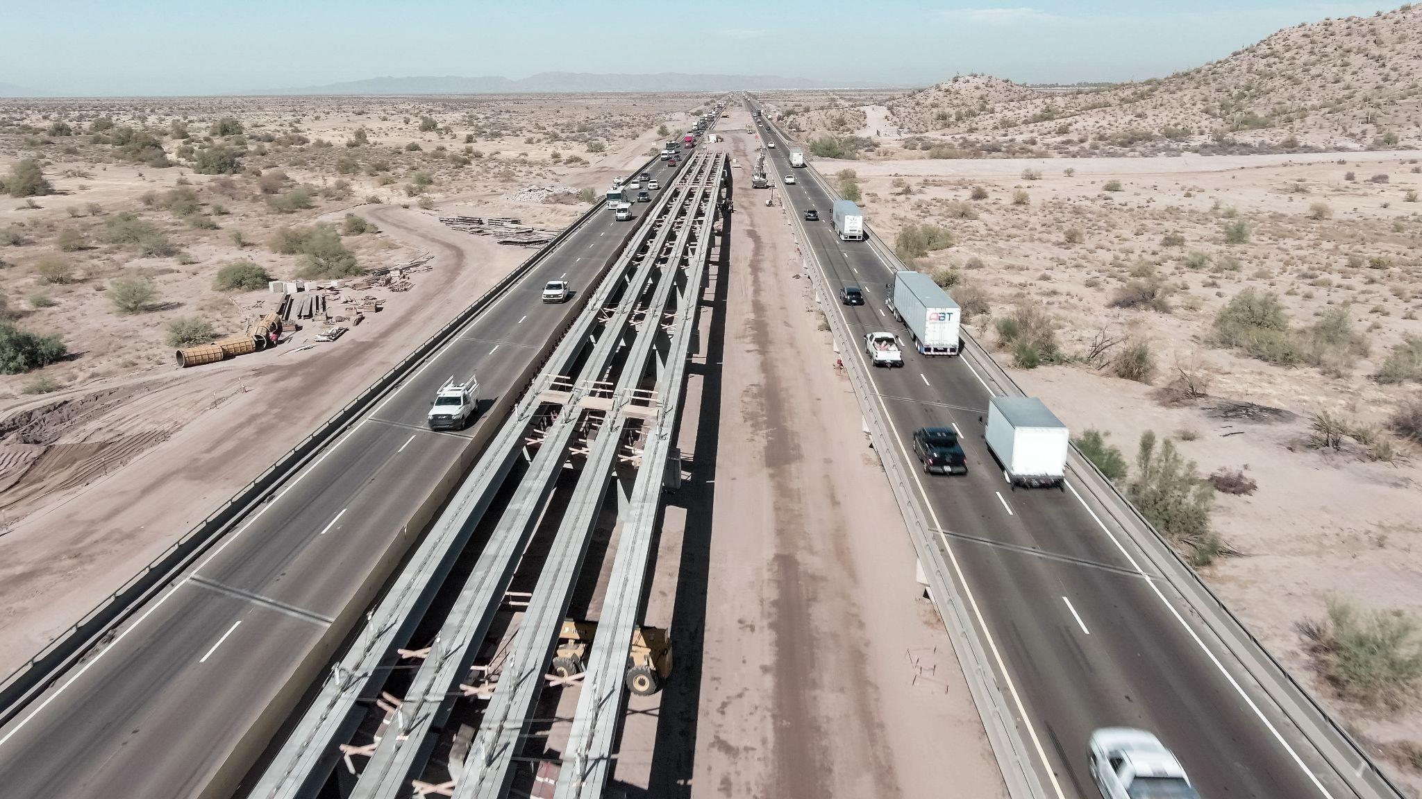
    I-10 Wild Horse Pass Corridor Project
Began Construction in May, 2024
Adding third general purpose lane and wider shoulders
Portion of new eastbound I-10 bridge constructed, Fall/Winter 2024
Former westbound I-10 bridge removed Spring 2025
Nov. 2025 - Poured concrete bridge deck for new westbound I-10 bridge
Estimated completion in late summer 2026
I-10 Gila River Bridges Project
www.I-10wildhorsepasscorridor.com
Notes:
Now focusing more on each project segment
The I-10 Bridges Over the Gila River Project began active construction in May 2024. The construction area runs along a 2 mile area of I-10 in both directions.
Both the east and westbound I-10 bridges are being replaced.
Crews are adding a 3rd general purpose lane and widening the shoulders.
Crews poured the concrete bridge deck recently, for the new westbound I-10 bridge over the Gila River. The bridge deck is the part of the bridge that motorists will drive on.
Completion for this segment of the project is estimated for late this summer (2026).

Slide 10
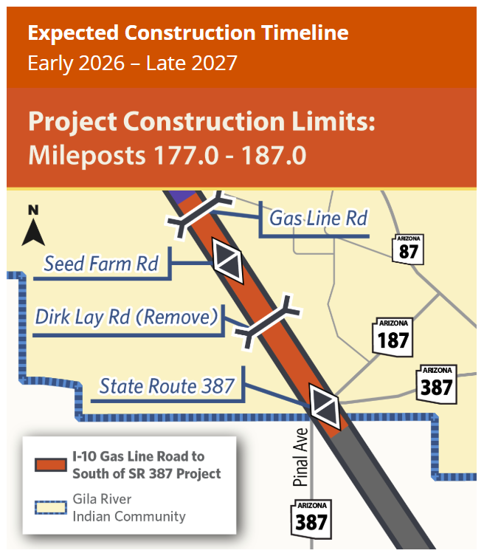
Began Construction Jan. 2026
Add 3rd General Purpose Lane
New interchange at Seed Farm Road
Reconstruct Pinal Ave./SR 387
Reconstruct/widen Gas Line Road bridge
Remove Dirk Lay Road bridge structure
    I-10 Wild Horse Pass Corridor Project
I-10 Gas Line Road to south of SR 387
Notes:
Moving on to the project segment at the most southern end and is now in active construction. Crews began work in this segment earlier this month.
Runs along 10 miles of I-10 in both directions from Gas Line Road to south of State Route 387.
For this segment, crews will add a 3rd general purpose lane in both directions.
construct a new interchange at Seed Farm Road
reconstruct the Pinal Ave/SR387 interchange
reconstruct and widen Gas Line Road bridge over I-10
and remove the Dirk Lay Road bridge over the freeway which the Gila River Indian Community determine was not being utilized by community members anymore.

Slide 11
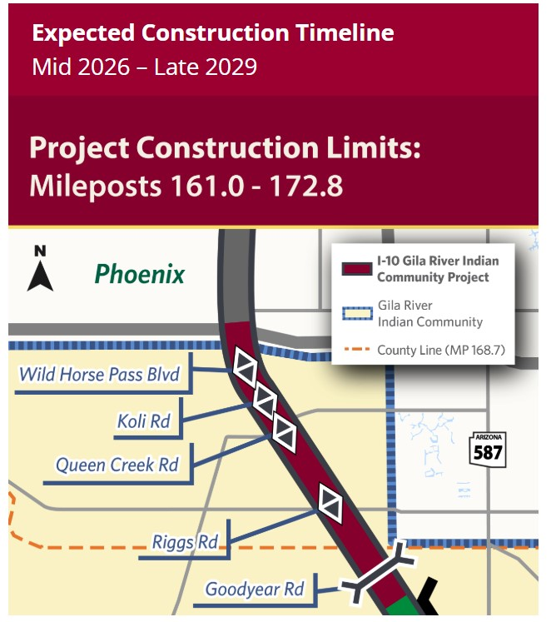
Gila River Indian Community Project
Begin Pre-Construction mid Jan. 2026
Add 3rd General Purpose Lane
Add High Occupancy Vehicle (HOV) lane from Loop 202 to Riggs Road
Reconstruct Wild Horse Pass, Queen Creek/SR 347, Riggs Road interchanges
Construct new interchange at at Koli Road (between Wild Horse Pass and Queen Creek interchanges)
Widen Goodyear bridge over I-10
    I-10 Wild Horse Pass Corridor Project
I-10 from Loop 202 to Gila River
Notes:
Then the next project segment to begin active construction is the 11 mile stretch of I-10 closest to the Phoenix area, running from the Loop 202 Santan/South Mountain Freeway, all the way down to the Gila River.
Crews will begin active construction in this segment this fall
But motorists should start seeing some pre-construction work right around now in the area…this includes clearing areas of vegetation in the median area and the setting up of work zones that will help to keep crews and motorists safe during construction work.
Crews are adding an additional travel lane in both directions.
They will also add a high occupancy vehicle or HOV lane from the Loop 202 down to Riggs Road in both directions.
The Wild Horse Pass, Queen Creek/SR 387 and Riggs Road interchanges will be reconstructed.
Widen the Goodyear bridge over I-10
Crews will also construct a new interchange at Koli Road located between the Wild Horse Pass Blvd. and Queen Creek interchanges.

Slide 12
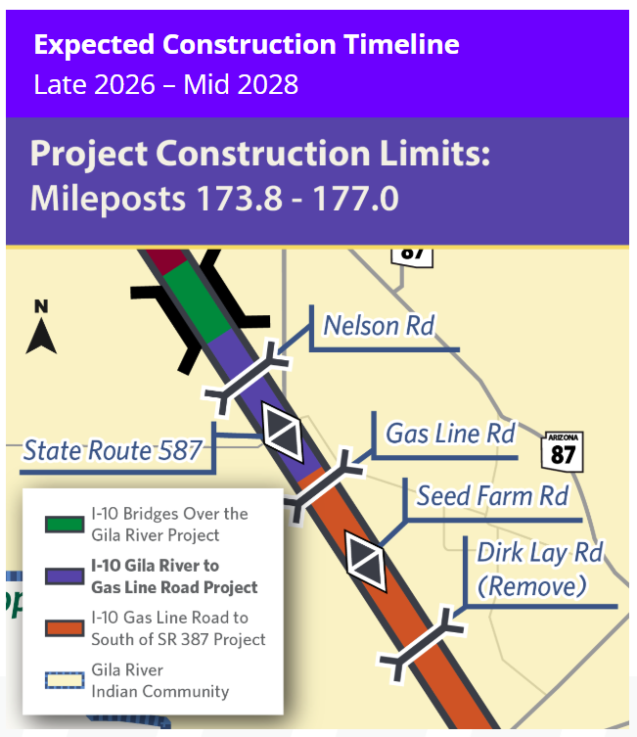
Begin Construction late 2026/early 2027
Add 3rd general purpose lane
Reconstruct Casa Blanca/SR 587 interchange (traditional diamond interchange)
Reconstruct and widen Nelson Road bridge
    I-10 Wild Horse Pass Corridor Project
I-10 Gila River to Gas Line Road
Notes:
And the last segment of the project to begin construction by late 2026 or early 2027……….is the I-10 Gila River to Gas Line Road Project.
This project is about 3 miles of I-10 in both directions between the Gila River and Gas Line Road.
In this segment, crews will add a third travel lane.
reconstruct the Casa Blanca/SR 587 interchange
and reconstruct and widen the Nelson Road bridge
**Throughout this entire project corridor, crews will be adding freeway management system equipment to include freeway cameras, digital overhead messaging boards and wrong way detection systems at interchanges.
***The entire project is estimated to be completed by late 2029.

Slide 13
Wild Horse Pass Corridor - Biggest Challenges
All on Gila River Indian Land
Busiest stretch of I-10 in the state
No restrictions during the day
Driver behavior
4 different project teams
So much interest

Slide 14
Wild Horse Pass Corridor - Biggest Wins
Strong project teams
Great relationships with the Gila River Indian Community and other partners
New outreach opportunities
Improving the busiest stretch of I-10 in Arizona
Part of the history books

Slide 15
State Route (SR) 347 Improvement Project
Notes:
I appreciate the opportunity to provide you with an update today on the SR 347 Improvement Project and the I-10 Wild Horse Pass Improvement Project.

Slide 16
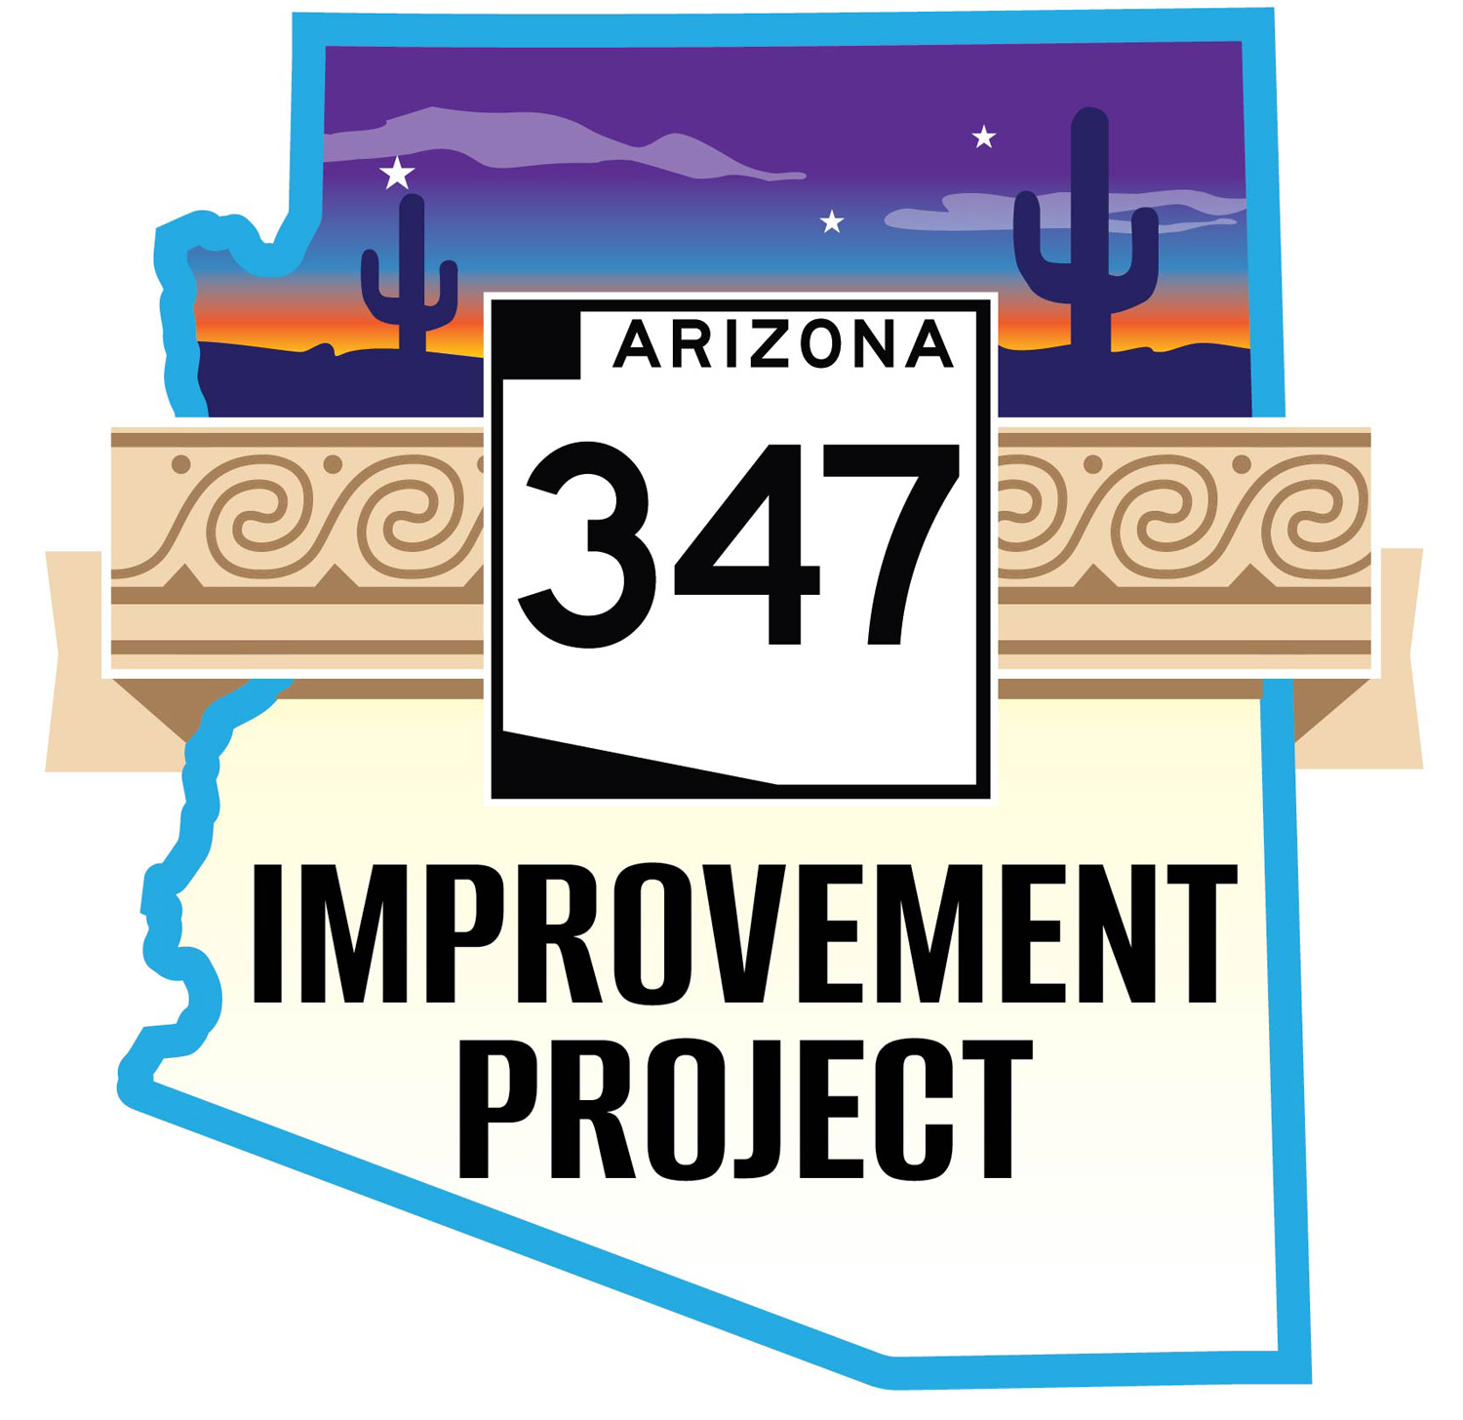
The project includes:
Widening (one lane in each direction) from I-10 to the city of Maricopa
Upgrades to existing intersections at Maricopa Road and Casa Blanca Road
Grade separated traffic interchange at Cement Plant/Mammoth Way
Grade separated traffic interchange at Riggs Road
Rehabilitation of existing pavement
Notes:
The planned improvements include:
Adding one lane in each direction along SR 347 from I-10 to the City of Maricopa
Rehabilitating the existing pavement along that same 15-mile stretch of roadway
Constructing new grade-separated interchanges at Riggs Road and Mammoth Way
Adding turn lanes and other intersection improvements at Casa Blanca Road and Maricopa Road

Slide 17
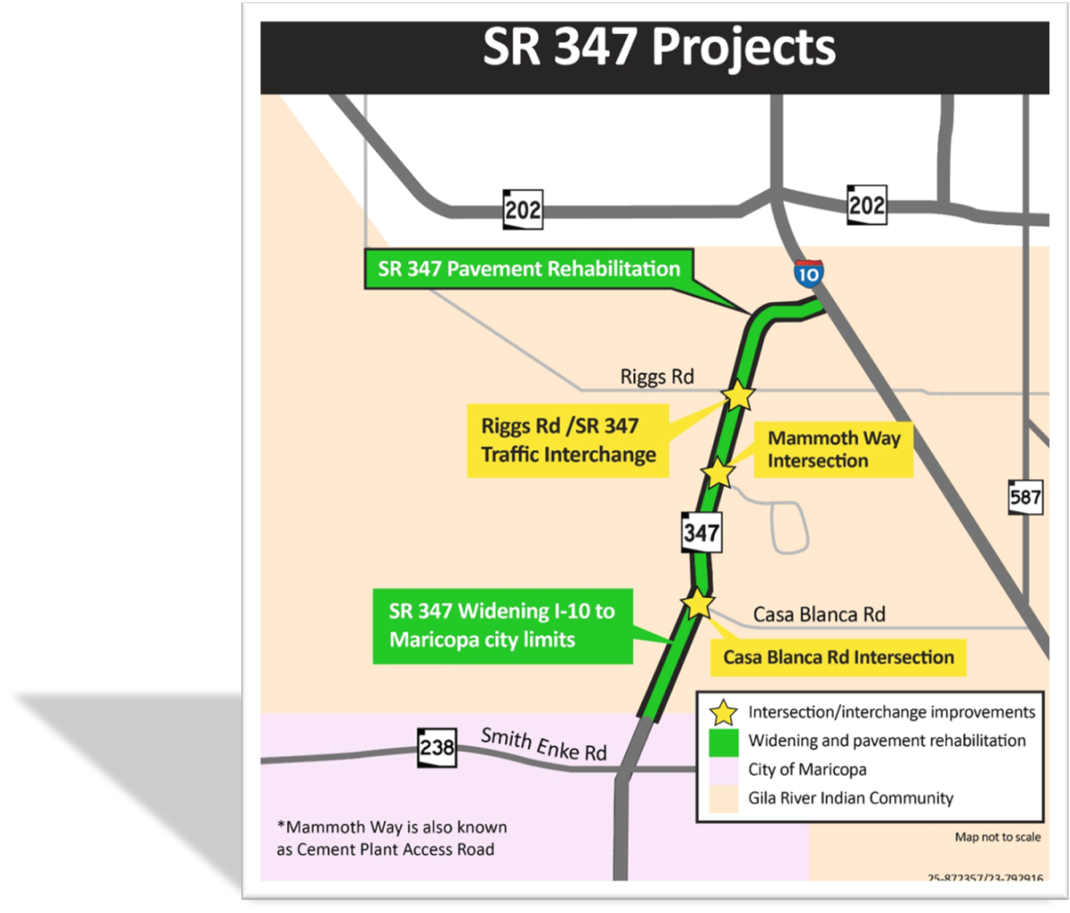
Notes:
Let’s begin with the widening. ADOT will add one general purpose lane in each direction along the 15-mile project corridor.

Slide 18
Biggest Challenges of the SR 347 Project
Extremely Busy Highway
Very involved stakeholders
No daytime closures with some exceptions
The Community wanted it yesterday
Most on Gila River Indian Land
Phasing

Slide 19
Biggest Wins of the SR 347 Project
Funded earlier than expected
Starting Construction earlier that expected
Working with the Gila River Indian Community
New Outreach opportunities
Great project team
Improving safety and efficiency

Slide 20
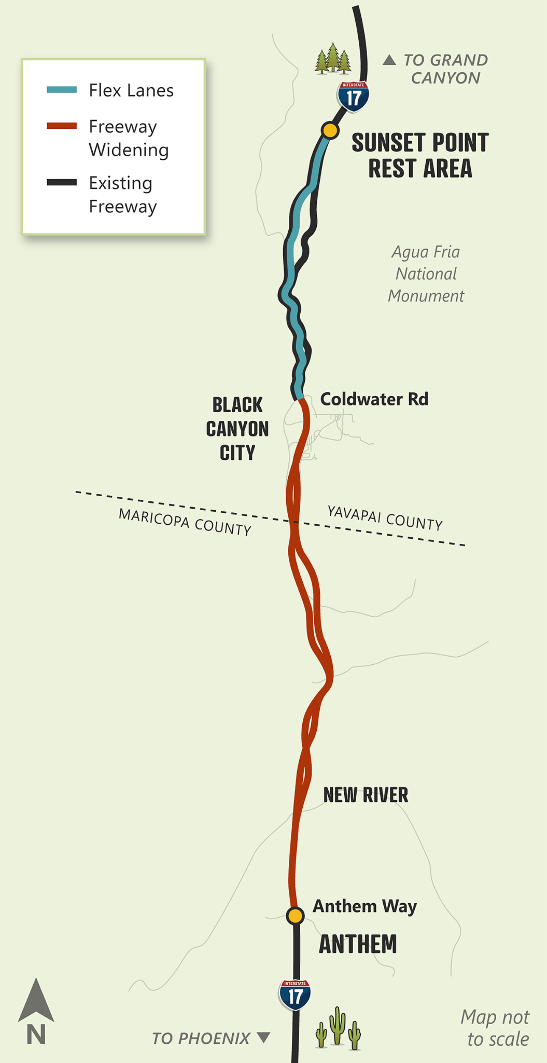
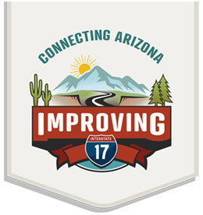
Notes:
We also plan to improve three bridges as part of this project.

Slide 21
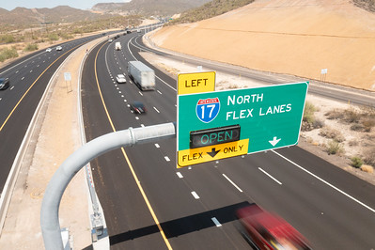
23 miles of new lanes
15 Miles of 3rd lane between Anthem and Black Canyon City
8 miles of new Flex Lanes between Black Canyon City and Sunset Point
62 blastings of mountainside
Notes:
One of the major elements of the SR 347 Improvement Project is converting Mammoth Way/Cement Plant Road to a grade-separated bridge crossing with access to the cement plant.

Slide 22
Biggest Challenges of the I-17 Improvement Project
Completion date
Communication
Conspiracy theories
Educating the public
Calming fears
Notes:
Sundt Construction was selected as the Highest Ranking Contractor in early January. We are currently in preconstruction negotiations with them and anticipate to have a preconstruction contract by mid February. Early construction will begin this summer with some work as early as June. One of the early items we are discussing with them is to see if they can go in and do some early pavement rehabilitation work in the areas with the worst pavement conditions

Slide 23
Biggest Wins of the I-17 Improvement Project
Literally blasting mountains to widen roads
Keeping Plants and relocating them
23 miles of new lanes
First Flex Lanes in Arizona
Greatly relieving traffic at busy times

Slide 24
I-10 Broadway Curve Project
Widening I-10 to six general purpose lanes and two high-occupancy vehicle (HOV) lanes in each direction between US 60 (Superstition Freeway) and I-17, and adding a fourth general purpose lane in each direction between Ray Road and US 60
Adding Collector-Distributor roads parallel to I-10 between Baseline Road and 40th Street to separate through-traffic on I-10 from local traffic entering or exiting the highway
Rebuilding the I-10 interchange with SR 143 to improve traffic flow and create direct connections to and from SR 143 for drivers in the I-10 HOV lanes
Replacing the Broadway Road bridge over I-10 and the 48th Street bridges over I-10
Widening the I-10 bridges over the Salt River
Building two bridges for pedestrians and bicyclists over I-10 between Baseline and Broadway roads
Notes:
These are the planned intersection improvements. You can see how we’re upgrading each of these three intersections.

Slide 25
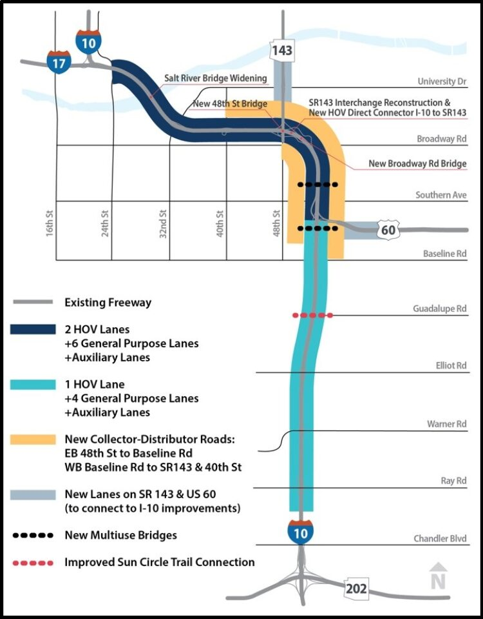
Notes:
We are also constructing a new traffic interchange at the intersection of SR 347 and Riggs Road to carry SR 347 traffic over Riggs Road to improve traffic flow and safety.

Slide 26
Biggest Project Challenges of the Broadway Curve Project
The Location
The size
New Collector Distributor lanes
Communication
High Profile Partners
Notes:
These are the best ways to stay informed about the upcoming project.

Slide 27
Biggest Wins of the Broadway Curve Project
Completing the largest Infrastructure project in ADOT history
New Collector Distributor Roads
Less congestion
Amazing Partnerships
Overall success!

Slide 28
Questions?

