Slide 1
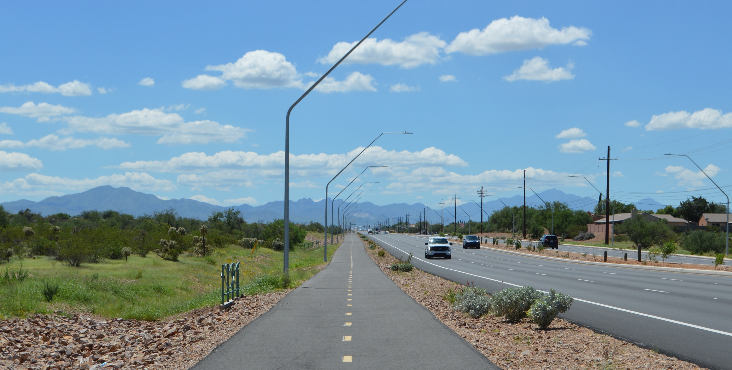



RTA Next Presentation| April 10, 2025
Jenny Fiore-Magaña | Director, Outreach and Engagement
IT’S YOUR PLAN
A draft $2.46 billion regional transportation plan
Notes:
(Personalized intro)

Slide 2
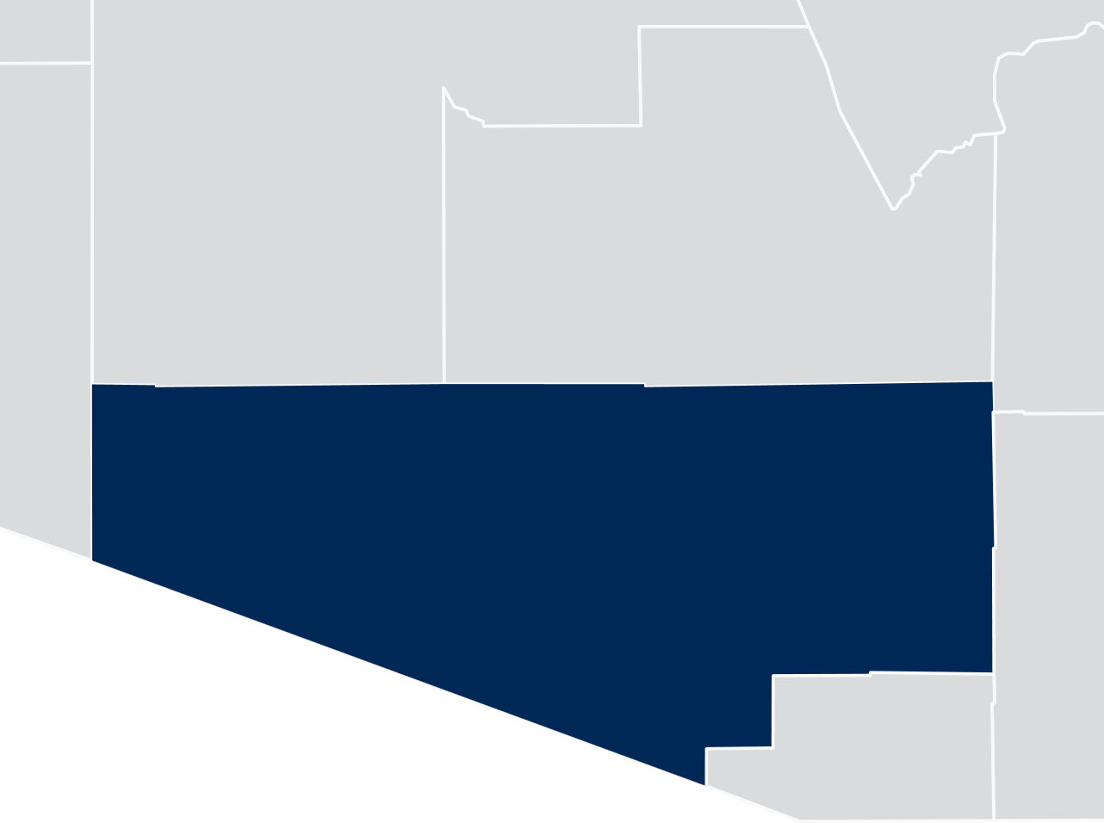



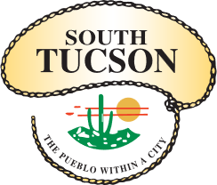

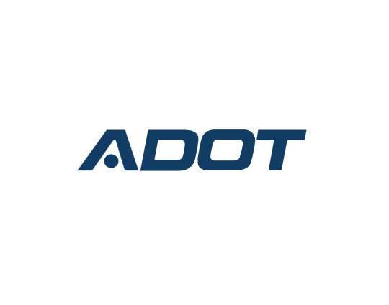




Regional Transportation Authority’s funding role
RTA members
RTA taxing district currently collects $120 million annually.
RTA Taxing District
$
Notes:
Transportation is literally our middle name, and it’s our charge to think about it regionally rather than town by town.
THE RTA HELPS YOU GET AROUND THE REGION AND OFFERS SIGNIFICANT FUNDING TO THE REGIONAL POOL OF TRANSPORTATION FUNDS
The RTA was created in 2004 by the Arizona State Legislature as a special taxing district within the boundaries of Pima County to provide supplemental transportation funding to the region.
The RTA is an independent governing body. It is not the city or the county.
The nine-member body is made up of local municipalities, Pima County, the Pascua Yaqui Tribe, Tohono O’odham Nation and Arizona State Transportation Board.
Each body has one seat on the RTA Board and one vote.
The RTA developed a 20-year REGIONAL TRANSPORTATION plan in 2005, and Pima County voters approved the plan and a half-cent countywide sales tax in 2006 to fund it.

Slide 3


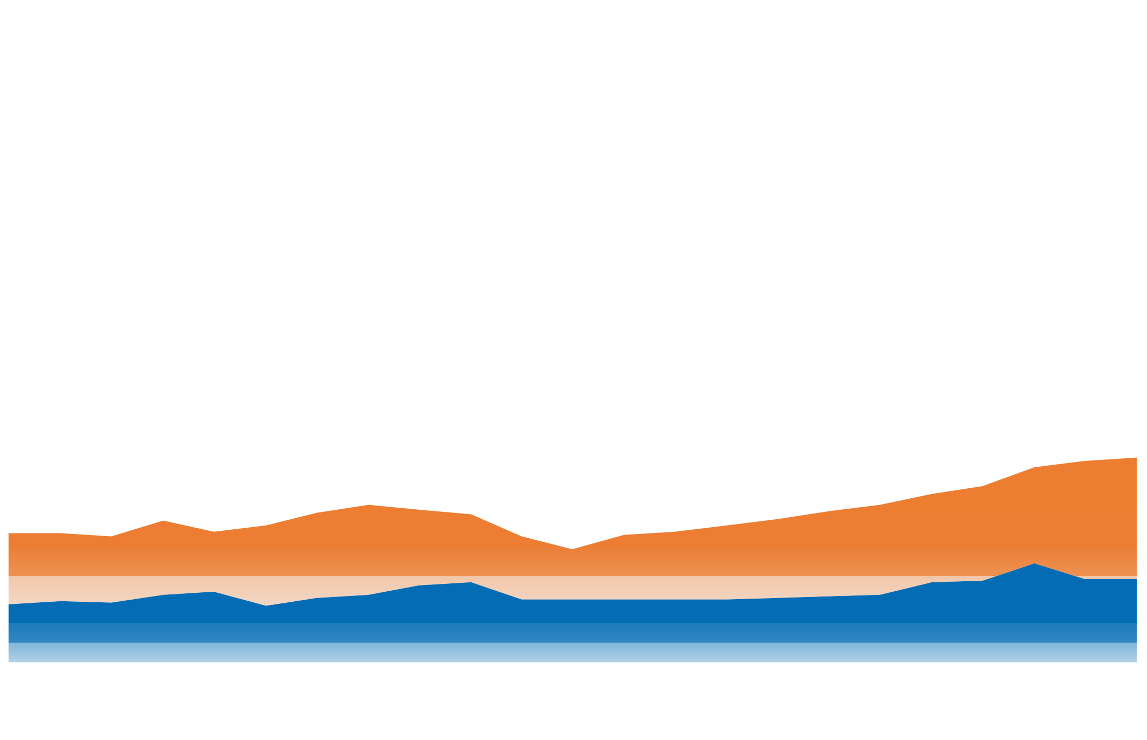
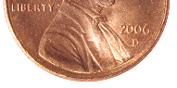
RTA investments compared to other regional transportation funding sources annually
Without
2/3 of regional funding
RTA’s half-cent excise tax begins
Regional Transportation Authority
$119 M in 2023
$29 M in 2023
State Funding Sources
Federal Funding Sources
$22 M in 2023
Notes:
RTA DOLLARS = 2/3 OF REGIONAL DOLLARS SPENT ON REGIONAL TRANSPORTATION IMPROVEMENTS
In 2023, $119 MILLION IN TRANSPORTATION FUNDING WAS GENERATED FROM RTA, COMPARED WITH A COMBINED $51 MILLION FROM FEDERAL/STATE FUNDING (gas taxes).
Importantly, voters determined how these RTA funds would be spent – through public feedback when the RTA plan was drafted AND when they went to the ballot box to vote on a plan and tax.
The current 2006-voter approved RTA tax expires in June 2026. Voters will again have the opportunity at a future election to decide on an extension of the 20-year tax and new plan to ensure continued regional transportation improvements.
That half-cent tax would not be on top of the ½ cent tax you already pay—it’s not one atop the other, it’s one after the other.
Without the continuation of funding, the RTA funding block above will disappear. (click for RTA funding block to fade away)
And without RTA funding, some tough decisions would need to be made and there would be some major gaps to fill, such as $30 million annually which goes toward transit services. Local jurisdictions would need to find another funding source to keep transit services running at current service levels.

Slide 4

Why does our region need RTA funding?
30 years with
No gas tax increases
Rise of
Fuel-efficient vehicles
Results in
Decline in
transportation resources
Notes:
So we saw in the last slide that our region has depended on RTA funding to supplement state and federal funds, but let’s dig in a little more as to why.
Federal and state gas taxes have not increased since the early 1990s.
Meanwhile, vehicles are more fuel efficient or not using fuel at all, which can be great for the pocketbook and air quality.
But it also means the region does not receive enough federal or state money to address our overall transportation needs.
Out of a $17 billion regional transportation funding need through 2045, the RTA is one funding source to reduce that funding gap.*
That’s where your RTA tax dollars help—and not just a little.
* While $2 billion is a significant contribution toward these unmet needs, we need eight times that to truly keep up with the demands of transportation users in the region.

Slide 5
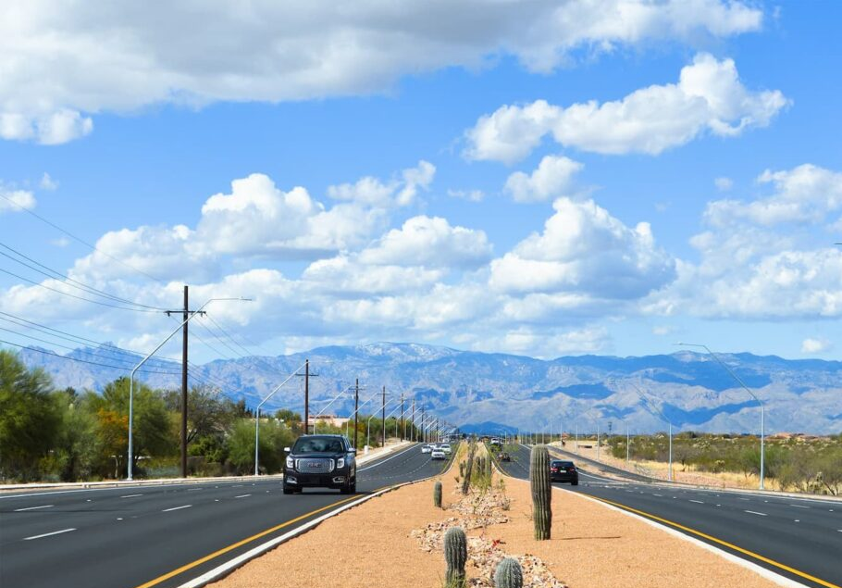
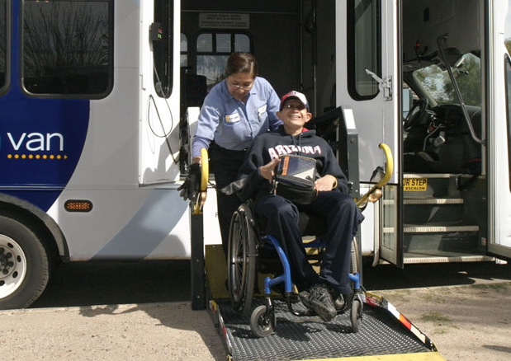
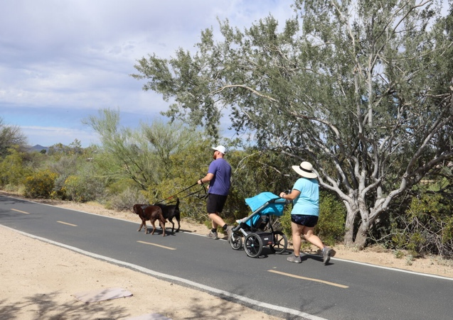
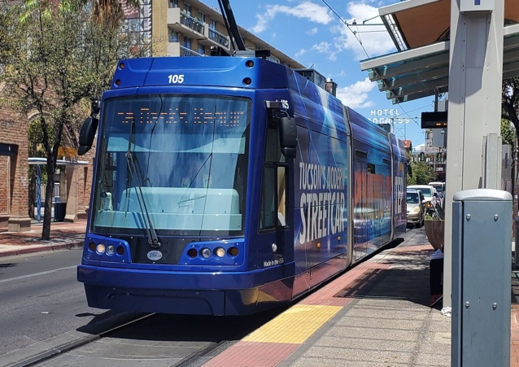

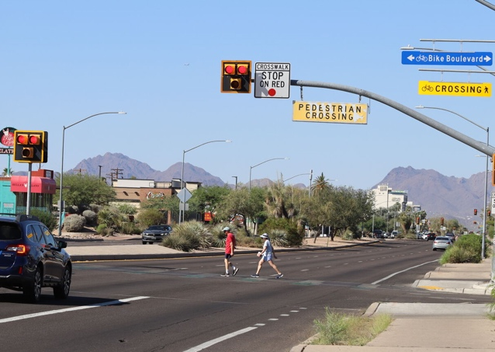
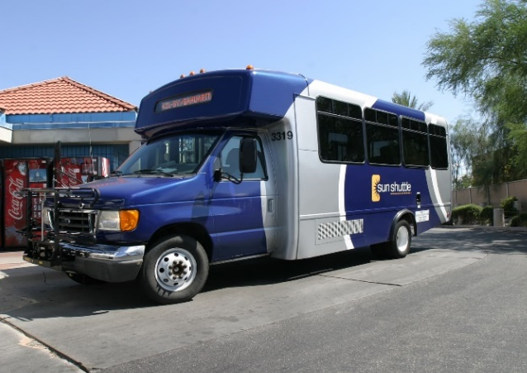
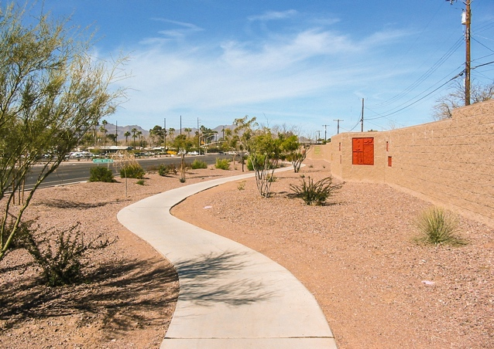
Benefits of RTA
transportation investments
Notes:
JURISDICTIONS WORKING TOGETHER ON VOTER-APPROVED PROJECTS = (1) HELPING YOU MOVE AROUND THE REGION SAFELY AND EFFICIENTLY AND (2) SUPPORTING OUR REGION’S ECONOMIC VITALITY.
Let’s talk about what those RTA investments look like in action. I mentioned earlier that RTA funds are versatile and their use is determined by voters.
The RTA allows a regional approach for jurisdictions to work together on projects that cross jurisdictional boundaries and to identify best practices for project delivery and efficient project scheduling.
Some of the more specific RTA projects include roadway widenings, transit service expansions and improvements, new infrastructure for pedestrians and cyclists, all with built-in safety improvements.
RTA improvements also support the region’s economic vitality through short-term and long-term job creation and complementing commercial and residential development.
One key thing to note here is the unique VERSATILITY of RTA dollars. RTA collected revenues can be directed to a broad variety of transportation improvements—SELECTED BY VOTERS WHEN THEY APPROVED THE PLAN—rather than restricted to a specific type of project, which is not necessarily the case for state and federal transportation funds…

Slide 6
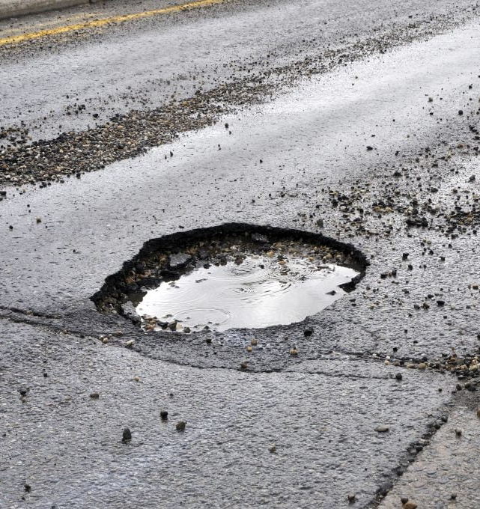
Think of the RTA as
a builder, not a fixer
Notes:
You may have noticed potholes were not shown on the previous slide.
The RTA is not allowed to provide funds to fix potholes because state law prohibits the use of RTA funds for routine maintenance.
Local governments are responsible for maintaining their transportation infrastructure, which includes fixing potholes on the roads which they own.
Once RTA projects are built, the local governments take ownership. The RTA, however, can provide funds for broader roadway restructuring or the rebuilding of roads.

Slide 7
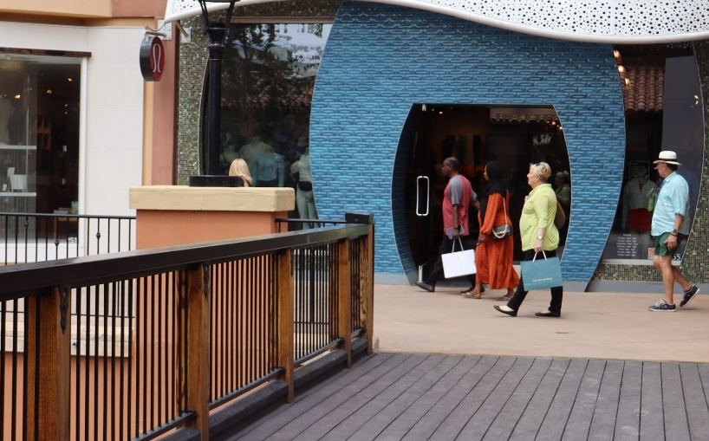


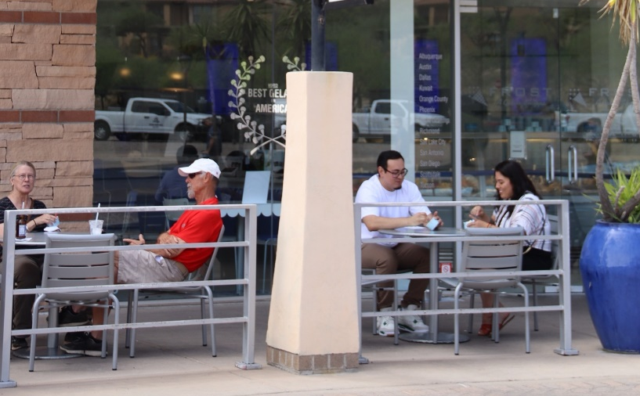



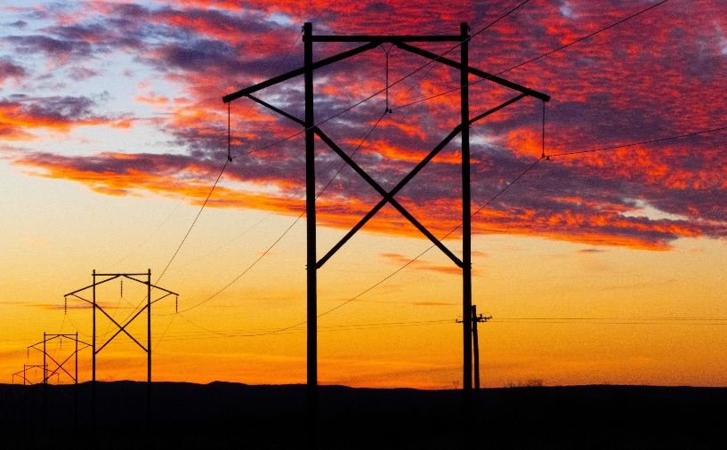

Who pays the sales tax?
Anyone who makes purchases in Pima County
Tax is assessed in six major categories:
  Retail sales*
  Contracting
  Utilities
  Restaurant and Bar
  Rental of Real Property
  Rental of Personal Property
*Grocery and pharmaceutical items are tax exempt.
Notes:
EVERYONE WHO MAKES PURCHASES IN PIMA COUNTY PAYS THE TAX—NOT JUST BUSINESSES AND HOMEOWNERS—EVEN WINTER VISITORS, TOURISTS, AND THOSE PASSING THROUGH
The six categories on the screen show a breakdown of what is taxed to fund the current RTA plan and what would be taxed under the next RTA plan, too, if approved at a future date.
It’s important to note that groceries and pharmaceutical items are tax exempt.
Everyone pays the half-cent sales tax across all jurisdictions – it’s applied across Pima County.
NOTE: Alternative is a bond election to raise property taxes, which would mean local businesses and homeowners would foot 100% of the cost for any regional transportation improvements beyond what state/federal funds cover.

Slide 8
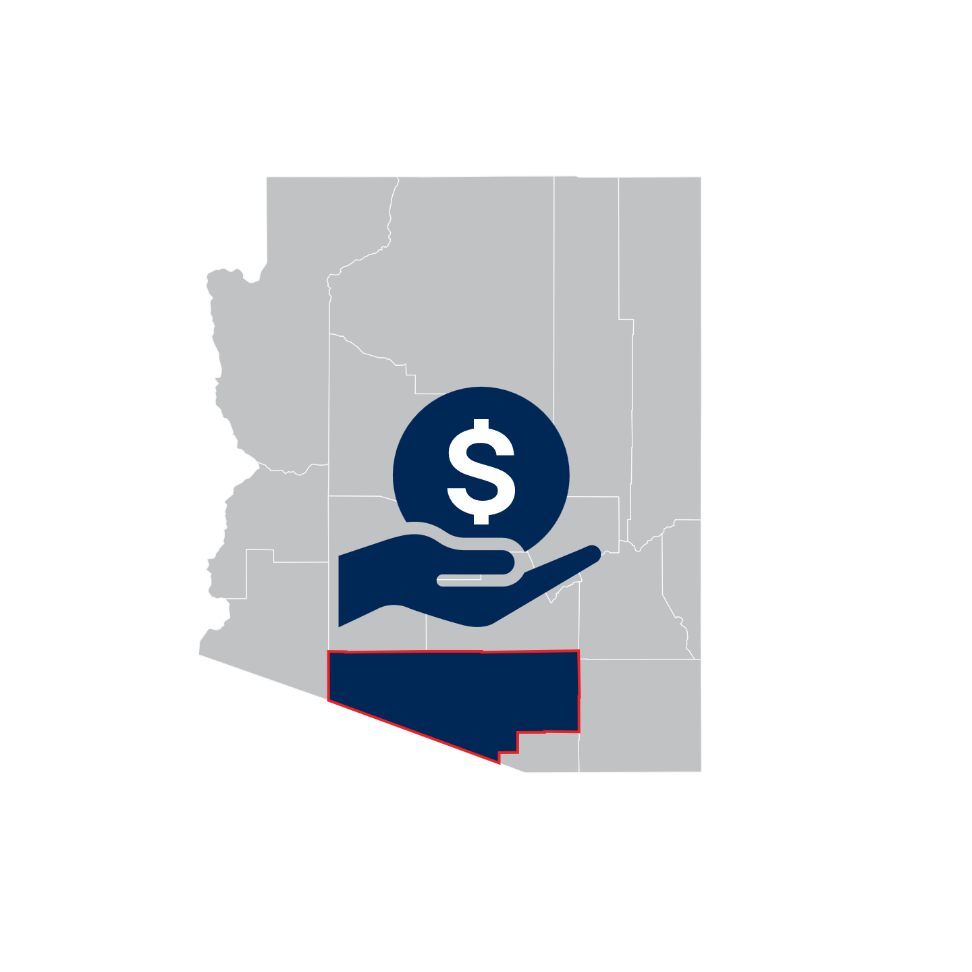

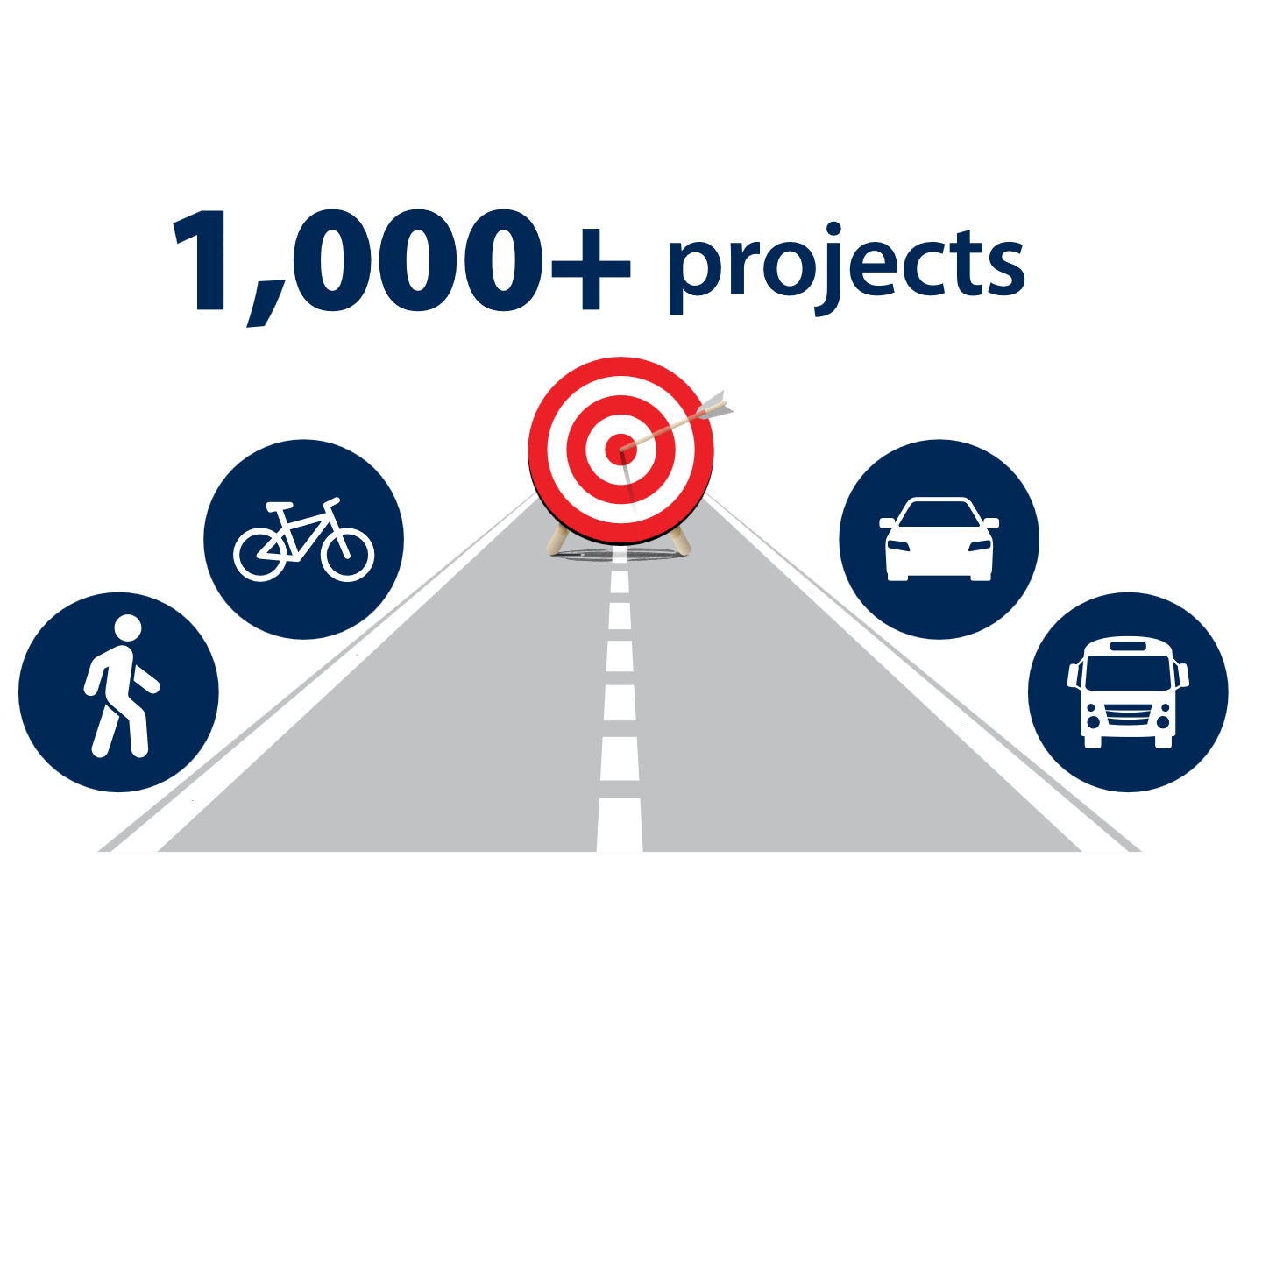
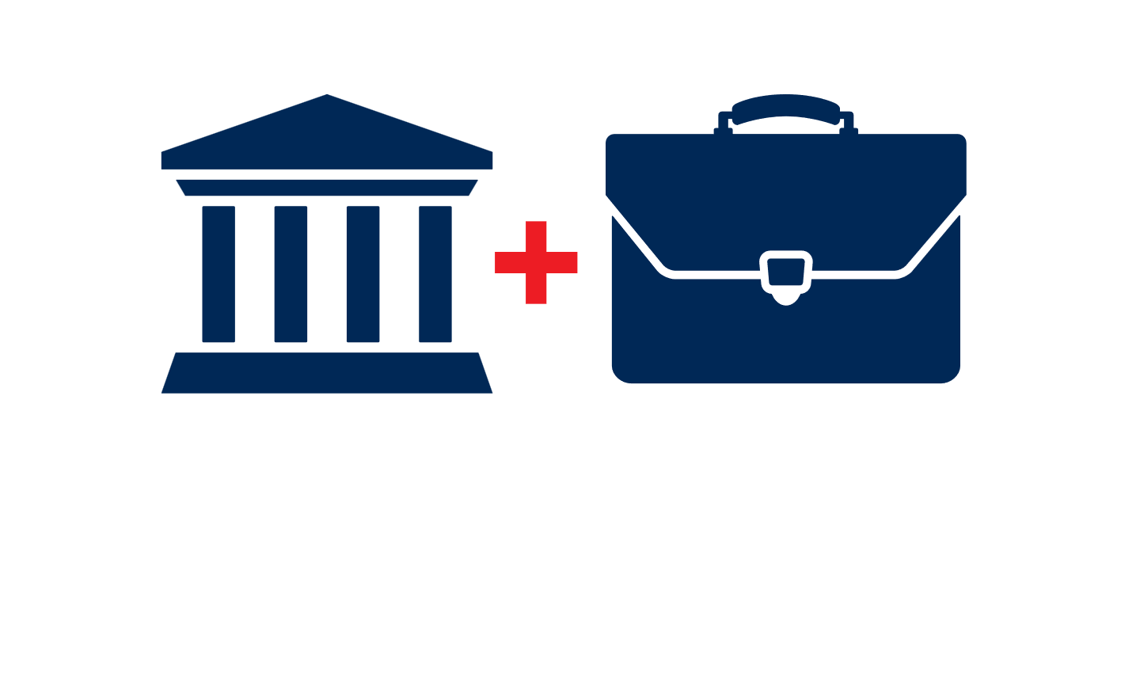
2006 RTA plan impact over 20 years
  RTA directly invested
  $1.6 billion in
  the region
  More than
  1,000 RTA plan improvements completed
  More than $3 billion in public/private investments total
  40,000 permanent jobs created
Notes:
2006 RTA BENEFITS: NOT “JUST” BETTER TRANSPORTATION, BUT AN ECONOMIC BOOST – RESULTS OF A RECENTLY COMMISSIONED ECONOMIC IMPACT STUDY
The half-cent sales tax has meant $1.6 billion in direct RTA investments in transportation here so far.
More than 1,000 improvements have been completed with those investments—including roadways, bike/ped improvements, safety enhancements, and transit enhancements—and have generated an additional $3 billion in public/private investment in the region.
Think of improvements such as Twin Peaks Road and interchange on the northern end or the Houghton Road corridor improvements on the east side.
These projects resulted in new businesses coming to the area and opening along those routes to improve your quality of life through improved access to services and creation of new jobs.
About 40,000 permanent jobs according to the study

Slide 9
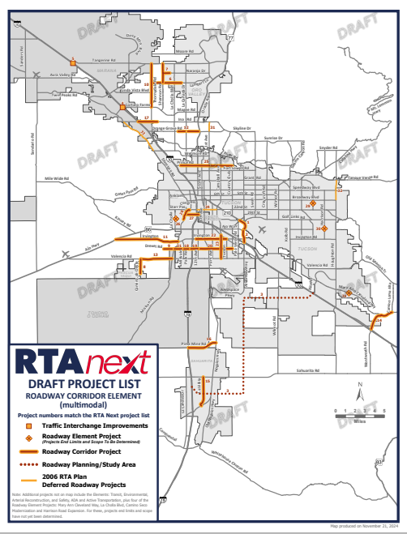
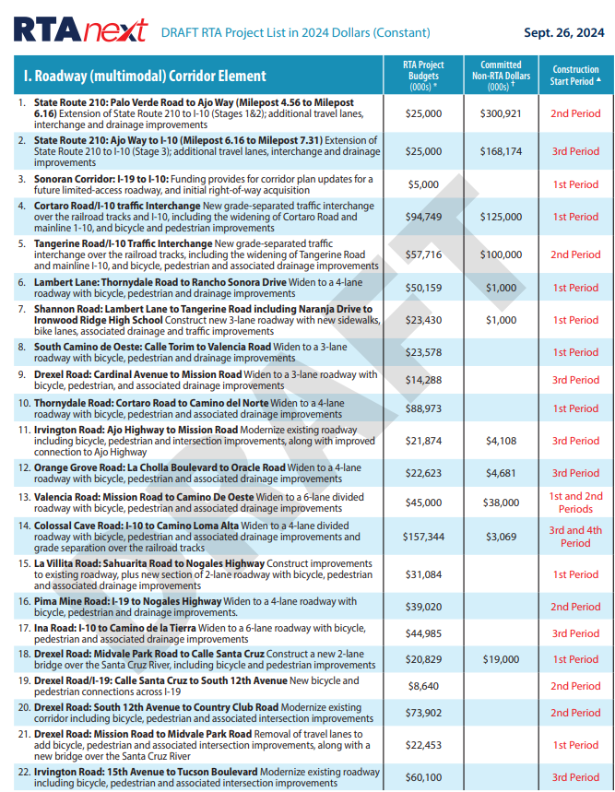
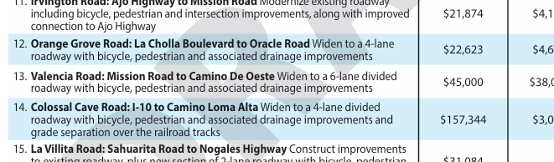

RTA Next
Roadway, transit, bicycle, pedestrian, and safety improvements for the next 20 years at no additional cost to you
Notes:
WITH CURRENT RTA ENDING IN MID-2026, IT’S TIME TO CONSIDER A NEW PLAN
You may know that back in the fall, the RTA Board approved a draft plan for public review and feedback.
The draft plan was developed over the course of about 6 years, with input from a citizens’ advisory committee and jurisdiction input through a technical advisory committee.
The RTA Board has been continuously seeking public feedback on final plan development efforts—we’ll look at that process more closely in just a minute.
Once they approve a final plan and set an election date, the power goes to Pima County voters, who will have an opportunity to consider the extension of the 20-year sales tax and a new plan at the ballot box.
While the tax, if approved, would be new for another 20 years, you will not see a tax increase. Instead, the funding would allow a seamless transition of regional transportation improvements.

Slide 10



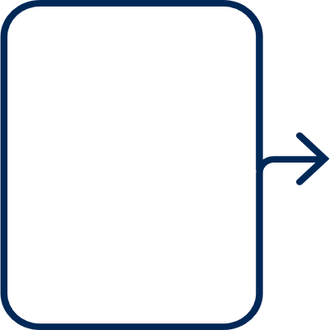






RTA Next: Draft based on varied inputs
Current Phase
RTA forms Citizens’ Advisory Committee (CAC)
CAC establishes plan goals based on public input
RTA Board sets budget based on projected sales tax revenues
CAC participates in drafting the 20-year regional transportation plan
Public provides feedback on the draft plan
RTA Board reviews, refines, finalizes the plan
RTA Board calls for election for public vote on final plan
2018
2025+
Notes:
RTA NEXT PLAN DEVELOPMENT PROCESS = SIX YEARS OF LISTENING, TALKING, AND COLLABORATING TO CREATE A REGIONALLY BALANCED PLAN
The first step was the formation of a citizens advisory committee that set plan goals based on public input.
You can see how it then progressed to where we are today—getting public feedback on a draft plan so the Board can finalize it for voter consideration.
WE’RE NEARING THE END OF THE PROCESS—WITH AN ELECTION ANTICIPATED BEFORE THE CURRENT PLAN EXPIRES
The plan has not yet been finalized but the Board will need to do that in the coming weeks in order to call for an election in November of this year, which is still the current plan.
The Board will be meeting later this month and may be making a decision on that timing.
KEEP IN MIND: This is a fiscally constrained plan—the budget was set based on projected revenues—and the region currently has more transportation needs than it has money, so there was extensive give and take involved in this plan.
Still we wanted to understand the public’s view on the results of that work.
We recently completed a major outreach effort, including a public survey to receive input on the RTA Next draft plan.
TIMELINE (IF ASKED):
April – RTA Board deliberation on the plan and potential adjustments
May/June – Pima County approval for placement on ballot
November 2025 or May 2026 – election
Note: In addition to the CAC, we have a citizens’ accountability committee to make sure we’re keeping our word to the voters, and we get audited every 5 years by the Auditor General.

Slide 11
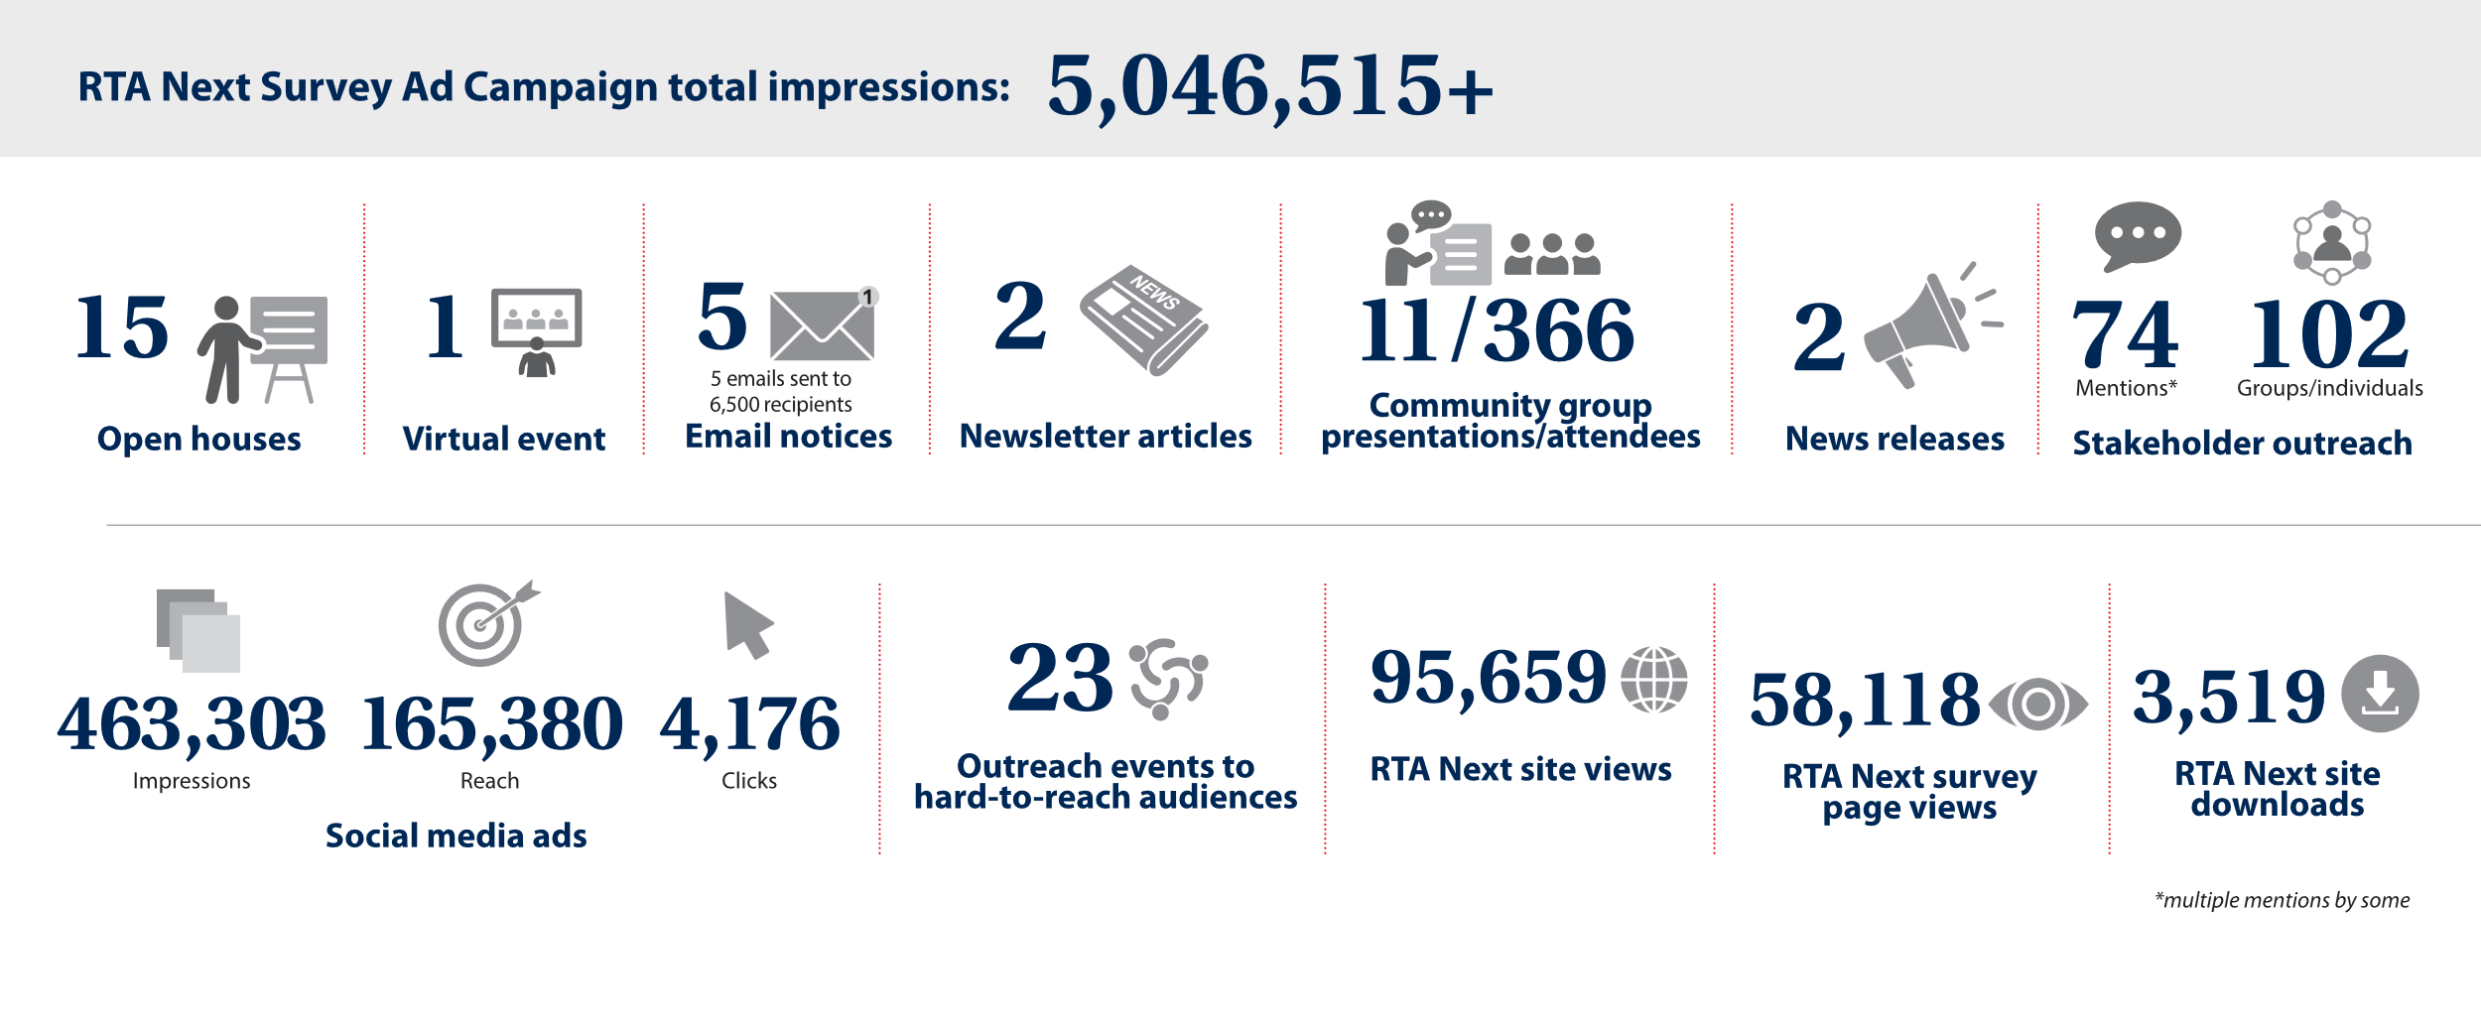
RTA Next Survey: Outreach at a glance
2,300+ respondents (3x participation benchmark)
Notes:
FOLLOWING BOARD APPROVAL OF A DRAFT PLAN IN SEPTEMBER, THE RTA DOVE INTO A COMPREHENSIVE PUBLIC OUTREACH CAMPAIGN TO SOLICIT FEEDBACK ON IT
Public outreach included a survey to solicit public feedback on the initial draft plan.
I’m not going to spend a lot of time going over all the metrics here, but this is just a snapshot of all the different ways we worked to get the survey in front of Pima County residents.
We had about 2,300 respondents, which is about 3x the average for surveys of this nature.

Slide 12
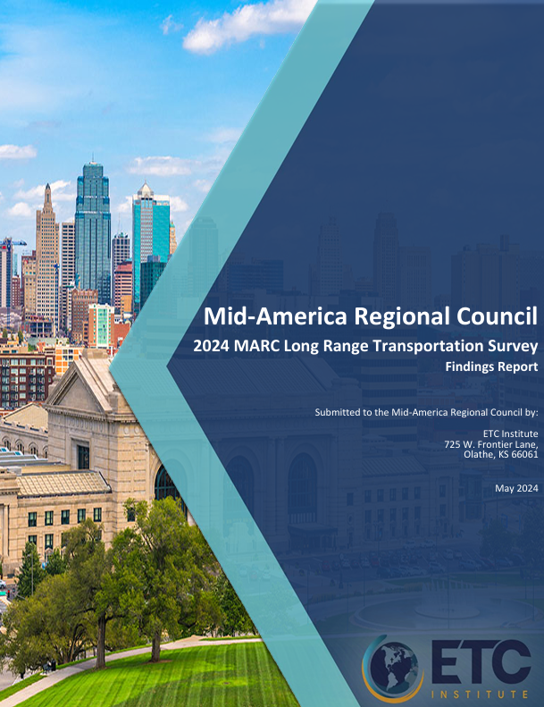
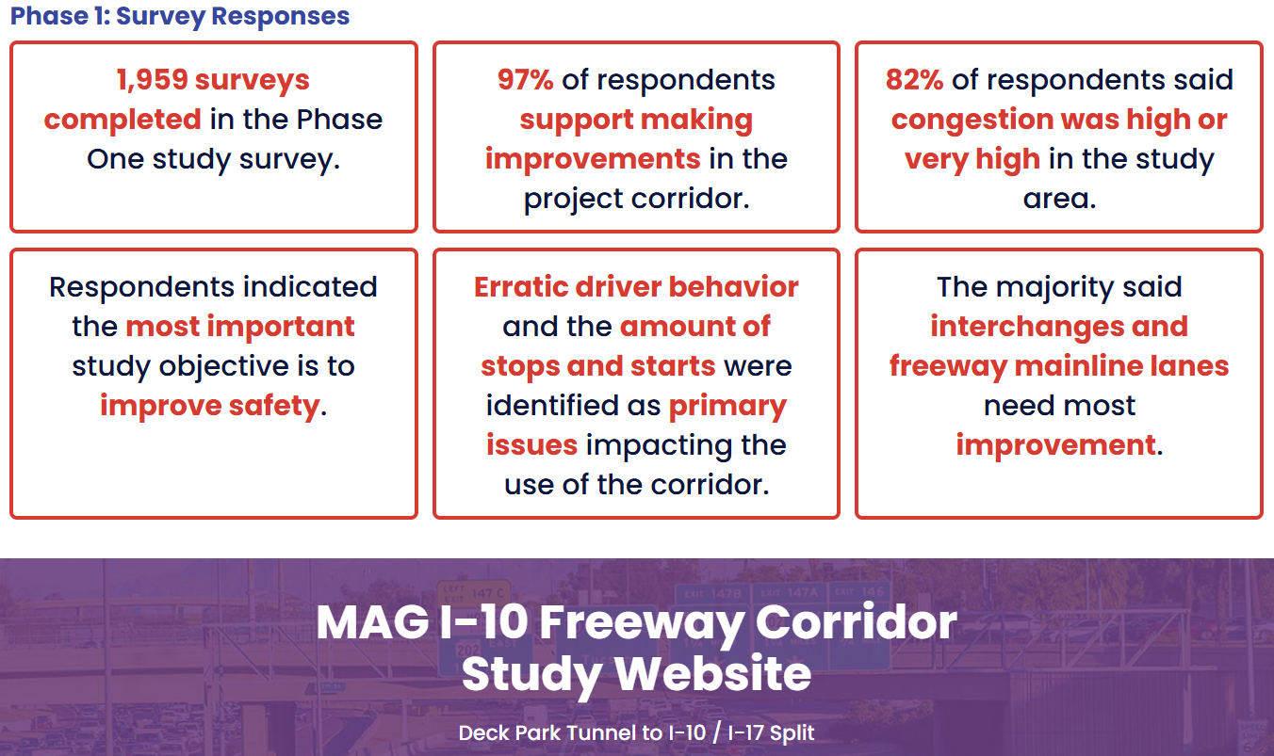
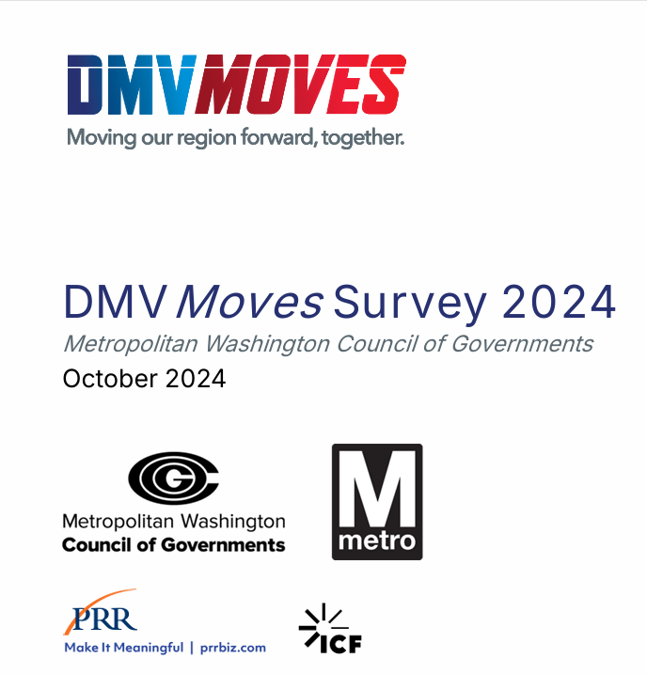
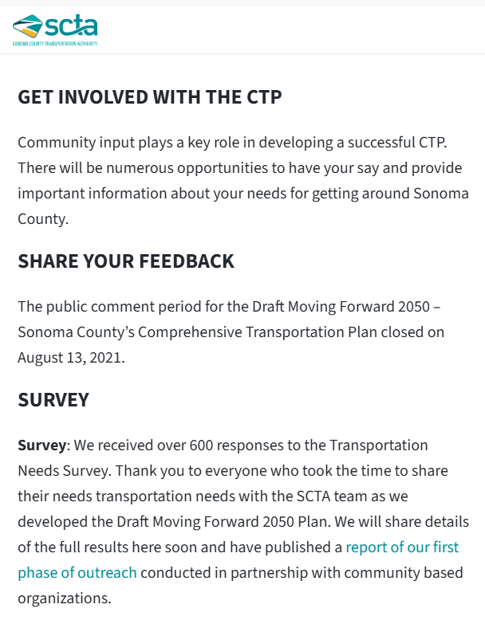
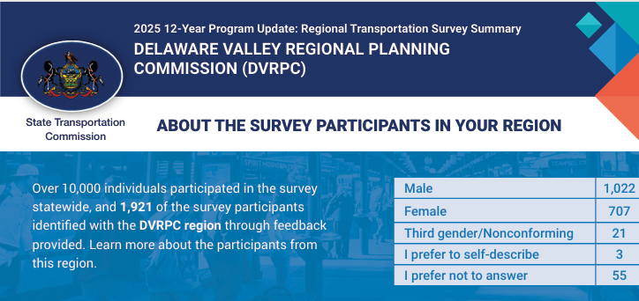
RTA Next Survey: Participation Benchmarks
More than 2,300 respondents = 0.3% of voters (nearly 3x the benchmark average)
.08 %
.04 %
.09 %
.03 %
.12 %
Notes:
For survey participation benchmarking: a desktop review of participation rates on similar transportation survey efforts in other metropolitan areas shows RTA Next survey participation rate was nearly 3x the average. That translated to just over 2,300 respondents in the RTA Next survey
Examples of benchmark surveys include the Metro Washington COG’s regional public transportation survey, a 12-year regional transportation planning effort in the Greater Philadelphia area by their regional planning commission, and a long-range transportation plan survey conducted by the Mid-American Regional Council

Slide 13

RTA Next draft plan survey takeaways
Qualitative trend survey, yielded this snapshot:
60% believe the plan is a good representation of regional needs
57% would either very likely or likely support the plan
Plurality of respondents say funding levels about right across the board
Respondents more focused on what they like than what they don’t like
Notes:
SURVEY TYPE AND THE KEY TAKEAWAYS:
This was an informal, qualitative trend survey meant to yield a snapshot of themes and patterns in feedback.
[Step through the four bullet points on the slide.]
Note that the plurality measure is a Goldilocks test. We asked people to give us their impression of whether the funding levels across each element were too high, too low, or just about right. Recognizing they aren’t transportation engineers or studied at doing cost estimates for roadway projects, we know that come time to vote on the plan, they’re going to see the funding levels and have feelings about them, so we wanted to get that gut sense or Goldilocks test included.
The RTA Board will consider survey results and other public input as it continues to deliberate on a final draft plan for future voter consideration.
To view the full survey report, visit RTANext.com
If needed: Add that survey was NOT intended to be:
Scientific
Statistical representative sample
Predictive of voting outcomes

Slide 14
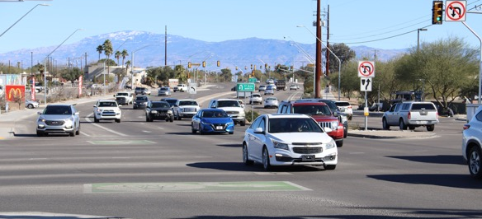
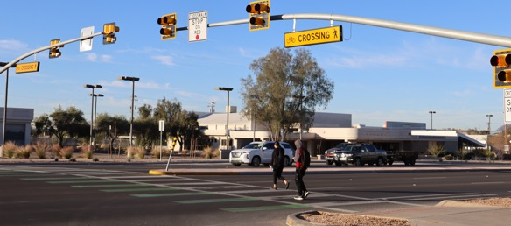
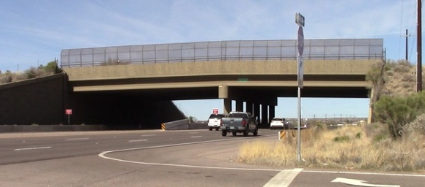
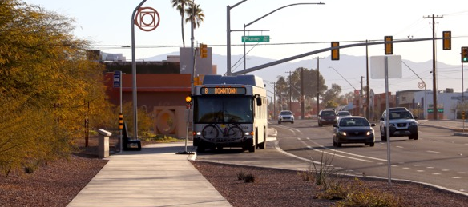
RTA Next draft plan
highlights
Roadway corridors
Safety, ADA and active transportation
Arterial reconstruction
Environmental (wildlife linkages)
Transit (including paratransit)
Notes:
WHAT’S IN THE PLAN AND HOW TO SEE IT
All told, the current draft of the plan includes five project elements with 34 roadway projects and at least another dozen project components.
RTA funds over the 20 years of the plan are limited to the incoming tax revenues, so the RTA Next plan reflects the region’s highest priority projects within a budget that matches anticipated revenues
Let’s look at the locations of the proposed roadway corridors (map on next slide)
Note (if needed): RTA Next includes four deferred projects from the 2006 plan that seek significant project scope changes, legally requiring voter review and approval.

Slide 15
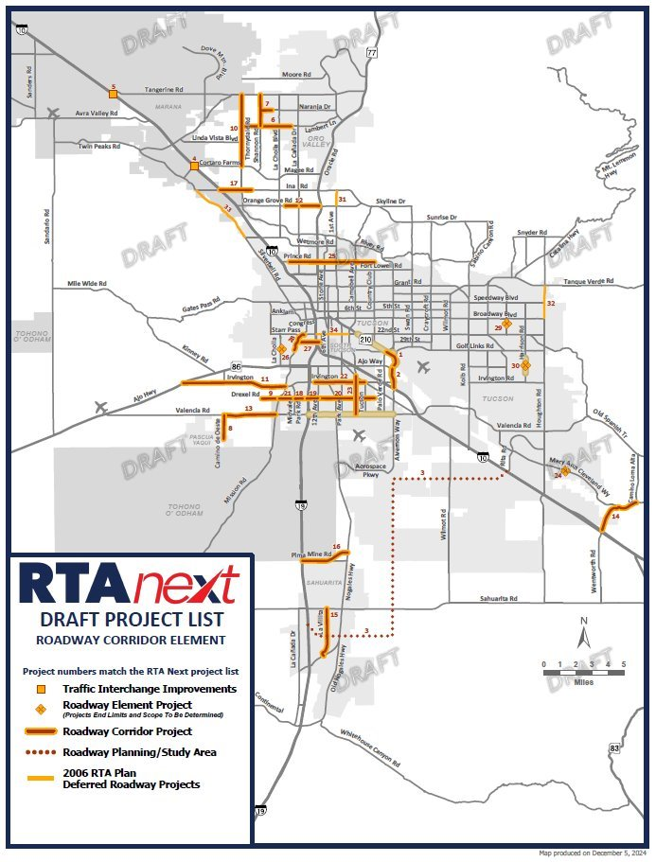
Roadway corridor projects in the RTA Next draft plan
Notes:
A CLOSER LOOK AT JUST THE ROADWAY CORRIDOR PROJECTS IN THE RTA NEXT PLAN
Shown here are the 34 roadway corridor projects included in the draft plan as of today, based on those six years of committee work and public input.
Remember, it’s not unusual for Pima County residents to regularly travel through several communities in the county for their daily lives.
To show how this plan builds upon the 2006 RTA plan, it can help to see the projects combined from the two plans. (see map on next slide)

Slide 16
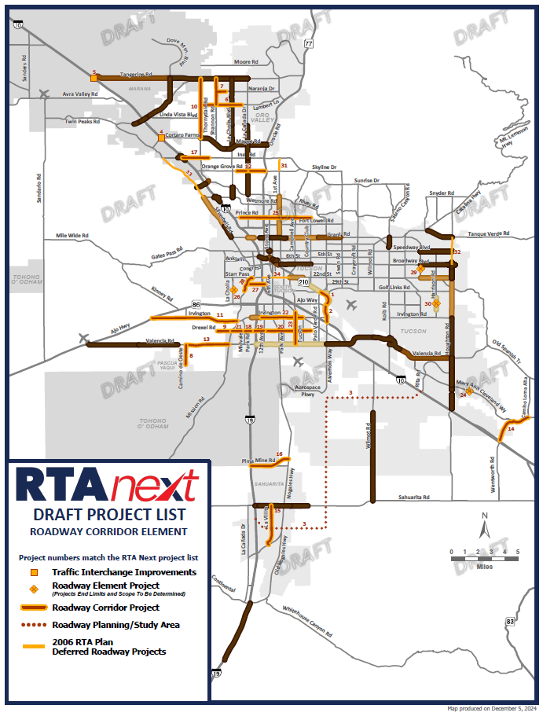
RTA Next builds upon improvements from 2006-
approved plan
Notes:
COMBINED IMPROVEMENTS DEMONSTRATE CONNECTIVITY AND REGIONALITY
In gold are the projects proposed for RTA Next, reflecting committee work with public input.
All other colors—every shade of brown—reflect roadways prioritized by voters in 2006 when the first RTA plan was approved.
NOTE: Those are all completed, underway, or forthcoming, as some projects in RTA current plan are still pending construction.
[Toggle back and forth as needed to emphasize/illustrate the connectivity]
CURRENT PLAN FUNDING IS COMING TO AN END; RTA NEXT CAN CONTINUE TO MAKE CONNECTIONS AND GET PEOPLE WHERE THEY NEED TO GO SAFELY AND RELIABLY ACROSS THE REGION.

Slide 17


RTA Next will lead to new jobs, new investments
88,000
new jobs
$1.4 billion
return
Notes:
ECONOMIC STUDY PROJECTED RTA NEXT IMPACTS: 88,000 NEW JOBS AND A $1.4 BILLION RETURN ON INVESTMENT BY YEAR 35
Study also projected that RTA Next investments will create 88,000 more jobs –more employment opportunities and higher wages.
And it’s projected to generate millions in private investments as well—yielding an estimated return of $1.4 billion by year 35.
(NOTE: The study looks out 35 years and not 20 because transportation projects completed in the last year of the RTA need time for the economic benefit to be realized.)

Slide 18
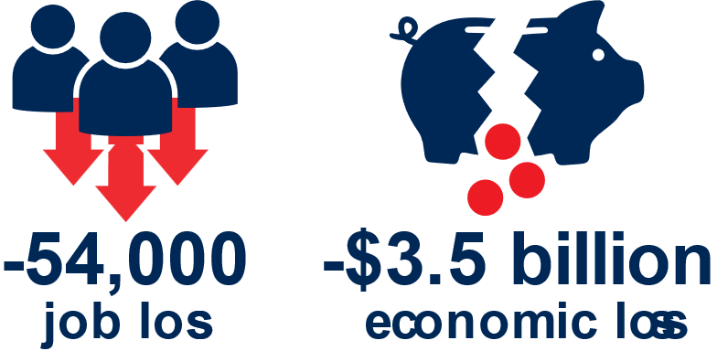
Our region without RTA Next
-54,000
job loss
-$3.5 billion
economic loss
Notes:
IF VOTERS DON’T APPROVE A NEW PLAN OR I.D. NEW FUNDING SOURCES BEFORE MID-2026, THE REGION STANDS TO LOSE A LOT
Remember that RTA currently provides 2/3 of the funding for regional transportation improvements
Without RTA Next plan investments, the region could lose an estimated 54,000 jobs and $3.5 billion in cumulative tax revenues by 2045.
Why? Because not investing in the transportation system can lead to its deterioration, and to economic stagnation or decline as businesses opt to relocate to areas with better transportation.
Remember: Site selectors are generally in the habit of figuring out which places to rule out—and a poorly maintained transportation system is certainly one way to get yourself taken off the short list.

Slide 19
RTA Next
New projects scheduled in four 5-year periods
Annual reports on project delivery and financial performance
Citizen committee oversight
State Auditor General performance audits every 5 years
Notes:
If a new RTA plan is approved at a future date:
New projects will be scheduled in four five-year periods
The RTA will provide annual reports on project delivery and financial performance
A citizen committee will provide oversight
The office of the State Auditor General will conduct mandated performance audits of the RTA every five years

Slide 20

No matter your destination
RTA Next improvements will serve to benefit you, regardless of where you live or work
Something
for everyone
Notes:
Most importantly, if the new plan and extension of the supporting tax are approved, transportation improvements will continue to be made across the region over 20 years to benefit all network users no matter where they live or work.
By design, there’s something for everyone—not everything for one or another interest, but something for all.

Slide 21


Follow RTA Next
Sign up for updates or leave us your comments at RTAnext.com
Notes:
CLOSING SLIDE: WE’RE STILL SEEKING YOUR INPUT. SUBMIT YOUR PUBLIC COMMENTS ONLINE AT RTANEXT.COM
Scan the QR code to see the current draft plan or to sign up for RTA Next updates.
Comments are still being accepted through the comment form on the website.
You’ll find more information about community presentations, stakeholder meetings, public meetings, and how to stay on top of further plan development.
Thank you!

