Slide 1
State of the Streets
January 16, 2025
Kathryn Skinner, P.E.

Slide 2
The Pima County Transportation Department uses advanced technologies, data, and the hard work of 190 employees to manage over 2,200 miles of roadways, bicycle and pedestrian facilities, transit services and infrastructure.

Slide 3
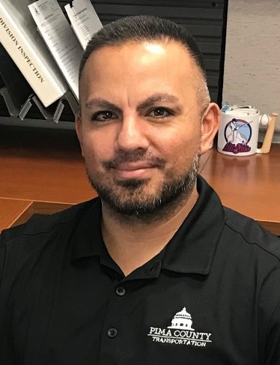
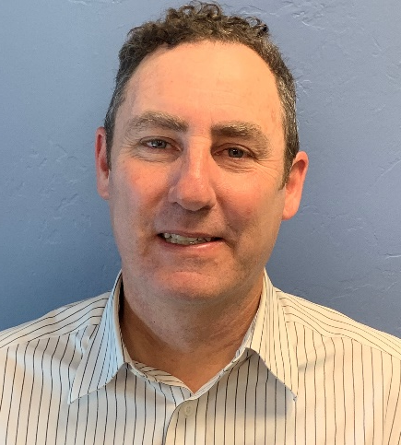
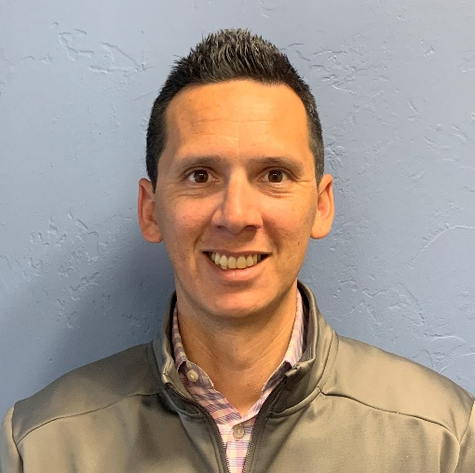
Kathryn Skinner, P.E.
Director
Lauren Ortega, P.E.
Deputy Director
Joseph Godoy
Deputy Director
Paul Casertano
Deputy Director
Gabe Leyva
Mobility, Innovation & Technology
Division Manager
Matt Sierras
Maintenance Operations
Division Manager
Cory Dent
Support Services
Division Manager
Michelle Montagnino
Construction Monitoring
Division Manager
Vacant
Planning & Engineering
Division Manager

Slide 4
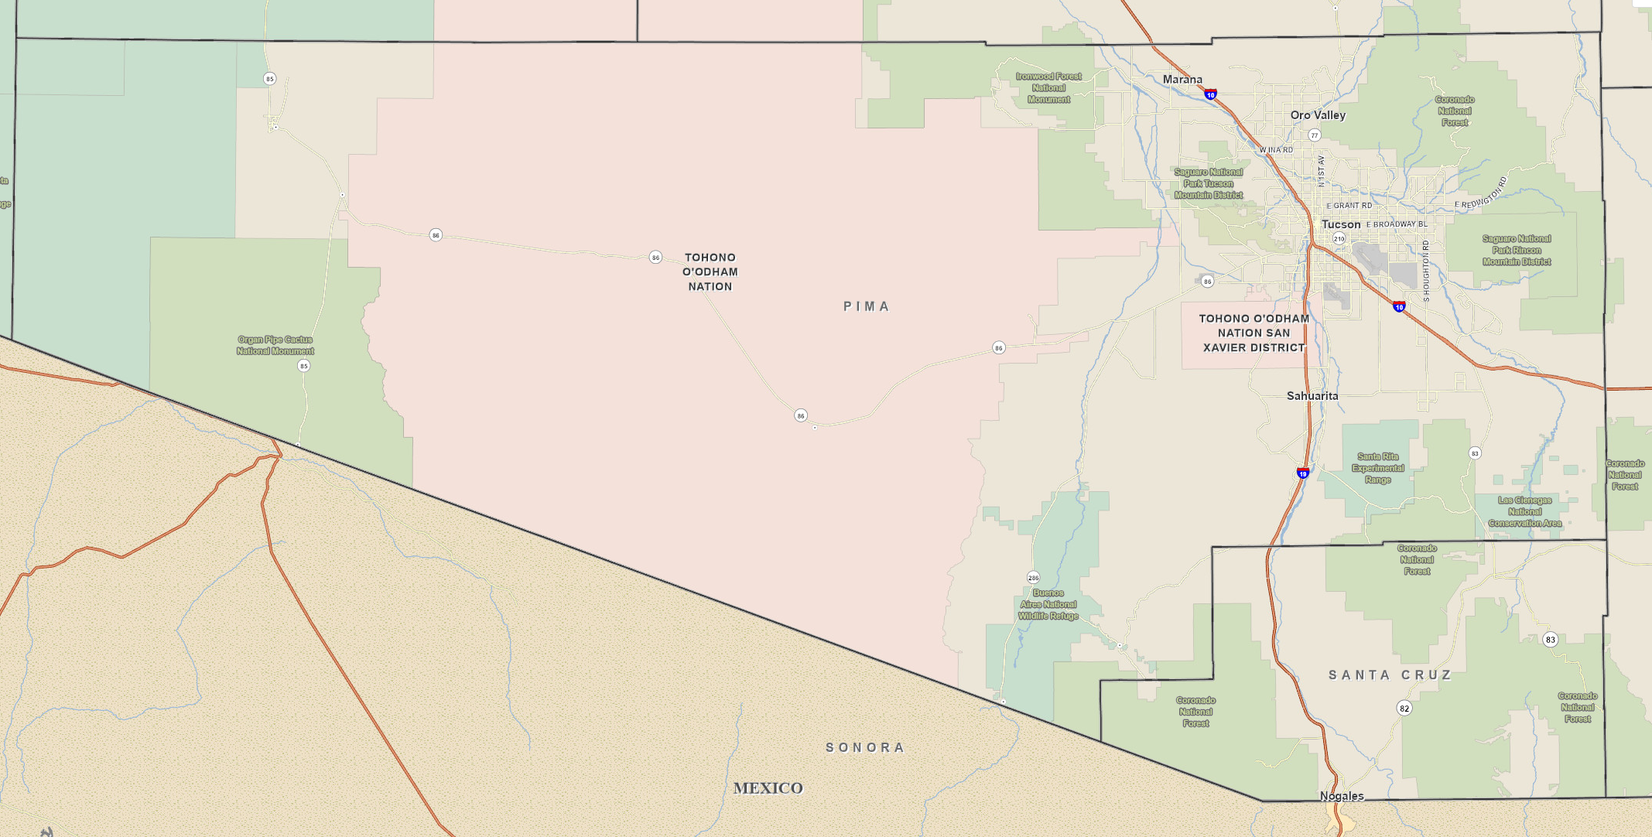
190 Positions (172 filled)
$72M FY25 DOT Budget
$19.9M FY25 CIP Budget
76 Network PCI
1959.93 Miles Paved Roads
282.24 Miles Unpaved Roads
105 Signalized Intersections
78 Bridges

Slide 5
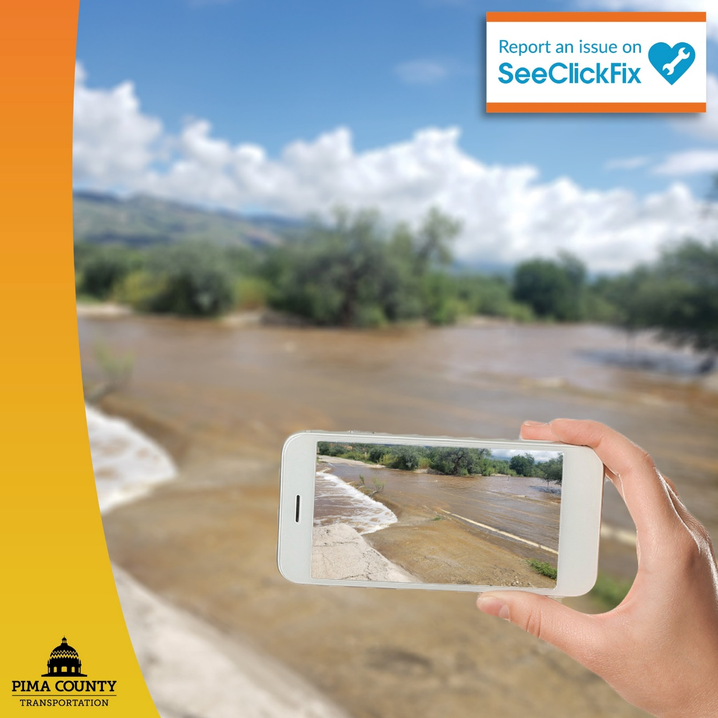
Scan to download
SeeClickFix
8048 Completed SeeClickFix Requests
1984 Completed Pothole Patching Requests
809 Completed Sign Maintenance Requests
1038 Completed Vegetation Management Requests
529 Completed Trash Removal Requests
5 |

Slide 6
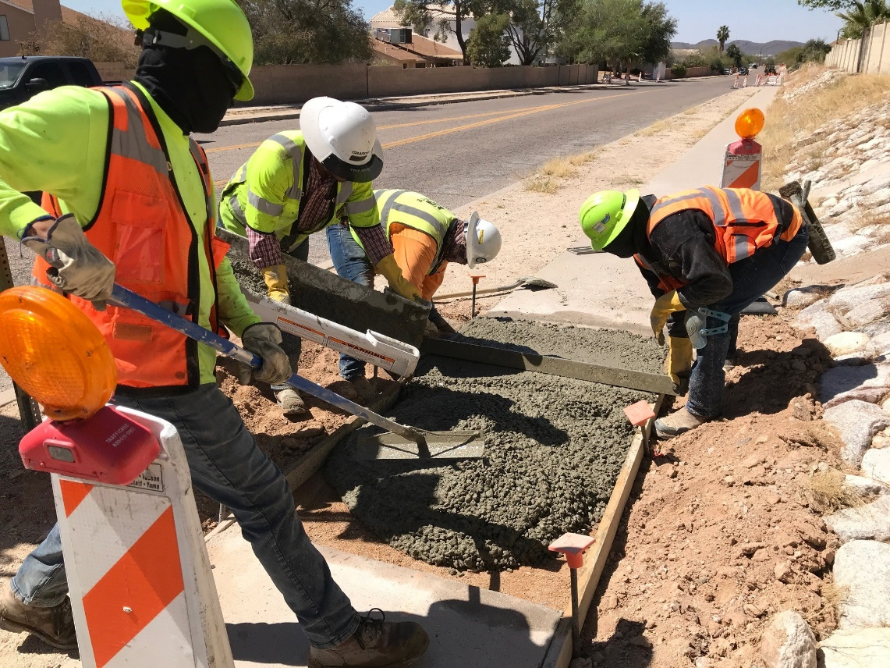
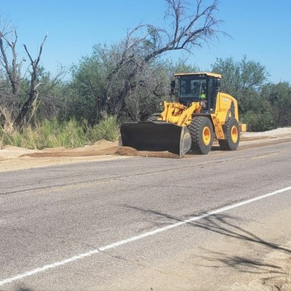
2024 Work Completed
2864 miles Street Sweeping
1438 miles Dirt Road Grading
395 miles Shoulder Repair
275 Storm Responses
9 Snow/Ice Responses
99 Drainage Maintenance
88 Sidewalk/Curb Repairs
14 Cattleguard Maintenance
129 Analytics Studies
14 Crash Analysis

Slide 7
Pavement Program
Fiscal Year | Curb Ramps | Local Miles | Arterial & Collector Miles
19/20 | 203 | 75 | 58
20/21 | 764 | 151 | 56
21/22 | 796 | 186 | 137
22/23 | 437 | 95 | 86
23/24 | 80 | 7 | 27
24/25 | 150 | 24 | 13
Total | 2430 | 538 | 377
FY24/25 program budget $24.1 Million
FY24/25 program includes 131 miles of preservation treatments.
Funded by PAYGO and DOT HURF Funds
FY25/26 program planned at $26.5 Million

Slide 8
Capital Improvement Program
FY2026 Proposed Budget $17.4
18 projects
14 County Managed
4 “pass-through” funding
Project Design and Construction Department manages DOT projects (Director Rod Lane)
All projects have federal funding

Slide 9
Capital Improvement Program
Construction Advertisement by end of FY2025
Project | Method | Total Cost
Ajo Wash at Telera Street Bridge (Ajo, AZ) | DBB | $1,040,000
Esperero Wash at Sunrise Dr Culvert | JOC | $3,340,000
Valencia Rd, Mission Rd to Cmo de la Tierra | CMAR | $34,940,000

Slide 10
Capital Improvement Program
Construction Advertisement by end of FY2026
Project | Method | Total Cost
Madera Canyon – Florida Wash Bridge Replacement | DBB | $8,070,000
Madera Canyon – Medium Wash Bridge Replacement | DBB | $4,630,000
S. Houghton Multiuse Path, Sahuarita Rd to Camino del Toro | DBB | $1,420,000
S. Campbell Rd Extension | DBB | $8,740,000

Slide 11
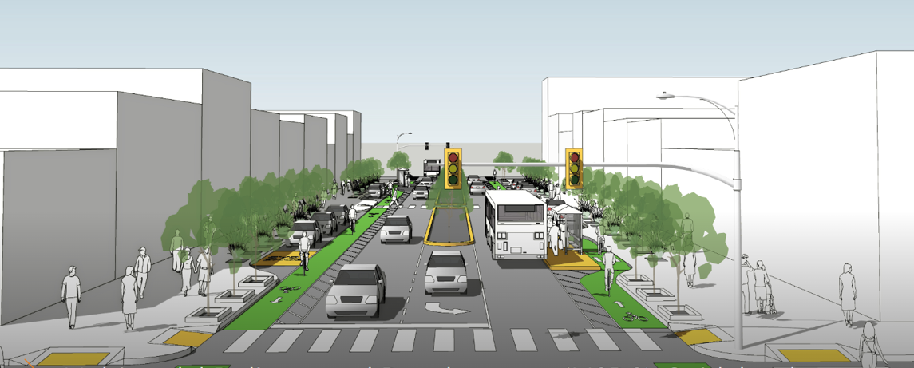
Planning for the Future
Southwest Area Mobility Study
Comprehensive Plan Update
Pima County Transportation Master Plan
Update of Impact Fee Project List
Safe Streets for All Safety Action Plan
Updates to Roadway Design Manual and Subdivision Development Street Standards
11 |

Slide 12
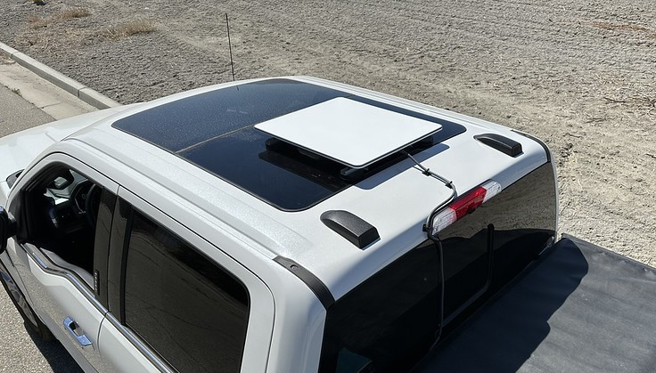
Innovative Tools and Technology for
Right-of-Way Management
Starlink – Satellite Internet
Internet coverage for remote areas
High-speed Wi-Fi internet
Easy to connect and install on work vehicles
Provides faster data entry at the work site
12 |
Notes:
Objective of the drone program:
To capture and provide aerial imagery of infrastructure and roadway projects for Department of Transportation.
Currently, the Right-of-way department spends a fair amount of the budget on inspecting infrastructure and maintaining a current database consisting of relevant metadata. Some of the main reasons for such a high cost is due manual labor and contracting manned flights to gather imagery at a higher resolution than satellite imagery. Therefore, there is a need to reduce these costs and provide a more efficient and more accurate way of obtaining this data.
There are many ways UAS can be used in Right-of Way management:
Tracking and Monitoring
Inspections
Data Gathering
These different applications can be costly when using a private contractor and manned aircraft. However, utilizing UAS and Pima County employees to conduct the image acquisition, data management and analysis, and producing results would be far more cost effective and efficient.
Going over some examples utilizing UAS:
Using UAS can help provide safe inspections for uncertain areas. These areas may have an unsafe condition which would require additional safety measures if the inspection is done manly. However, the UAS can provide a safer option for the employees to inspect the same area. The GIS team can use the flight planning software to plan a safer route to inspect these unsafe areas.
UAS can also help with asset inventories and their management. For example, construction plans provide all of the details concerning a project including the traffic signals and signage. After a project is finished, these assets can be identified and cross-referenced in the UAS images taken in the field. This can enhance tracking and organization of these assets.
During construction projects there are a series of inspections that occur to keep the project within the timeline and at the highest standards of the County. Since these inspections occur multiple times a year, the UAS offers greater opportunities to capture the construction progress. With a greater frequency of image acquisition, more attention to the project can be given.
There is an opportunity to increase community engagement with aerial pictures and video as well.

Slide 13
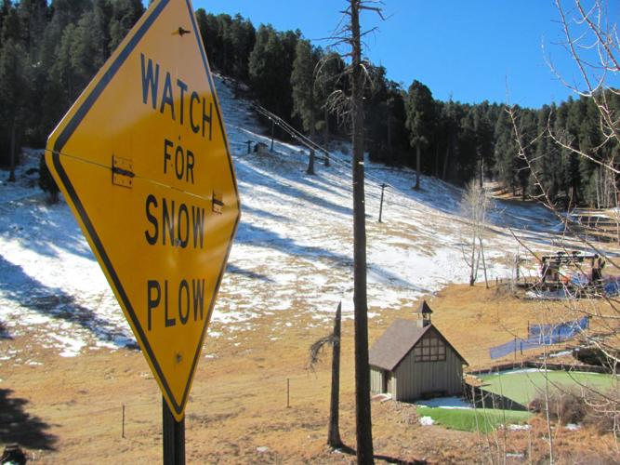
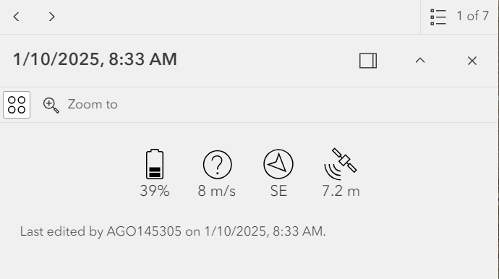
Innovative Tools and Technology for
Right-of-Way Management
Snow Plow Tracking App
Tracks individual snow plows
Live interactive map to view the tracking
Allows for real-time monitoring of operations
13 |
Live snow plow tracking information

Slide 14
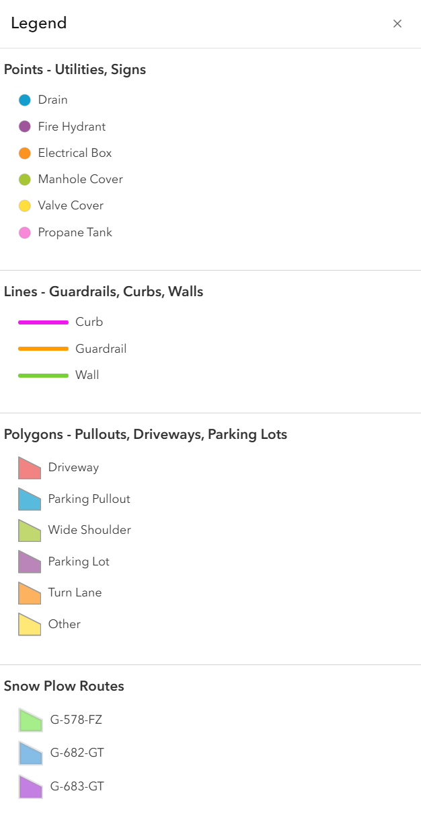
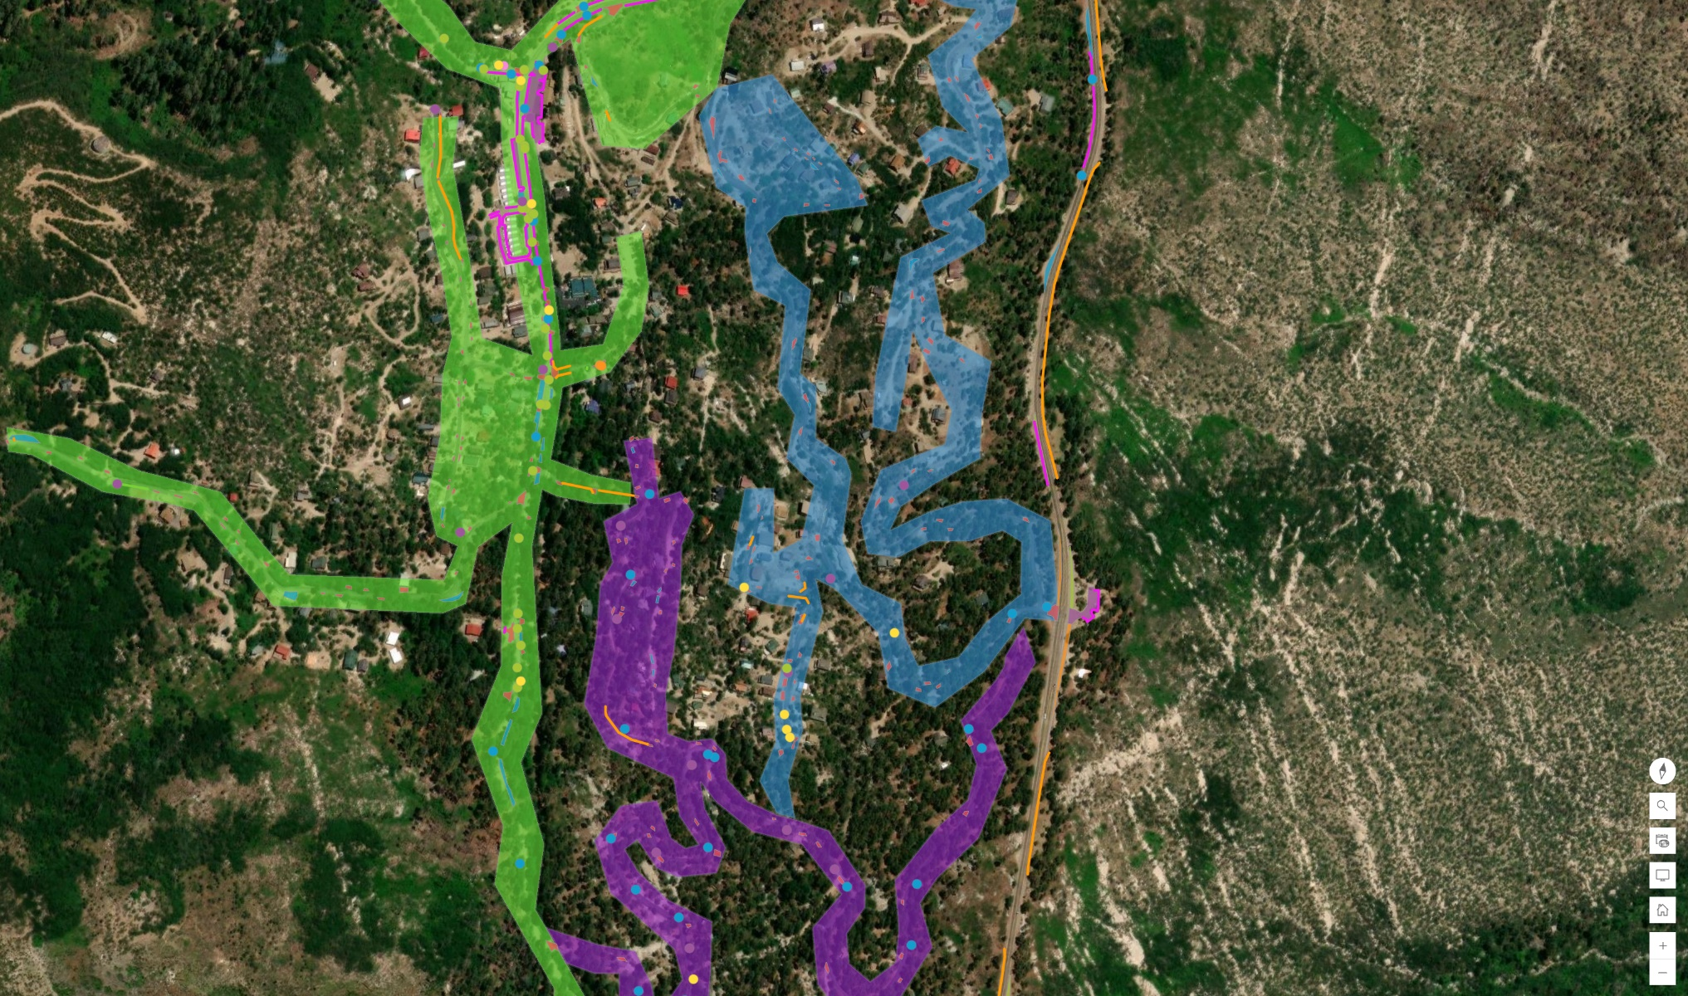
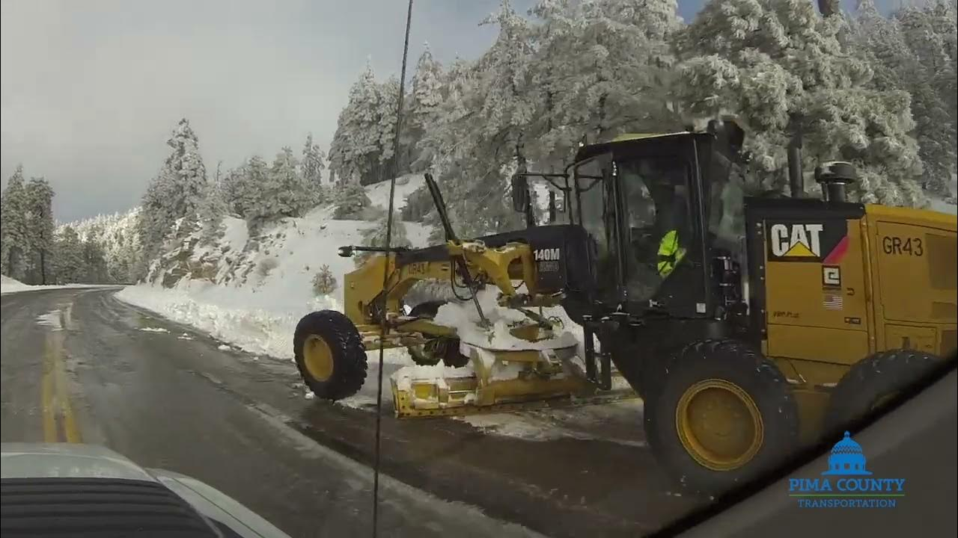
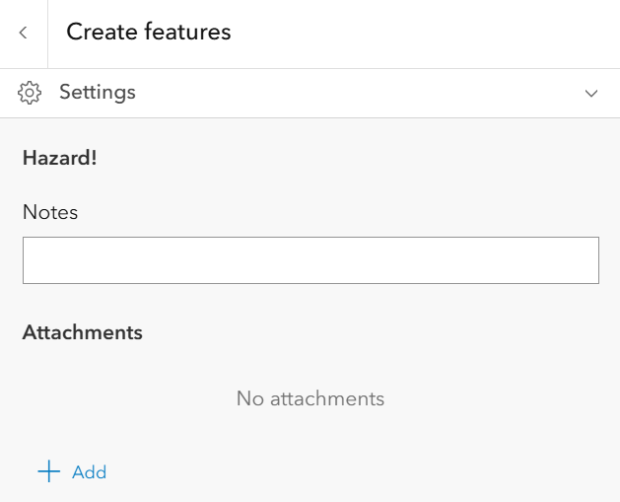
Innovative Tools and Technology for
Right-of-Way Management
Mt Lemmon Infrastructure App
Identifies snow plow routes, infrastructure, and hazards
Users can add hazards obstructing roads
Technicians can identify locations of infrastructure during snow plow operations
14 |

Slide 15
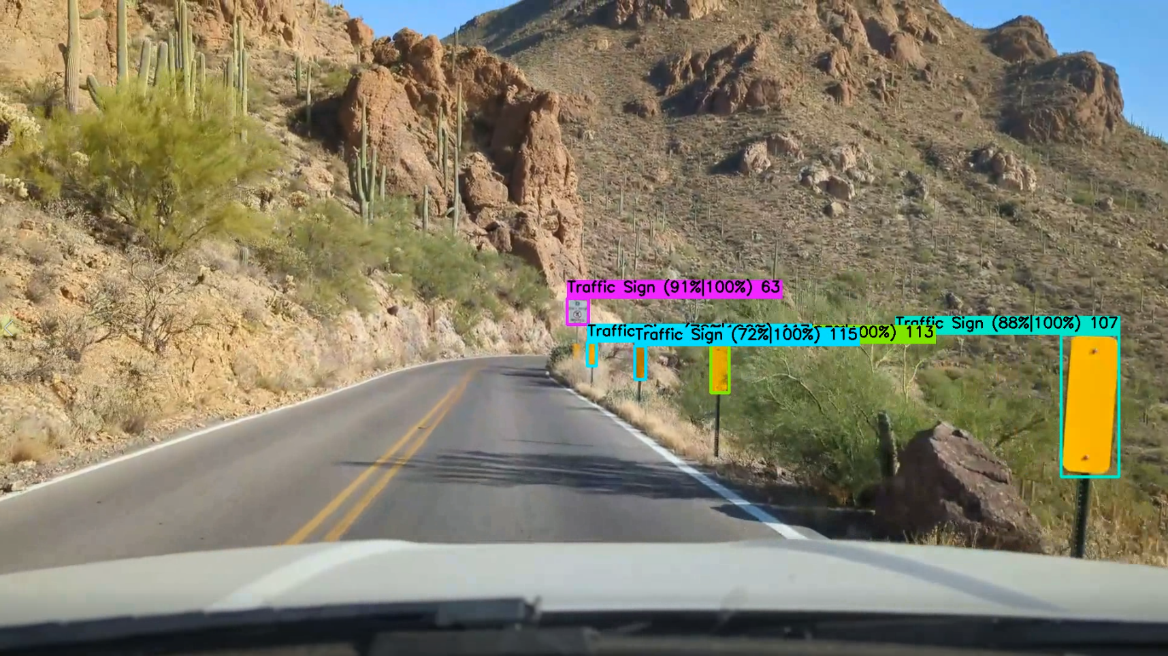
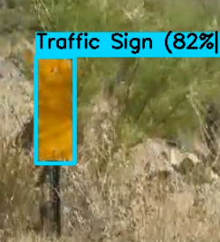
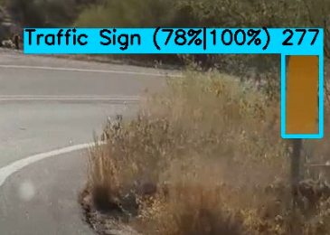
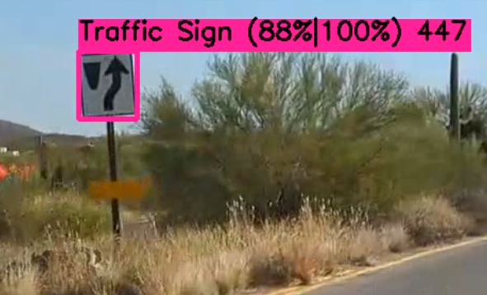
Innovative Tools and Technology for
Right-of-Way Management
AI Sign Detection Project - UA CATS
Mounted recording device captures every sign while driving around Pima County
AI model identifies and labels signs as seen in the recorded video
Helps validate the locations and conditions of the signs as they are video
15 |

Slide 16
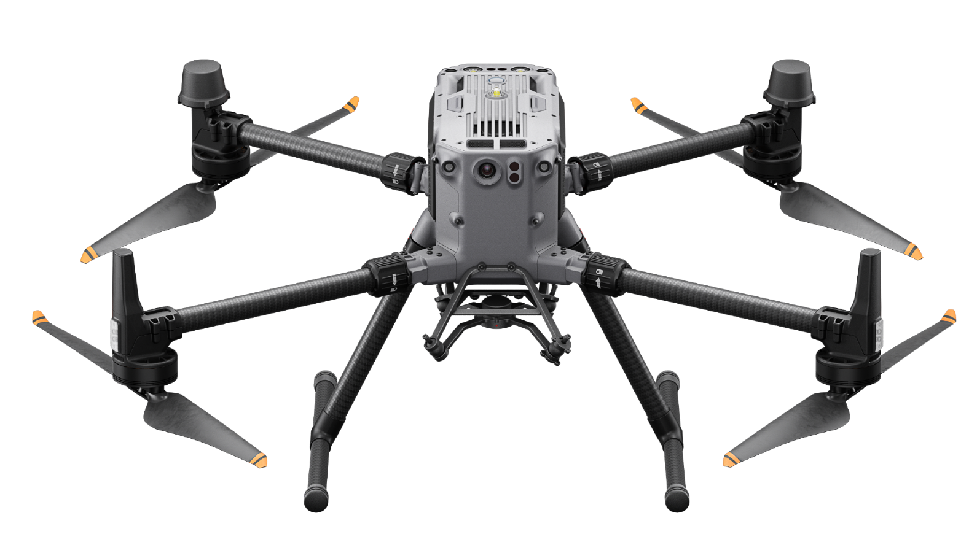
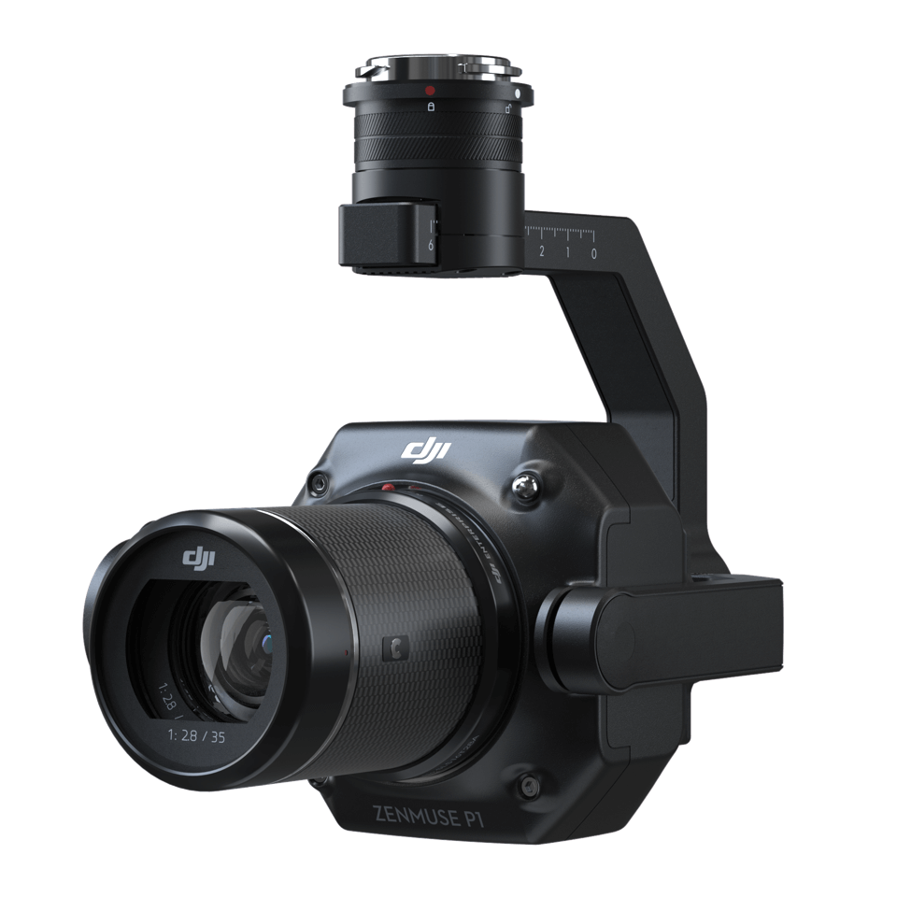
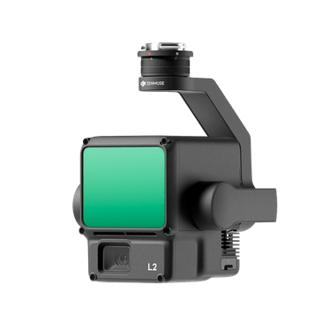
Innovative Tools and Technology for
Right-of-Way Management
Future Plans - Upgrade Drone Program
Interchangeable cameras for color and LiDAR imagery
The highly precise color images will be used to map transportation assets
The LiDAR imagery will be used to identify the conditions of the assets and generate 3D models of structures
16 |

Slide 17
Join Our Team!
We A.R.E. Pima County
Accountable, Respectful, Ethical

