Slide 1
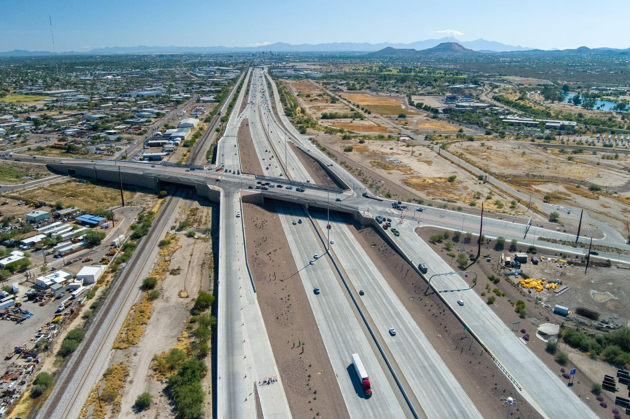
State of the Streets
Anthony Casselman District Administrator ADOT Southcentral District January 2025

Slide 2
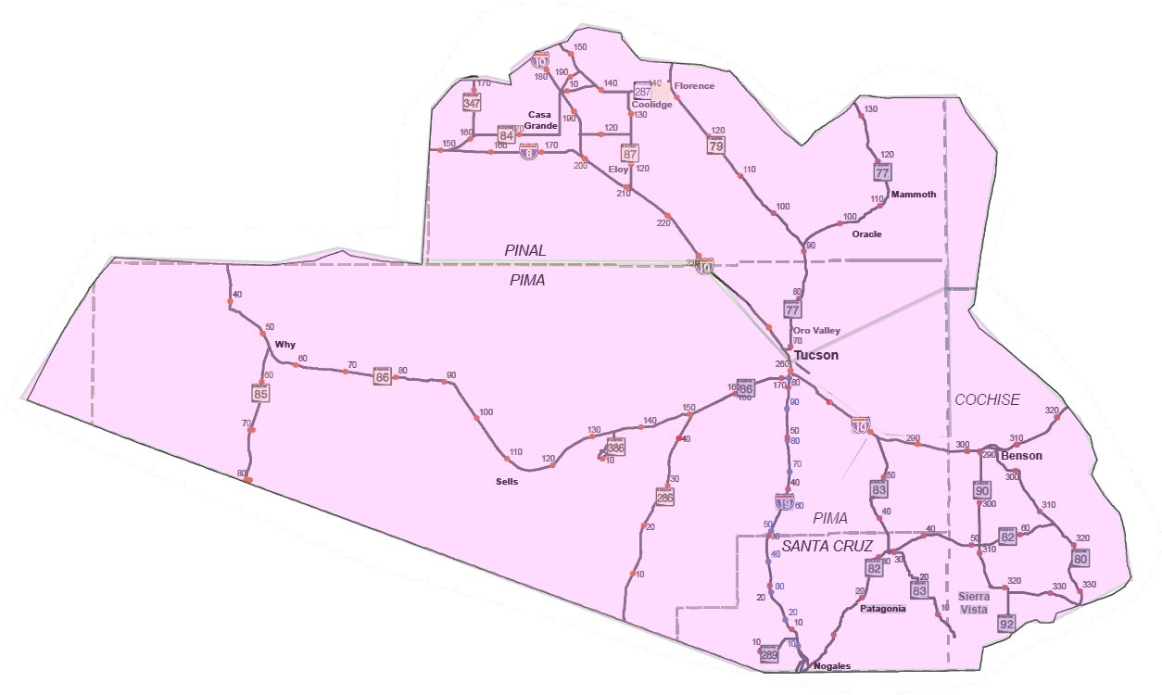
Southcentral District Boundaries
A R I Z O N A D E P A R T M E N T O F T R A N S P O R T A T I O N
Significant Rural Component
3 Interstates
4 International Border Crossings
5 Councils of Governments/Metropolitan Planning Organizations
5 Tribal Nations

Slide 3
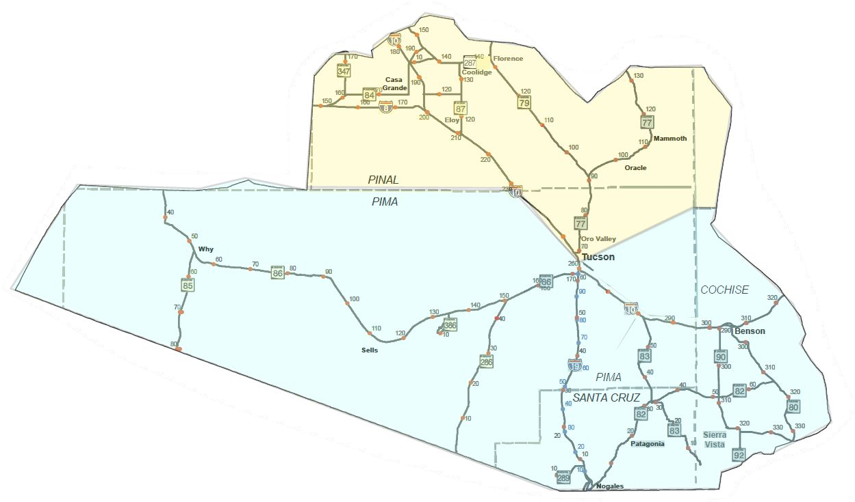
Southcentral District Administration
A R I Z O N A D E P A R T M E N T O F T R A N S P O R T A T I O N
District Administrator
Anthony Casselman
Assistant District Engineer
Priscilla Thompson
Assistant District Engineer
Jeremy Moore

Slide 4
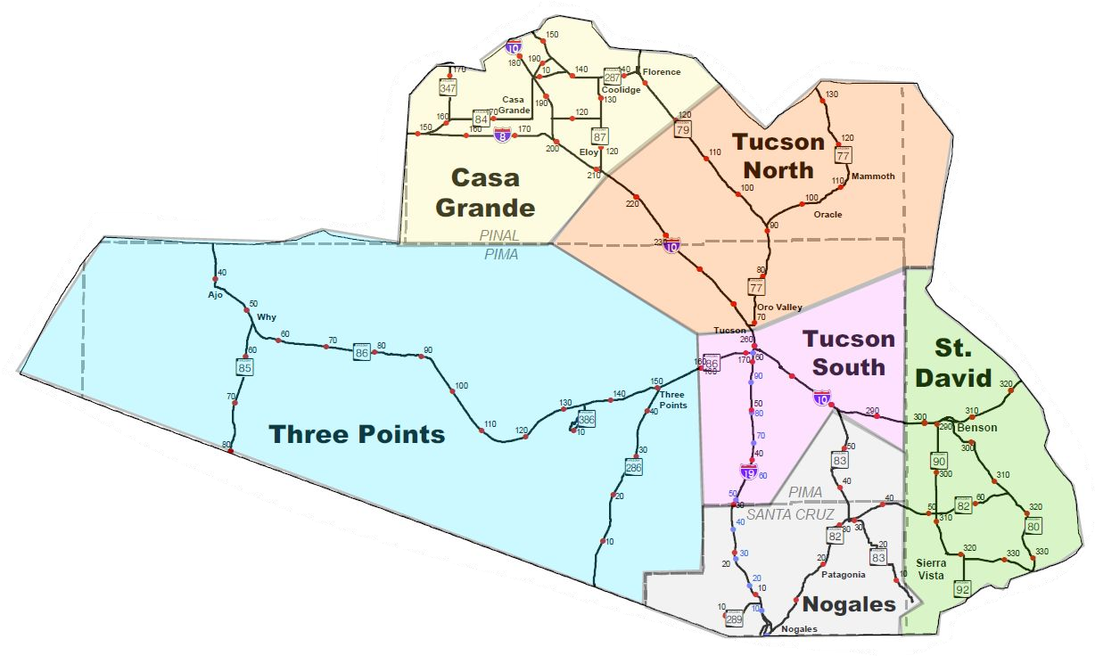
Southcentral Maintenance Organization
A R I Z O N A D E P A R T M E N T O F T R A N S P O R T A T I O N
7 Maintenance Units
Each unit has a supervisor and is responsible for overall maintenance of the state highway system.
Maintenance activities include guardrail repair, fence repair, pothole patching, vegetation management, etc.
Maintenance crews also respond to and provide on scene traffic control for incidents on the state highway system.

Slide 5
Successes From Last Year
A R I Z O N A D E P A R T M E N T O F T R A N S P O R T A T I O N

Slide 6
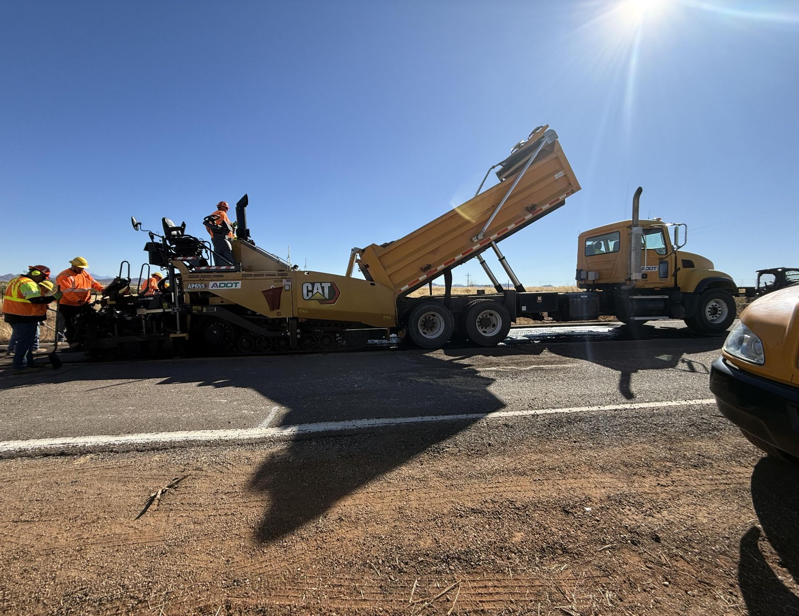
Self-Perform Paving
A R I Z O N A D E P A R T M E N T O F T R A N S P O R T A T I O N
Spot Mill & Fill
I-10 near Benson
I-10/Tangerine WB Ramps
SR-286 near Sasabe
SR-82 in Patagonia
I-10 in Vail

Slide 7
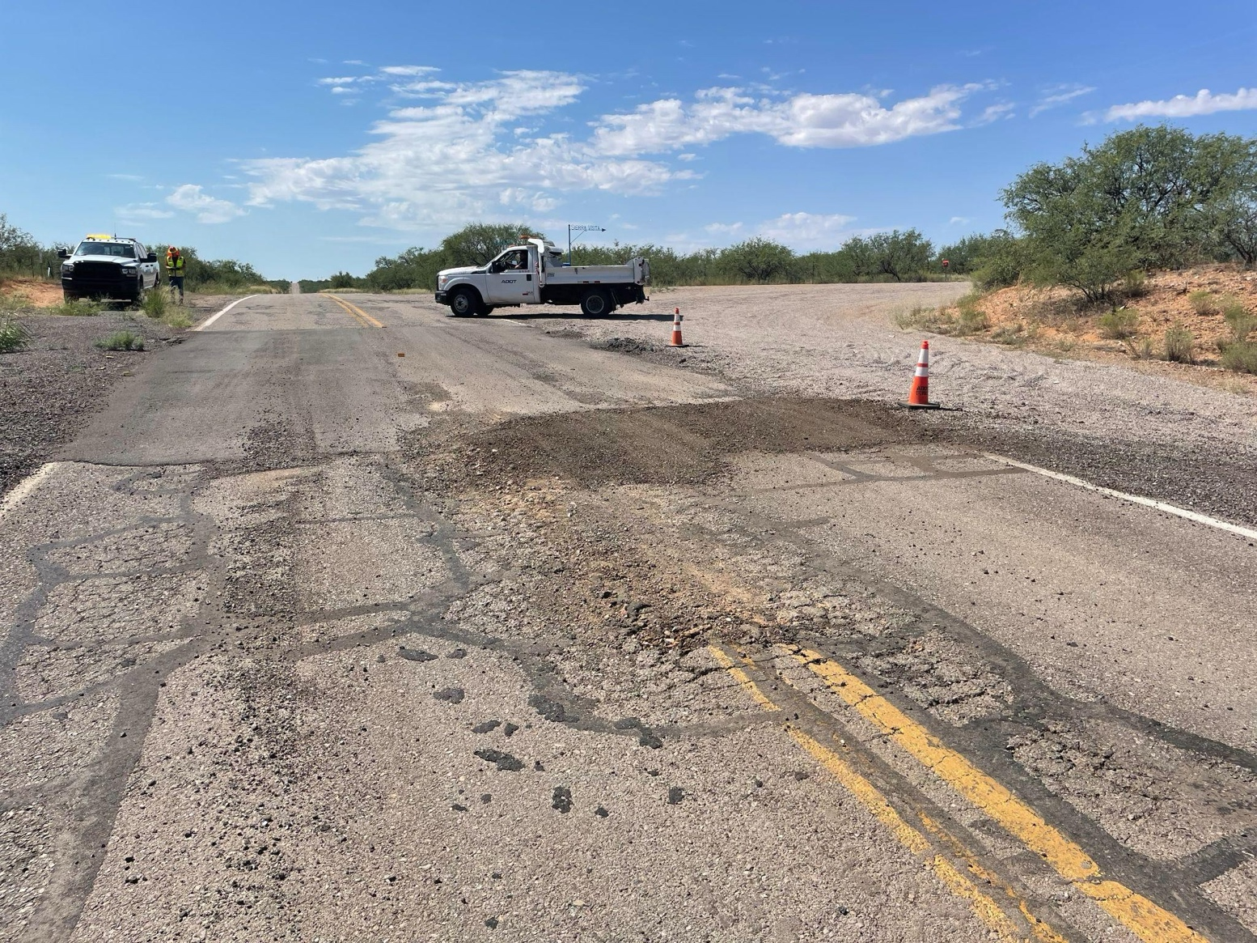
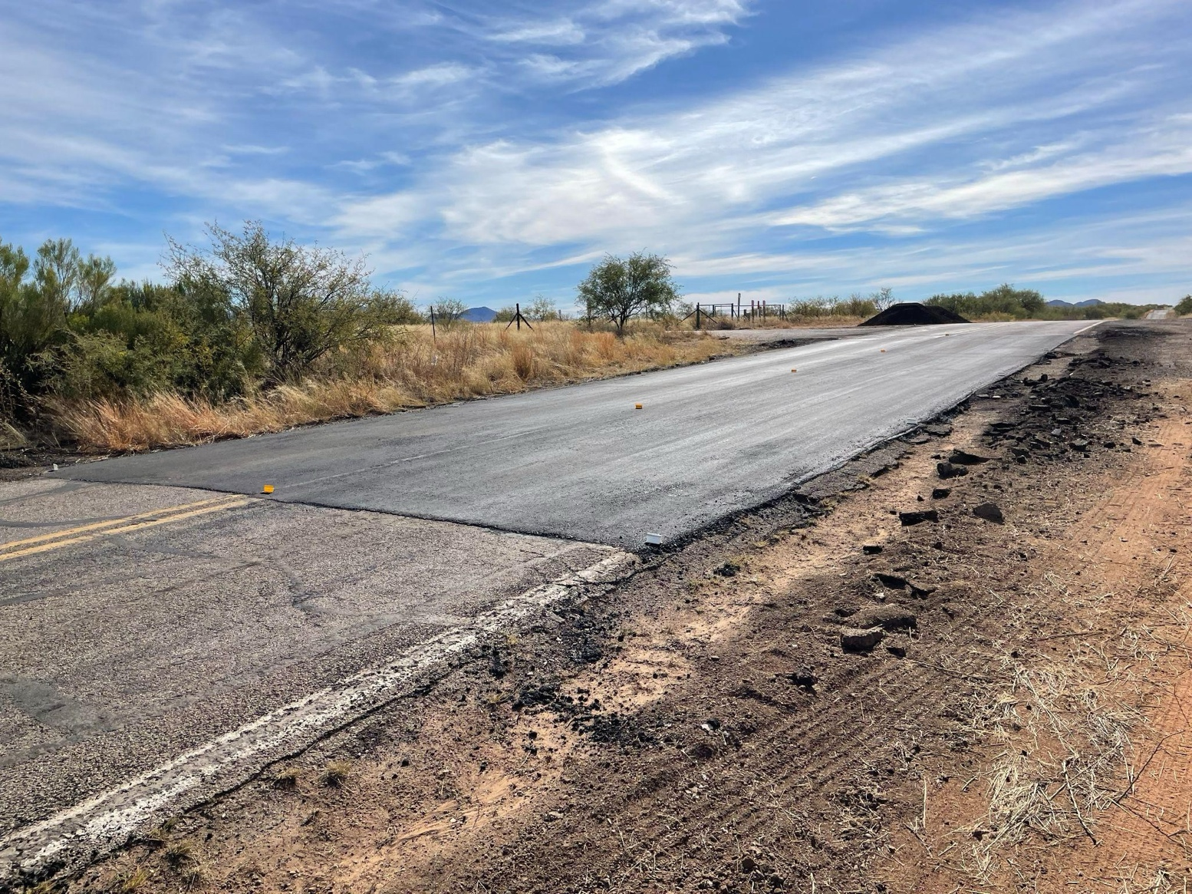
SR-286 Near Sasabe (MP 1.8-MP 7.3)
A R I Z O N A D E P A R T M E N T O F T R A N S P O R T A T I O N

Slide 8
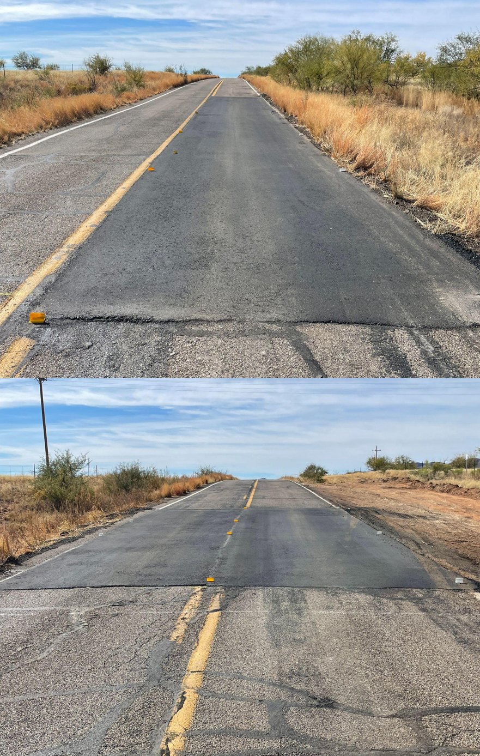
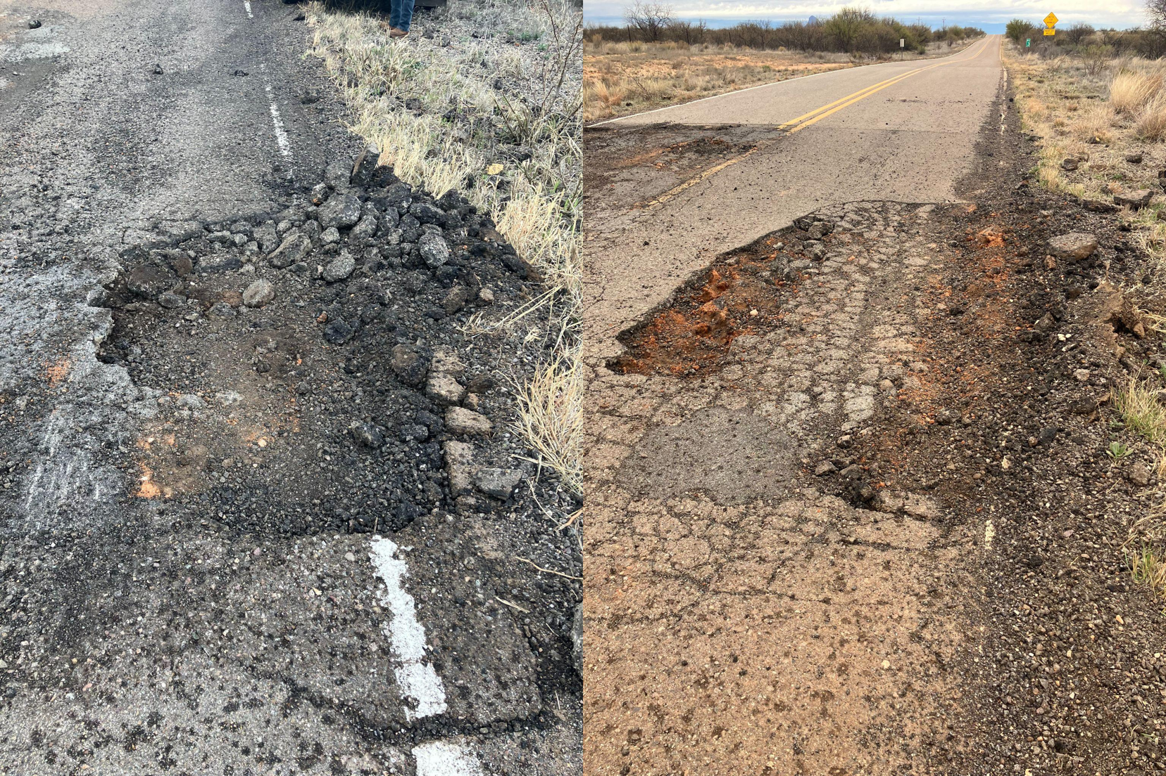
SR-286 Near Sasabe (MP 1.8-MP 7.3)
A R I Z O N A D E P A R T M E N T O F T R A N S P O R T A T I O N

Slide 9
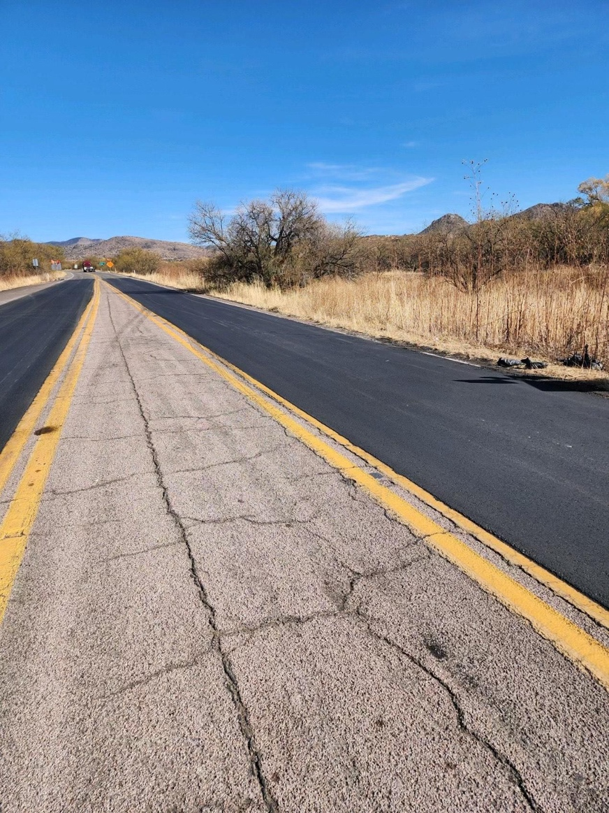
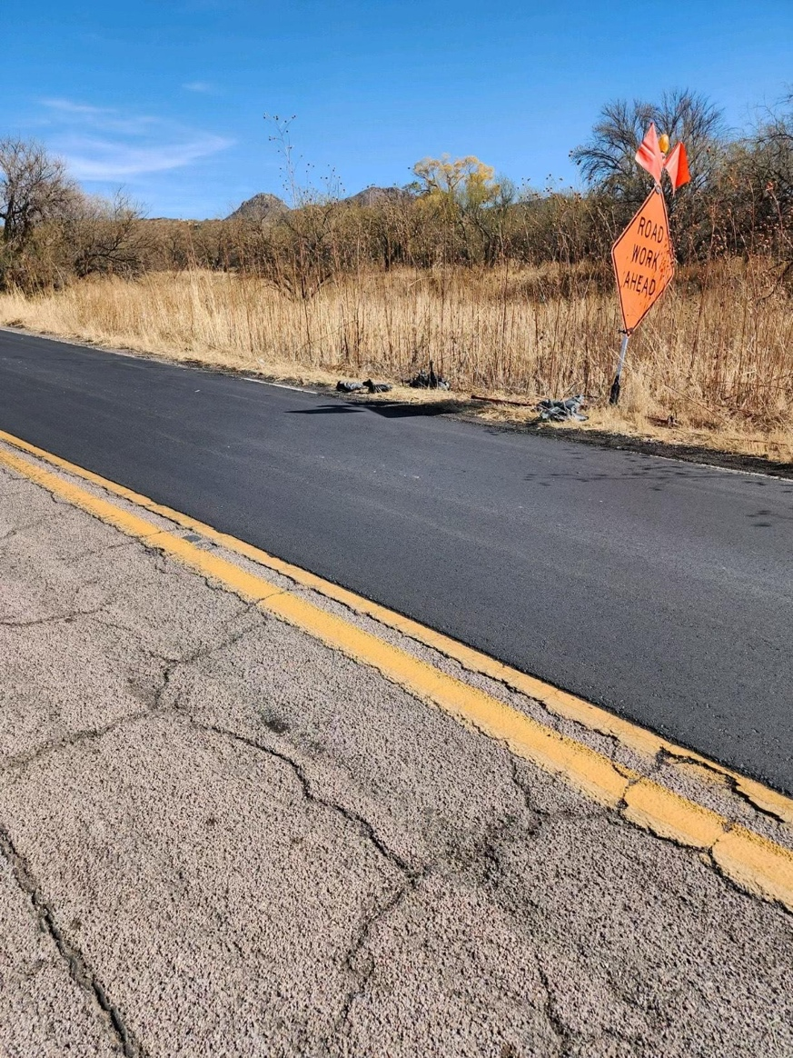
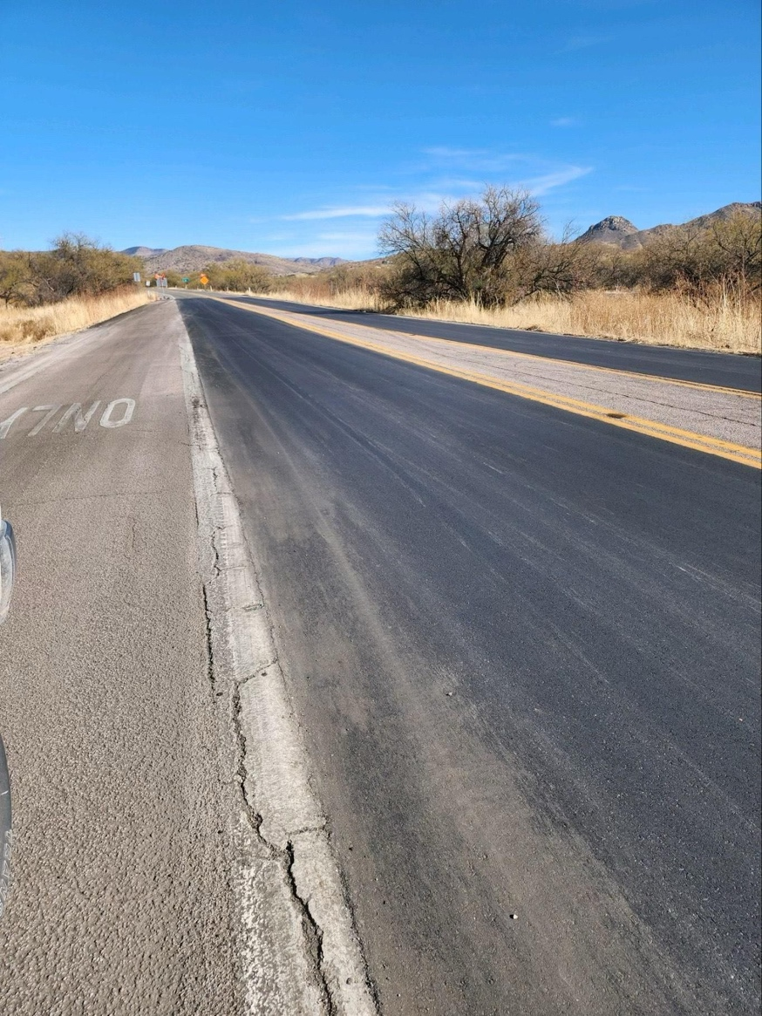
SR-82 in Patagonia (MP 19.83-MP 20.13)
A R I Z O N A D E P A R T M E N T O F T R A N S P O R T A T I O N

Slide 10
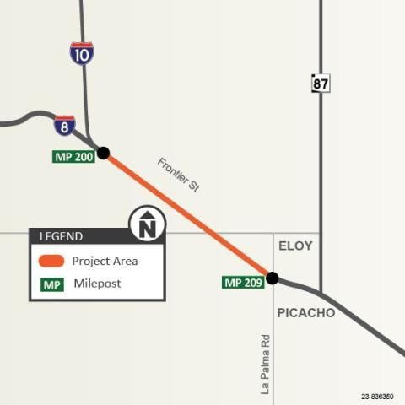
I-10: Pavement Rehab (I-8 to SR-87)
A R I Z O N A D E P A R T M E N T O F T R A N S P O R T A T I O N
Contractor: FNF Construction
Programmed Amount: $7.7M
Construction started January 2024 and was completed April 2024.

Slide 11
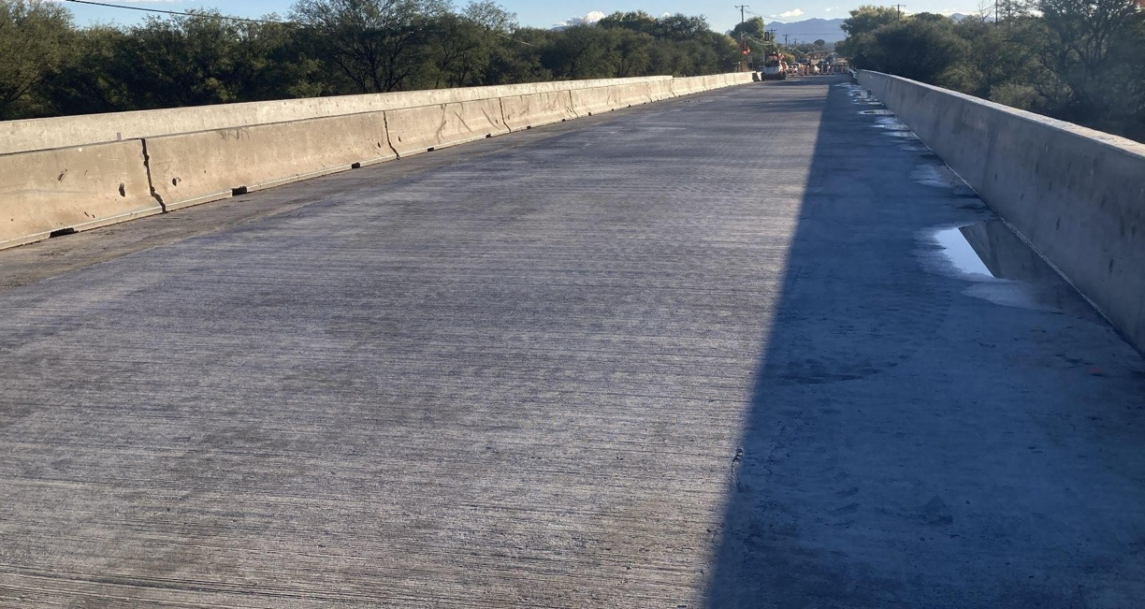
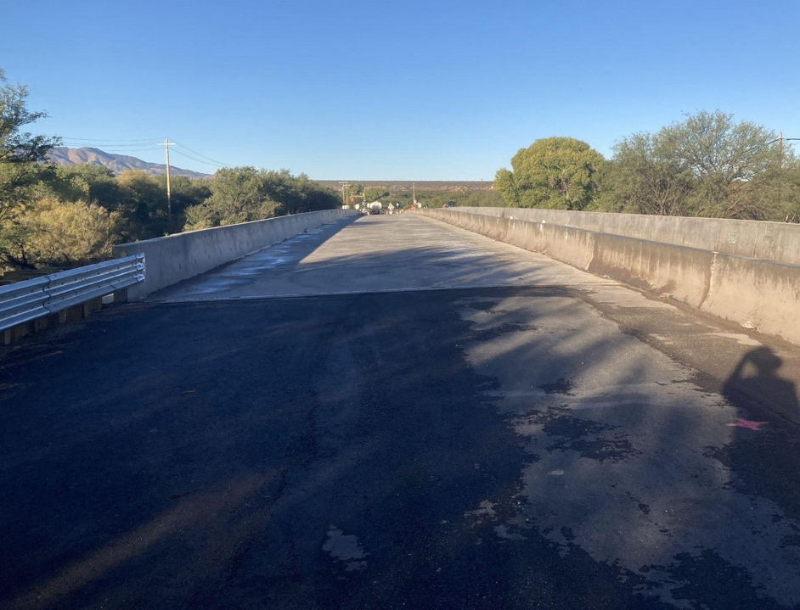
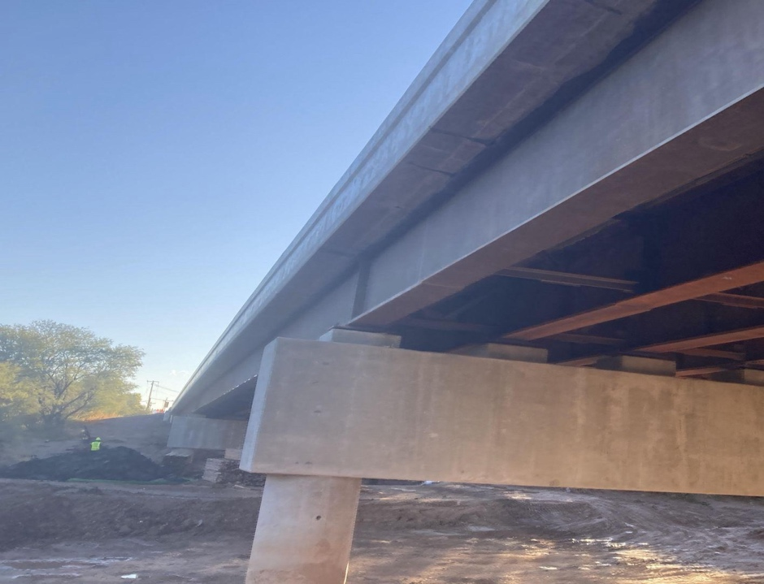
SR-80: San Pedro River Bridge Replacement
A R I Z O N A D E P A R T M E N T O F T R A N S P O R T A T I O N
Contractor: FNF Construction
Programmed Amount: $9.8M
Construction started October 2022 and is expected to be completed Spring 2025.

Slide 12
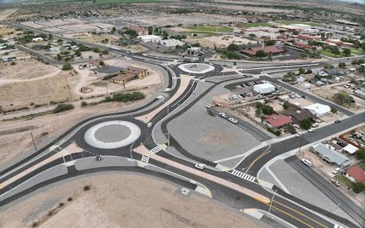
SR-287/SR-79B Roundabout in Florence
A R I Z O N A D E P A R T M E N T O F T R A N S P O R T A T I O N
Contractor: J. Banicki Construction
Bid Amount: $6.47M
Construction started January 2024 and is nearing completion.

Slide 13
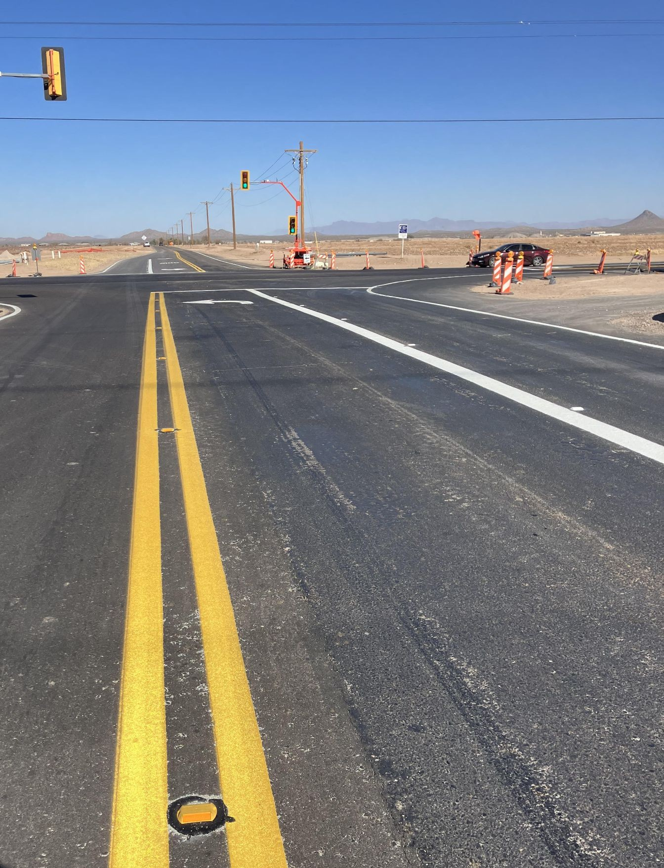
SR-87/Skousen Road Intersection
A R I Z O N A D E P A R T M E N T O F T R A N S P O R T A T I O N
Contractor: PaveCo
Contract Value: $2.3M
Construction started June 2024 and is nearing completion.

Slide 14
Current Construction
A R I Z O N A D E P A R T M E N T O F T R A N S P O R T A T I O N

Slide 15
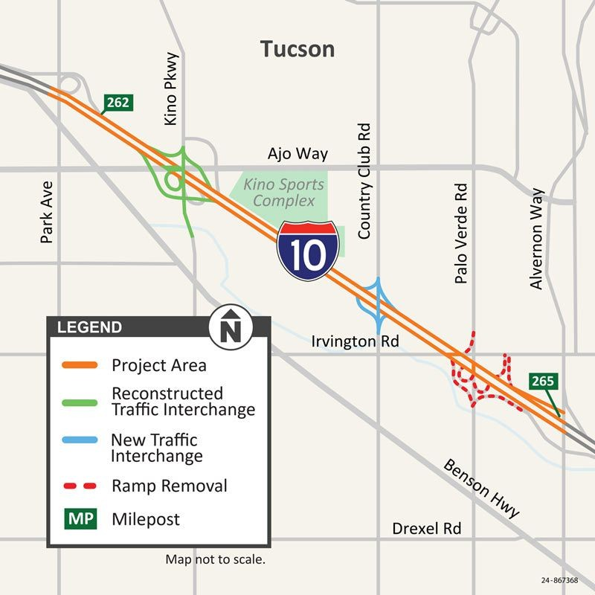
I-10: Kino-Country Club (Design-Build)
A R I Z O N A D E P A R T M E N T O F T R A N S P O R T A T I O N
Design Builder: Sundt/Jacobs
Programmed Amount: $600M
Scope
I-10 Widening
Reconstructing Kino Pkwy TI
Constructing new Country Club Rd. TI
Removing Palo Verde Rd. TI
Currently in NTP 1 Design
Construction NTP 2 June 2025

Slide 16
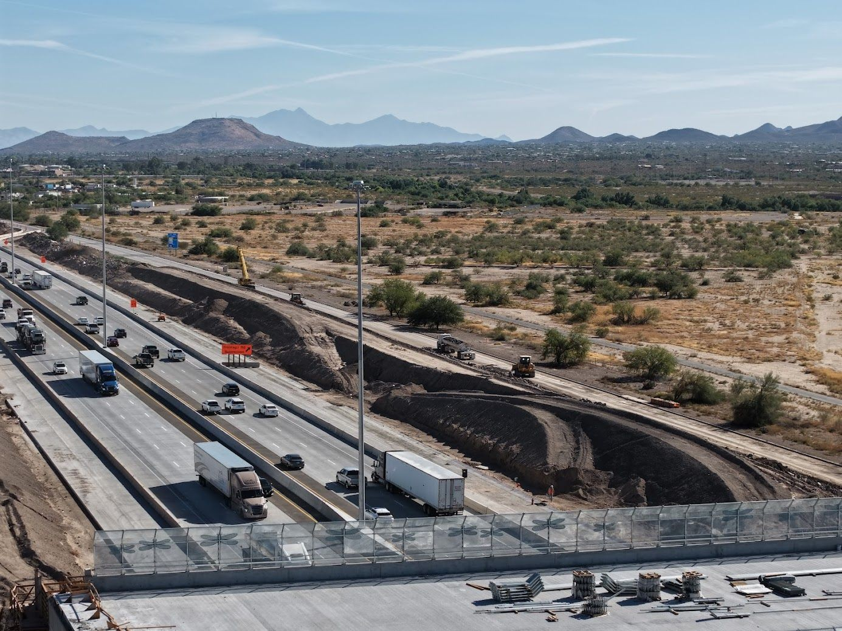
I-10: Ina to Ruthrauff
A R I Z O N A D E P A R T M E N T O F T R A N S P O R T A T I O N
Contractor: Granite Construction
Contract Value: $171M
Scope:
Nearly 4 miles of widening
Adding auxiliary lanes
Reconstructing Orange Grove TI
Reconstructing the Canada del Oro Wash and Rillito River bridges
Constructing new bridges at Sunset Rd.
Construction started February 2023 and is estimated to be completed by the end of 2025.

Slide 17
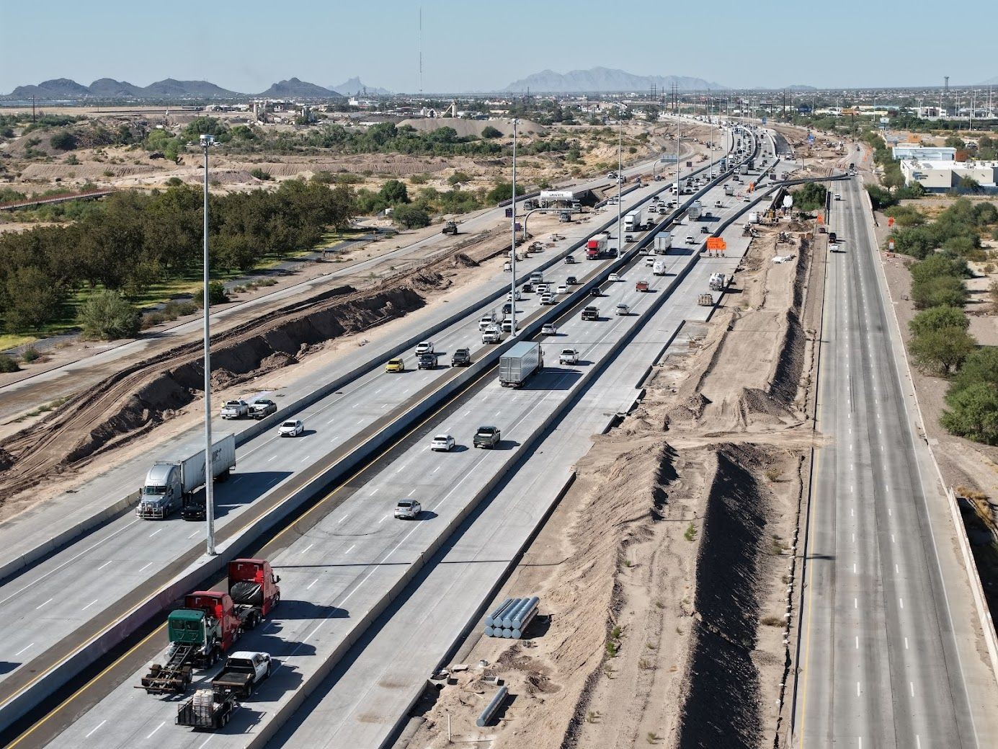
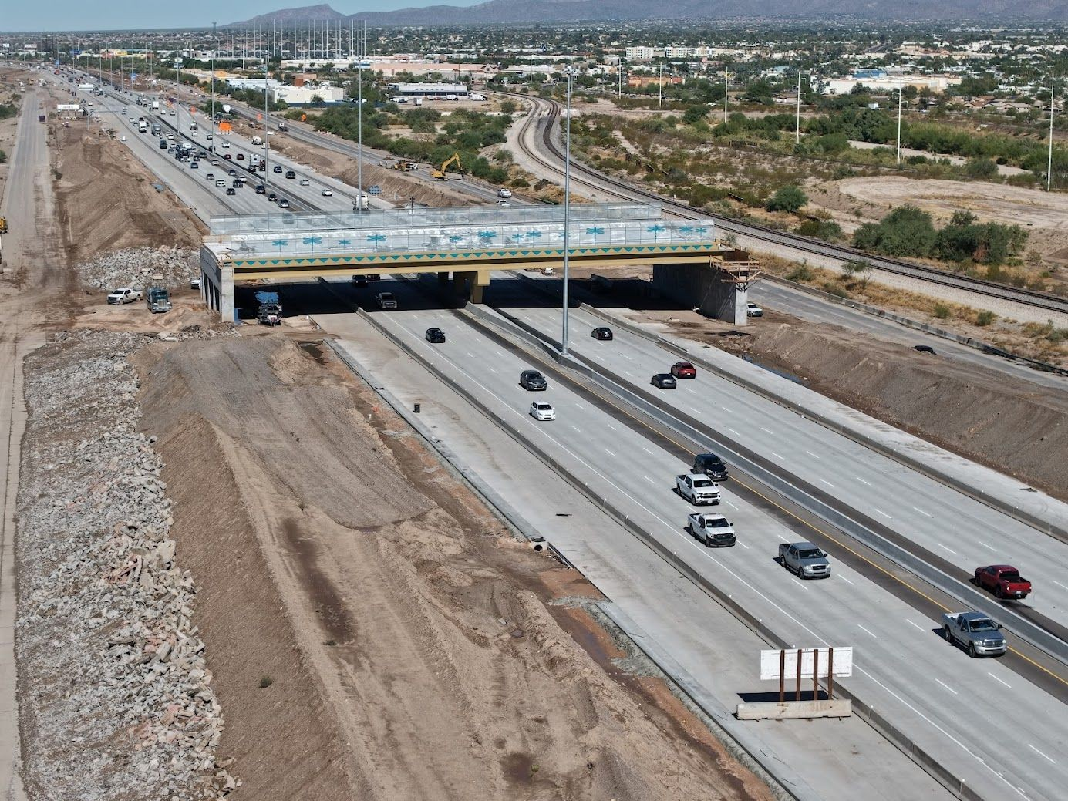
I-10: Ina to Ruthrauff
A R I Z O N A D E P A R T M E N T O F T R A N S P O R T A T I O N

Slide 18
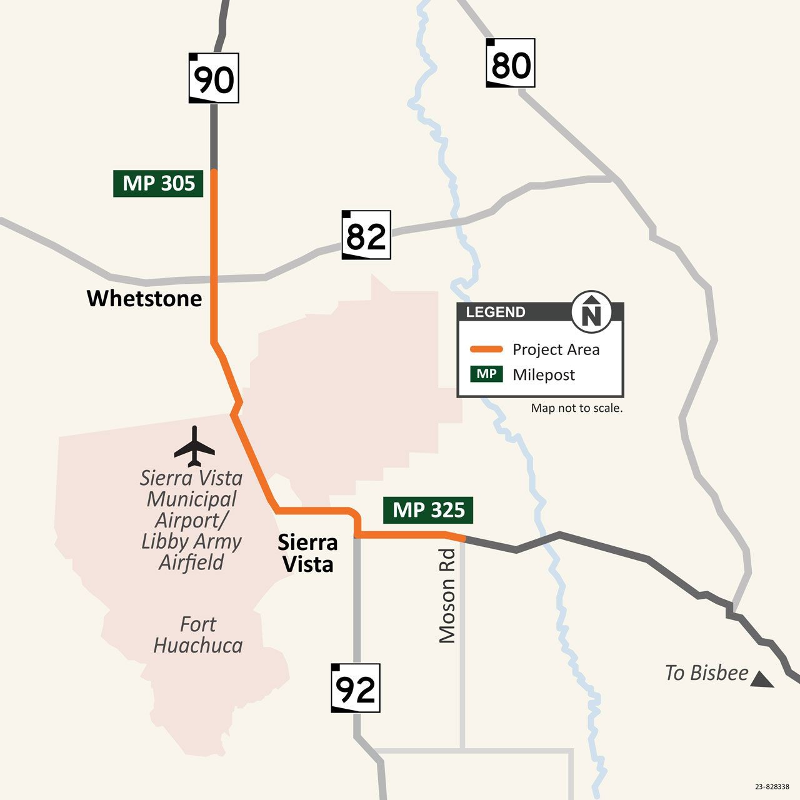
SR-90: Pavement Rehab (Border Patrol Station to Moson Rd.)
A R I Z O N A D E P A R T M E N T O F T R A N S P O R T A T I O N
Contractor: FNF Construction
Contract Value: $27.7M
Scope
Replacing existing asphalt with new asphalt
Replacing guard rail
Installing new sidewalks, sidewalk ramps and signage
Schedule
Construction started April 2024 and is estimated to be completed Summer 2025.

Slide 19
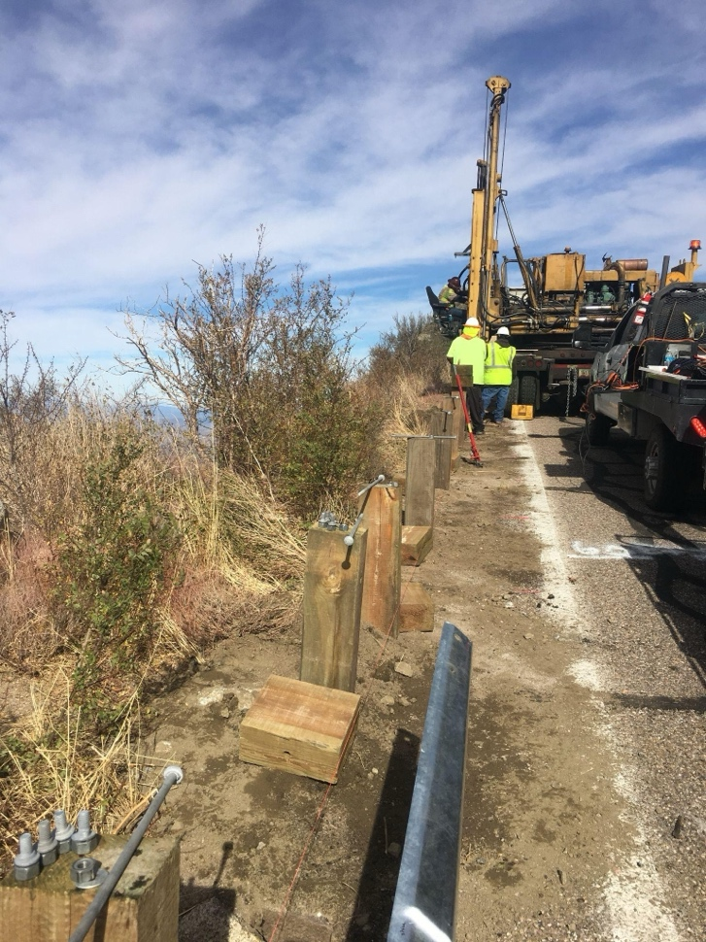
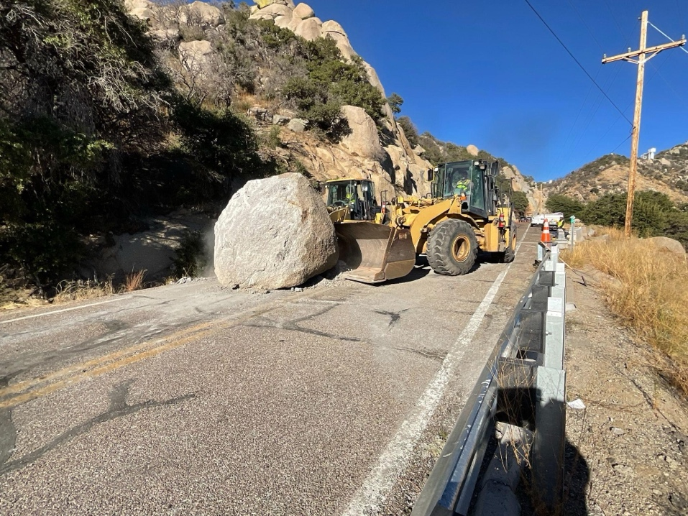
SR-386: Kitt Peak Observatory Guardrail Reconstruction
A R I Z O N A D E P A R T M E N T O F T R A N S P O R T A T I O N
Contractor: Ashton Company
Contract Value: $2.4M
Scope:
Replacing guardrail and guardrail end terminals
Drainage improvements
Rockfall mitigation
Schedule
Construction started September 2024 and is estimated to be completed April 2025.

Slide 20
Upcoming Projects
A R I Z O N A D E P A R T M E N T O F T R A N S P O R T A T I O N

Slide 21
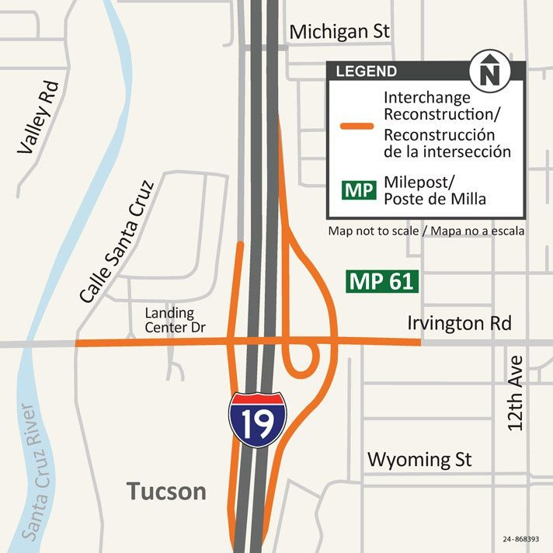
I-19: Irvington TI
A R I Z O N A D E P A R T M E N T O F T R A N S P O R T A T I O N
Final Design Firm: WSP
Scope:
Reconstructing the existing diamond interchange and adding a partial cloverleaf.
Widening on-ramps
Irvington Road Improvements (West & East of I-19)
Construction Anticipated Early 2026

Slide 22
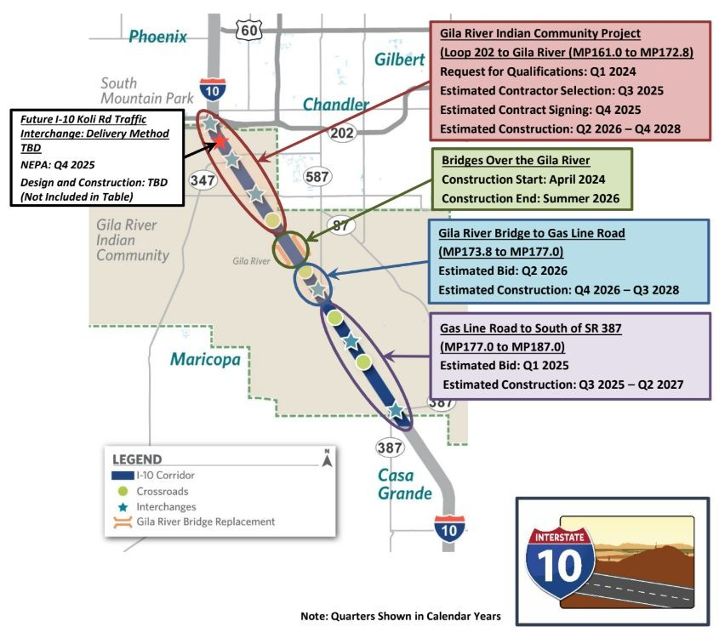
I-10: Wild Horse Pass Corridor
A R I Z O N A D E P A R T M E N T O F T R A N S P O R T A T I O N
Corridor Improvement Benefits
Increased I-10 Capacity - Provides drivers with three continuous travel lanes in each direction between Phoenix and Tucson.
New & Improved Interchanges - 1 new interchange and 5 existing interchange reconstructions.
Increased Safety - Includes the installation of freeway management systems, such as traffic sensors, cameras, variable message signs and other highway safety-related technology.
Updated Infrastructure - Existing pavements, bridges and culverts within the corridor will be reconstructed or repaired as applicable.

Slide 23
Corridor Studies
A R I Z O N A D E P A R T M E N T O F T R A N S P O R T A T I O N

Slide 24
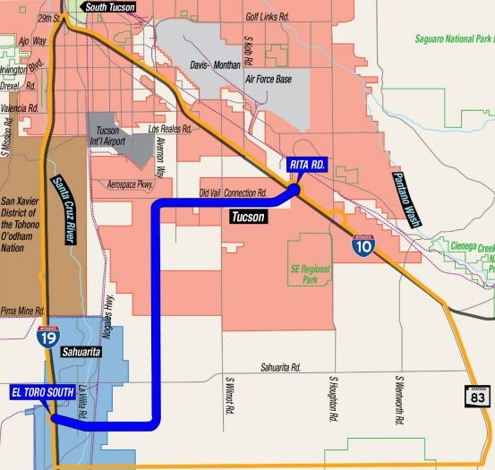
A R I Z O N A D E P A R T M E N T O F T R A N S P O R T A T I O N
Proposed new freeway connecting I-19 and I-10.
Tier 1 EIS completed and ROD issued in 2021.
Identified 20.5-mile, 2,000-foot wide preferred alternative.
Tier 2 EIS currently underway.
Develop and evaluate a range of 400-foot wide alignment alternatives.
Evaluate “no build” alternative.
Select a preferred alternative.
ROD estimated in 2026.

Slide 25
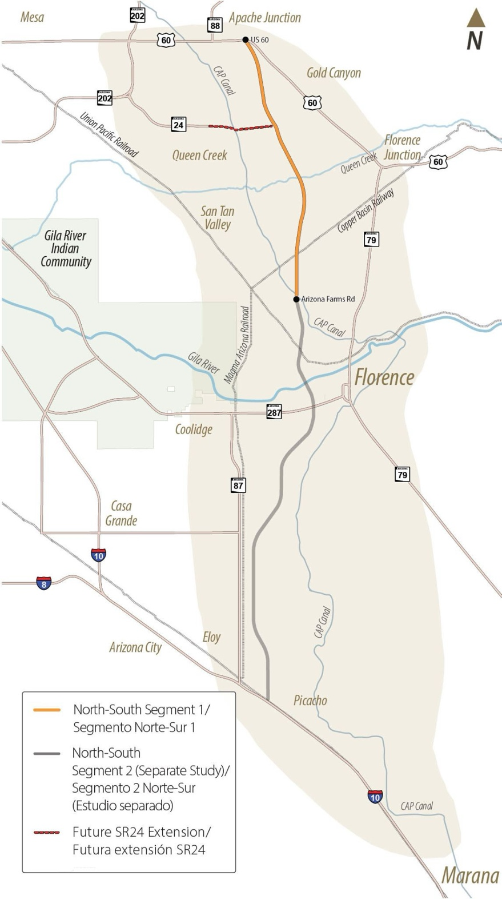
North-South Corridor
A R I Z O N A D E P A R T M E N T O F T R A N S P O R T A T I O N
Proposed corridor spans over 50 miles between US-60 and I-10.
Tier 1 EIS completed and ROD issued in 2021.
Identified 1,500-foot wide preferred alternative.
Tier 2 EIS proceeding in two segments:
US-60 to Arizona Farms Rd.
Arizona Farms Rd. to I-10.
Each study expected to take approximately 2-3 years to complete.

Slide 26
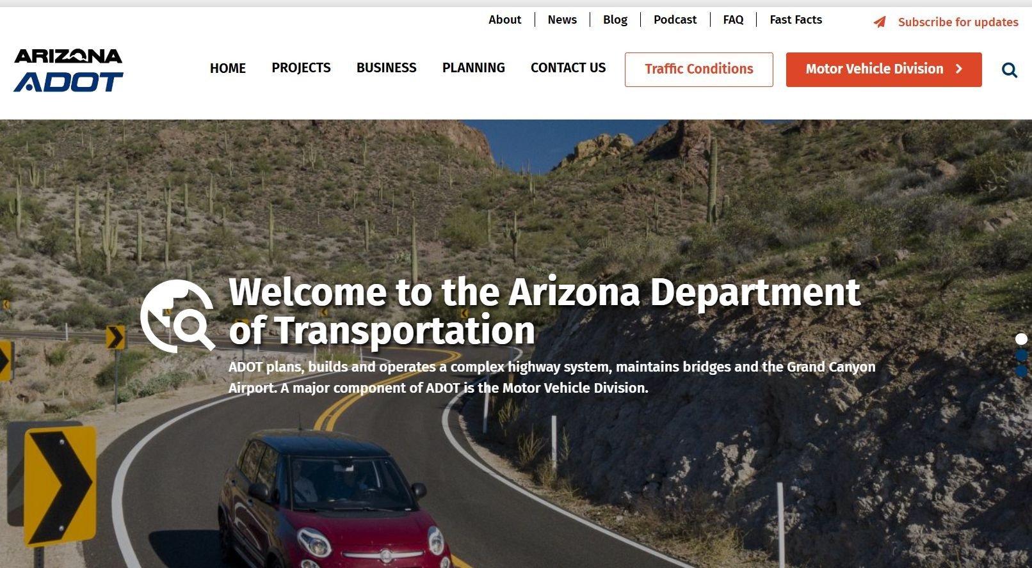
Stay Informed: www.azdot.gov
A R I Z O N A D E P A R T M E N T O F T R A N S P O R T A T I O N

Slide 27
Questions?
Anthony Casselman District Administrator Office: 520-388-4210
Cell: 480-261-1623
acasselman@azdot.gov

