Slide 1
Mentor protégé Program
Beyond the mandates - Racial, Ethnic, and Gender Inclusion in Transportation and Intentionally Developing an Equitable Industry
Daryl st. clair August 2022

Slide 2
Who am I?

Slide 3
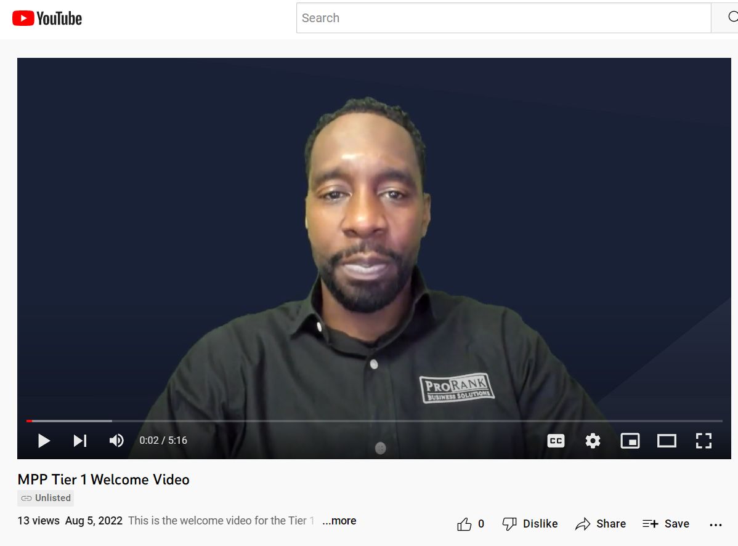
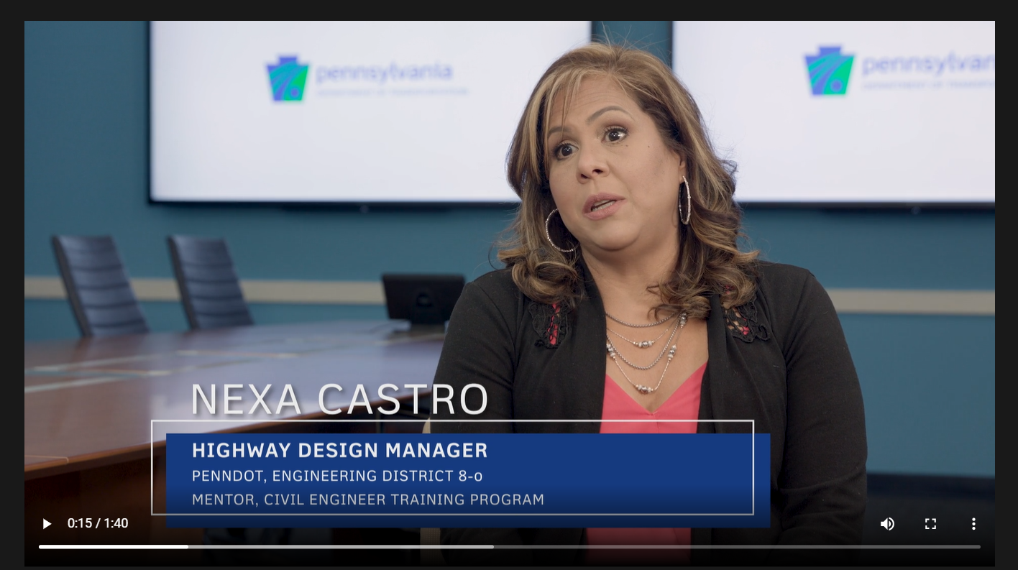
What is my vision?

Slide 4
Disparity study recommended a mentor protégé program
Black American owned businesses account for 0.1% of linear highway construction and 1.5% of engineering dollars in the Commonwealth (whereas 11% of the population is comprised of people of color)

Slide 5
Prior efforts
Consultant small business set aside (The pilot program was developed in 2017 and (7) design agreements. In 2019, the pilot program was expanded to include (8) Construction Inspection Agreements

Slide 6
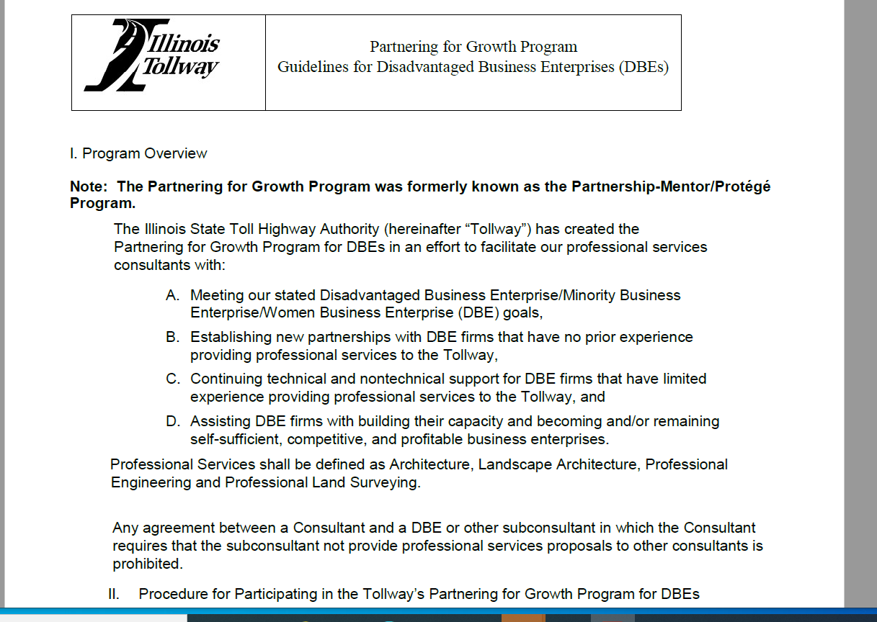
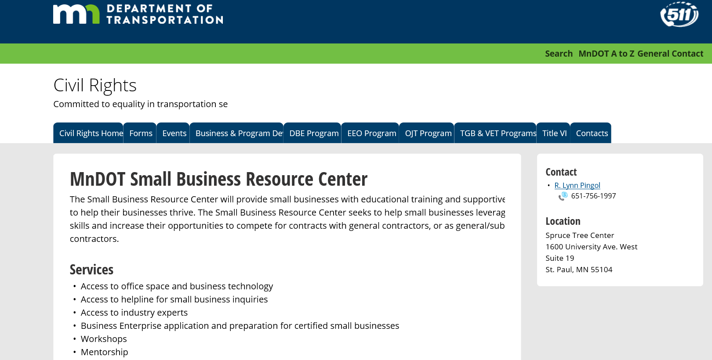
Researched other states & conducted industry forums

Slide 7
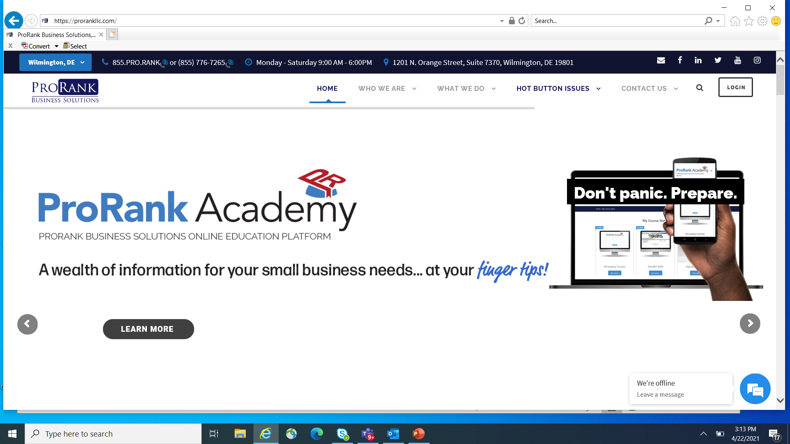
Who is PROrank?
The Administrator of the DBE Supportive Services Program

Slide 8
Consultant program as it relates to the Mentor
Go to Pro Rank Academy
Pairing
MOU/ Work Plan/ CUF
Submit Work Plan
If selected, a WBS Code is available as the Mentoring Tool
Submit SOI
PHASE I
PHASE III
PHASE II
Notes:
Projects will be advertised in ECMS and also ProRank Academy
Selection will include the Primes ability to mentor the DBE
An established DBE can also be the mentor
WBS Code 2% of the man hours similar to 5% for PM

Slide 9
Consultant program
Selection based upon statements of interest where criteria will include ability to mentor DBE Sub Consultants- must take on a Protégé Sub or you will not get the project.
A 2% of the total agreement dollar value work task would be utilized to pay the Mentor and the Protege.

Slide 10
Construction Program as it relates to the Mentor
Go to Pro Rank Academy
Pairing w/ retired contractor and Protege
Bid
Special Provision available to gain additional Pre Qual Code
MOU/ Work Plan/ CUF
PHASE I
PHASE III
PHASE II

Slide 11
Construction pre qualification innovation
$25,000 line item for mentoring a Protégé Firm

Slide 12
Program Documents
Program Guide
Core Competency Questioner (built into PRA)
MOU
Work Plan
Invoicing Form

Slide 13
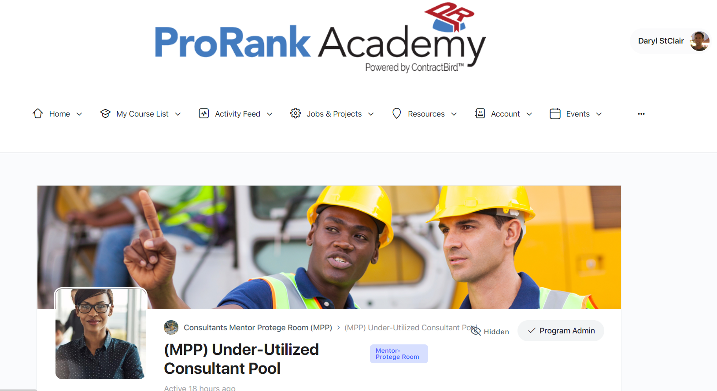
Equity for underrepresented firms
Goal is to help all DBEs get a job and address Disparity Study
After awarded a project, remove from PRA pool unless in the Under Represented Category

Slide 14
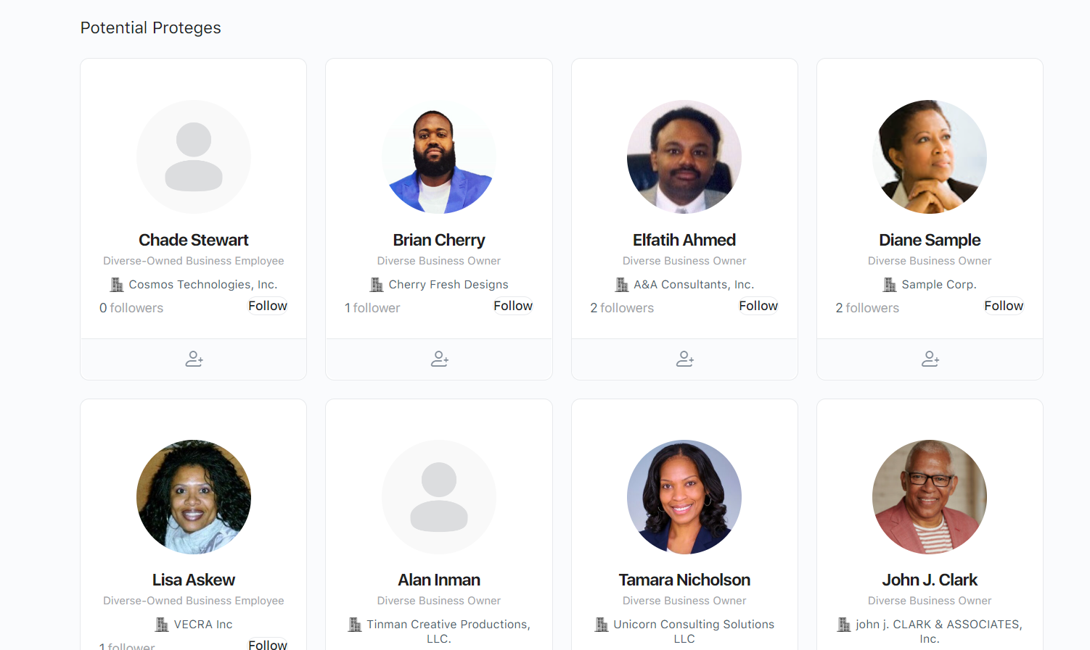
Marketing of underrepresented firms
UNDER DEVELOPMENT

Slide 15
industry goals
Increase participation in the DBE pool with underrepresented firms
Provide a framework for success that draws firms to participate
Eradicate barriers to opportunity
Notes:
PennDOT’s disparity study illustrated the underrepresentation of minority-owned businesses, particularly of African-American owned businesses which ranked last in total number of consultants and contractors. The purpose of the mentor protégé program will be to increase the participation of disadvantaged businesses in an effort to improve upon the findings of the disparity study.
This way you can spotlight an area of focus without making it solely about the demographic data.

Slide 16
industry success measures
Number of agreements earmarked
Number of new Protégé Firms participating and getting first project
Work billed by Protégé Firms
Additional prequal codes obtained

Slide 17
It’s Here
8 construction and 7 consultant projects in the Planned to Advertised phases
One year goal is to have each district advertise 2 construction and 2 consultant projects each (44 total)
Could be an ongoing Program (FHWA)
19 consultant mentors/ 22 consultant proteges have signed up
3 construction firms/ 8 construction protégés have signed up
Next virtual industry forum to further market the program is September 19

Slide 18
Hot FAQs
Did we get FHWA approval yet? No, but that’s ok
Do I attach any docs to the SOI?- no
Where does the MOU go? Email to MPP@PRORANKLLC.com
When do I do a Work Plan? For consultants, wait till you get a job- construction is different
Mentors are signing up in the wrong location
Retired Construction mentors is forthcoming
Mick Girondo
Beth Nury
Stacy Ginkle
Craig Hoogstraten

Slide 19
Let's not stop at Mentor Protege
SBE Set Aside
Eradicate DBE and Small Business Barriers

Slide 20
Eradicate DBE BARRIERS- Sample

Slide 21
Questions?

