Slide 1
WTS Pittsburgh Annual Membership Meeting
February 10, 2022

Slide 2
WTS Pittsburgh
This meeting is required in our by-laws.
Inform you of changes in leadership
Share our ideas and goals for 2022
Obtain feedback from you!!
Currently membership of over 135 base members.
Chapter Goals –
Become more organized, as an organization! Ha
Expand our reach and diversify by mode and industry
Events tonight – Door Prizes!!

Slide 3
WTS Pittsburgh Chapter and Board
President – Kelly Rigot
Vice-President – Jennifer McCracken
Treasurer – Amelia Harris
Secretary – Jennifer King
Immediate Past President – Monica O’Neil
Director-at-Large – Wendy Berrill
Director-at-Large – Barb Sloan
Regional Council – Linda Zug
Social Media – Michelle Hinds
Corporate Sponsor – Jennifer King
Communications – Lauren Doyle
Diversity & Inclusion – VACANT
EPIC – Rachel Stockert & Amanda Purcell
Membership – Kristen Sklarsky
Mentoring – VACANT
Newsletter – Damon Rhodes
Student Outreach – Moriah Eck
Recognition Awards – Linda Zug
Scholarship – Jennifer McCracken
TransportationYou – Jenna Gonzales

Slide 4
Membership Kristen Sklarsky
135 Active Members:
2020 – 31 New Members
2021 – 27 New Members
2022 – 8 New Members
2022 Honorary Members:
Lynn Manion – Executive Director of the Airport Corridor Transportation Authority
Mavis Rainey – Executive Director of the Oakland Transportation Management Association
2022 Goals:
Continue to grow our membership numbers and expand our networking opportunities
Increase membership engagement
Continue to provide support and responses to all member questions/concerns
Plan yearly events to recognize new members
Compile honorary member nominees
Need Help!!

Slide 5
New Member List Thank you for your commitment and support!!!
2020 Members 2021 Members 2022 Members
Melanie Percha
Sharmon Winters
Jenna Gonzales
Renee Scott
Sherry Hockenberry
Lindsey Ulizio
Lori Musto
Rosanne Rodgers
Laura Lesher
Melanie Berry
Katelyn Colella
H. Daniel Cessna
Lauren Doyle
John Nicholson
Caleigh Wanson
Allana Conn
Cathleen Zeisler
Tara Archer
Katharine Kelleman
Andrea Ebur
Burcu Akinci
Jeff Hans
Valerie Lahti
Lori Rossetti
Christopher Droznek
Emily Gordon
Jane Patton
Billie Budner
Meredith Santini
Stephen Scheerer
Erin Russell-Story
Lauren Huet
Sarah Smallwood
Gabrielle Braclay
Kathryn Trupo
Erin Clark
Melissa Sebastian
Cassandra Schanck
Christine Sgro
April Dorcak
Terri Slack
Amy Ivoska
Deena Dreher
Lisa Kay Schweyer
Fereshteh Noorbakhsh
Donald Pasquinelli
Koren Sprinkle
Christie Cohan
David Jackson
Melissa D'Loss
Abigail Martin
Ismet Erdagi
Suhaib Alshayeb
Slavica Gavric
Jennifer Provenza
Jessica Schumer-Rowles
Lindsey Stefanou
Amanda Titus
Lynn Manion
Mavis Rainey
Taylor Novitsky
Greg Cerminara
Jen Kacin
Cheryl Moon-Sirianni
Nicholas Burdette

Slide 6
Communications Chair – Lauren Doyle
Responsible for communicating events, opportunities, and important notices.
Members and Non members and students
Ensure the correct people are included on every chapter email that is sent out and the corporate sponsorships are included on every email.
Coordinate with the Social Media Chair to ensure consistent messaging across platforms
Goals for 2022
Improve appearance and consistency of emails
Engage more subscribers
Increase number of members and non member participants at events
Open to help and suggestions on how to improve communications
Need Help!!

Slide 7
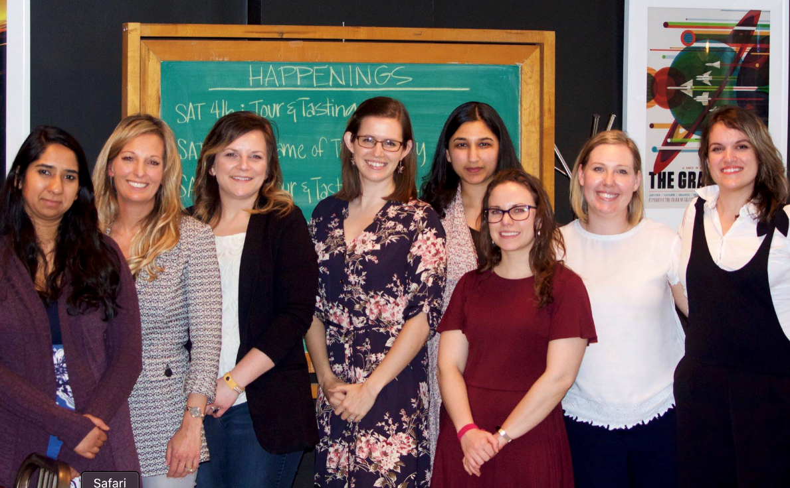
Mentor/Mentee Chair – VACANT
Members are matched with either a Mentee(s) or Mentor(s) based on interests
Monthly Zoom calls
Book Discussions
Quarterly events
A new chair can reboot
with new pairs!

Slide 8
Mentor/Mentee Chair – VACANT
As a member WTS International’s website allows you to sign up to participate in their mentorship program
Go to wtsinternational.org
Log in to your account
At the top left of the page click the My WTS communities
You will be redirected to a new page

Slide 9
Mentor/Mentee Chair – VACANT
From the new MyWTS Communities page navigate to the mentor match tab at the top and click “About Mentor Match”
There will be buttons to sign up as a Mentor or Mentee
Once enrolled you can navigate to the “mentoring directories”
See photo under step 4

Slide 10
Mentor/Mentee Chair – VACANT
There will be instructions on how to find a Mentor or a Mentee
You will be able to find either based on different parameters
Name
Company
Geographic Location
Communication Preferences
Transportation Subject Focus
Employer Type
WTS Chapter Affiliation
Discipline
Mentoring Topics
Years of Experience
The more parameters you select the less results you will get

Slide 11
Mentor/Mentee Chair – VACANT
Once you click find mentors/mentees a list will appear that best matches your parameters
You will be able to send a message to the person you would like to match with and see if they are available to be a mentee/mentor
Wait for a response!
This is my mentor!

Slide 12
Social Media & Website Chair – Michelle Hinds

Slide 13
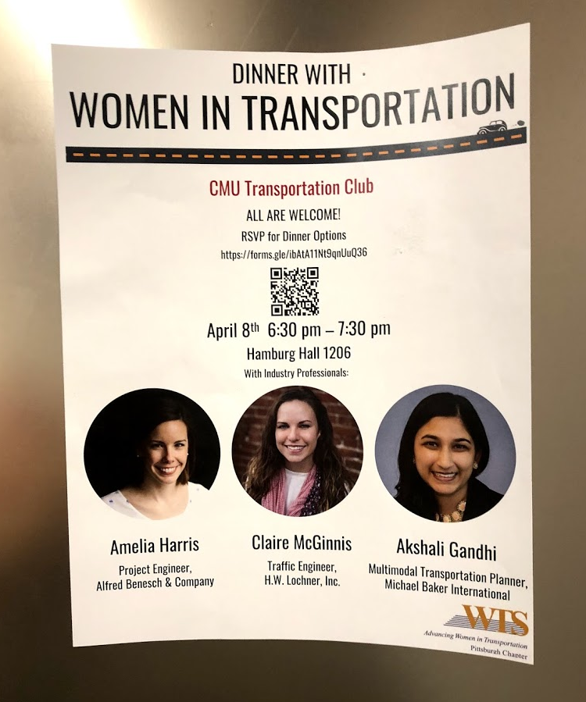
Student Outreach Chair – Moriah Eck
Outreach to local universities to get students involved in Pittsburgh chapter
Members:
Claire McGinnis
Monica O’Neil
Kathleen Burke
Lisa Kay Schweyer
Targeted student communication
Reduced or no cost for students to attend WTS Chapter events
Communicate job and internship opportunities

Slide 14
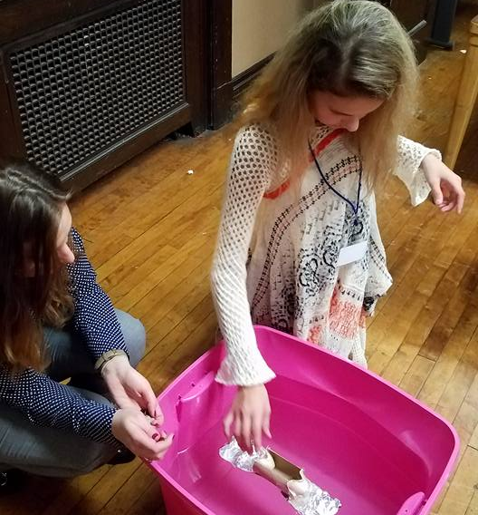
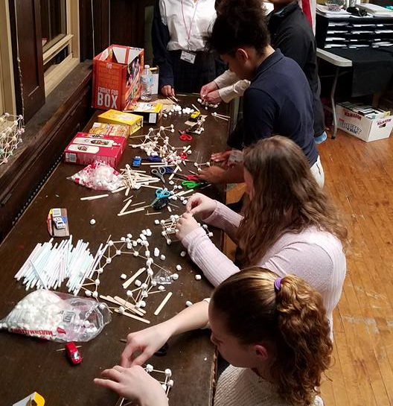
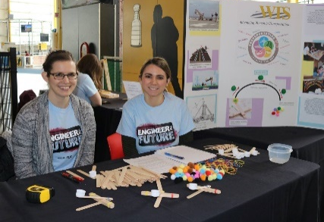
TransportationYOU Chair - Jenna Gonzales
What is TransportationYOU?
We work to develop a program of activities to encourage and engage young women between ages 13-18 to get involved in STEM (science, technology, engineering, and mathematics).
What do we do?
Pre-covid we would volunteer with local Girl Scout Troops, Big Brother Big Sister, Carnegie Science Center and local schools
Award scholarships to local middle school and high school students interested in attending STEM summer camps
Hoping to bring back our Trivia Night fundraiser in the fall of 2022

Slide 15
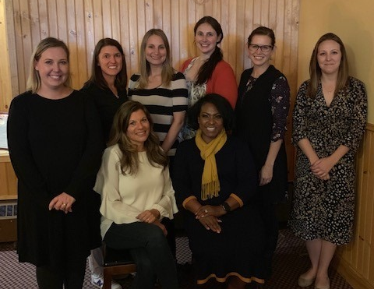
TransportationYOU Chair - Jenna Gonzales
What are we looking for?
New volunteer opportunities – especially digital or covid-safe options
Companies willing to have students shadow an employee
Industry and facility group tour options
New volunteers to add to our email blasts as events come up
Email Katie at transportationyoupittsburgh@gmail.com if you are interested in being added to our volunteer email list!
Additional Committee members interested in planning and coordinating events
We have had 2 members change career paths, 1 member currently on maternity leave now and 1 member to begin maternity leave in April
Fresh ideas are always welcomed in our group! Minimal time commitment to join!
Email Jenna at jgonzales@fisherassoc.com if you are interested in joining our committee!

Slide 16
Diversity and Inclusion Chair - VACANT
Work closely with other committees to target specific diverse facets of transportation career fields and public partnerships
Advise the Chapter, promote dialogue, and create useful tools to educate our Chapter while fostering a greater sense of community so that all members and potential members feel welcome.

Slide 17
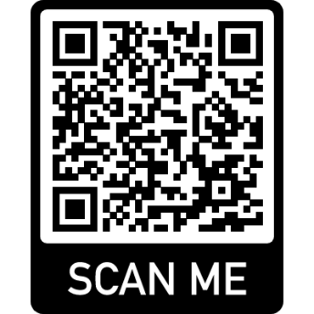
Corporate Sponsorship Chair – Jennifer King
Sponsorship support helps to:
Improve the quality of WTS Programs;
Raise funds for scholarships, Transportation You and mentoring.
10% of revenue funds the WTS Foundation & fosters the next generation of women in the transportation industry
Corporate Sponsors, Public Agency & Educational Partner Programs available
WTS Pittsburgh Sponsors & Partners receive various benefits:
WTS Membership for Individuals
Access to WTS International Platforms
Recognition at events and through our chapter email blasts
Invitations to Member-only events, and special member pricing
Job Postings online via website and social media
Additional benefits based on tier of sponsorship

Slide 18
Corporate Sponsorship

Slide 19
Recognition Awards Chair – Linda Zug
AWARD CATEGORIES AND WINNERS
WTS Woman of the Year – Lisa Cooper, P.E., Senior Vice President, JMT
Designed to reach out beyond WTS to honor a woman who is an outstanding role model in transportation.
WTS Member of the Year – Claire McGinnis, P.E., PTOE, Traffic Engineer, Lochner
Acknowledges a WTS member who has made extraordinary contributions to the success of the organization.
WTS Honorable Ray LaHood Award – Tim Ward, P.E., HDR
Acknowledges a man who is a leader in the transportation industry and has helped to advance women in the transportation industry.
WTS Employer of the Year – Michael Baker International
Honors an organization for recruiting, retaining and advancing women.
WTS Rosa Parks Diversity Leadership Award – Darcy Cleaver, Section Manager of Transit Amenities, Port Authority of Allegheny County
Recognizes either an organization or individual exhibiting extraordinary efforts or initiatives in facilitating professional opportunities for women and minorities.
WTS Innovative Transportation Solutions Award – I-579 Urban Open Space Cap Project, Cheryl Solosky, P.E., PennDOT and Mary Conturo Pittsburgh Sports and Exhibition Authority
Salutes an innovative transportation project led by a woman.

Slide 20
Scholarship Committee Chair – Jennie McCracken
2021 Highlights
2021 Virtual Scholarship Gala
Kathryn was absolutely amazing! She inspired all of us that night and we are so lucky to have her support as an international board member.
Highlighting the 2020 and 2021 Winners was awesome
Great support from WTSI on using their Zoom account and in pulling off our first audience participation with the live polling
Raised $581 for Foundation at virtual gala
3 - $2500 Scholarships
Multiple applications for each scholarship from 3 universities
Submitted applications to WTSI
CHECK OUT OUR UPCOMING NEWSLETTER FOR A FEATURE ON OUR 2022 SCHOLARSHIP WINNERS!!

Slide 21
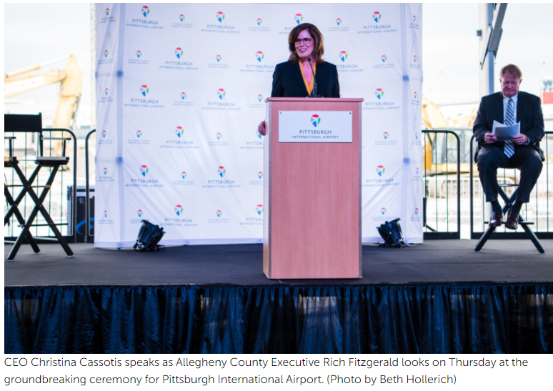
Scholarship Committee
Plans for 2022
Save the date: Scholarship Gala in March 24, 2022 from 6:00-8:00 PM at the Sheraton Station Square
Registration will be out in the next week
Christina Cassotis, CEO at Allegheny County Airport Authority
Successful Silent Auction at the Gala – going to be our biggest year yet and we already have a few donations that are valued at $900
Follow-up with our past winners– highlight on social media this year with a Where are They Now Series?
2022-2023 Scholarships – Great way to get engaged on the committee in reviewing scholarship applications or supporting outreach to our universities
Looking for new committee members please reach out if you are interested!
Begin transition of next Scholarship Chair – looking for folks who are interested

Slide 22
Events and Programs of Interest Committee (EPIC) Co-Chairs: Rachel Stockert & Amanda Purcell
Do you want to…..
Have a say in what WTS events are held
Get involved on an active committee with low time commitment
Help plan the monthly WTS events
EPIC is always looking for new members!
If you are interested in joining EPIC, see Rachel or Amanda after the presentation!
Email: Rachel- rstockert@larsondesigngroup.com
Amanda- apurcell@trafficpd.com

Slide 23
Events and Programs of Interest Committee (EPIC)
Tentative 2022 Events
January
Membership Meeting
February
Recognition Awards
2/22/2022
March
Scholarship Gala
03/24/2022
April
Golf Tune Up
May
Mental Health in Engineering
June
ACOE Lock and Dam System
July
Members Only Happy Hour
August
Virtual Lunch Presentation
September
Oktoberfest Headshots and Happy Hour
October
Northeast Regional Event
November
Hardhat Fundraiser
December

Slide 24
Website:
https://www.wtsinternational.org/
https://www.wtsinternational.org/Pittsburgh/
Email:
WTSPittsburghChapter@gmail.com
We are also on Facebook and LinkedIn.
THANK YOU!!

