Slide 1
Impacts from the Infrastructure Bill on Colorado Dec. 14, 2021

Slide 2
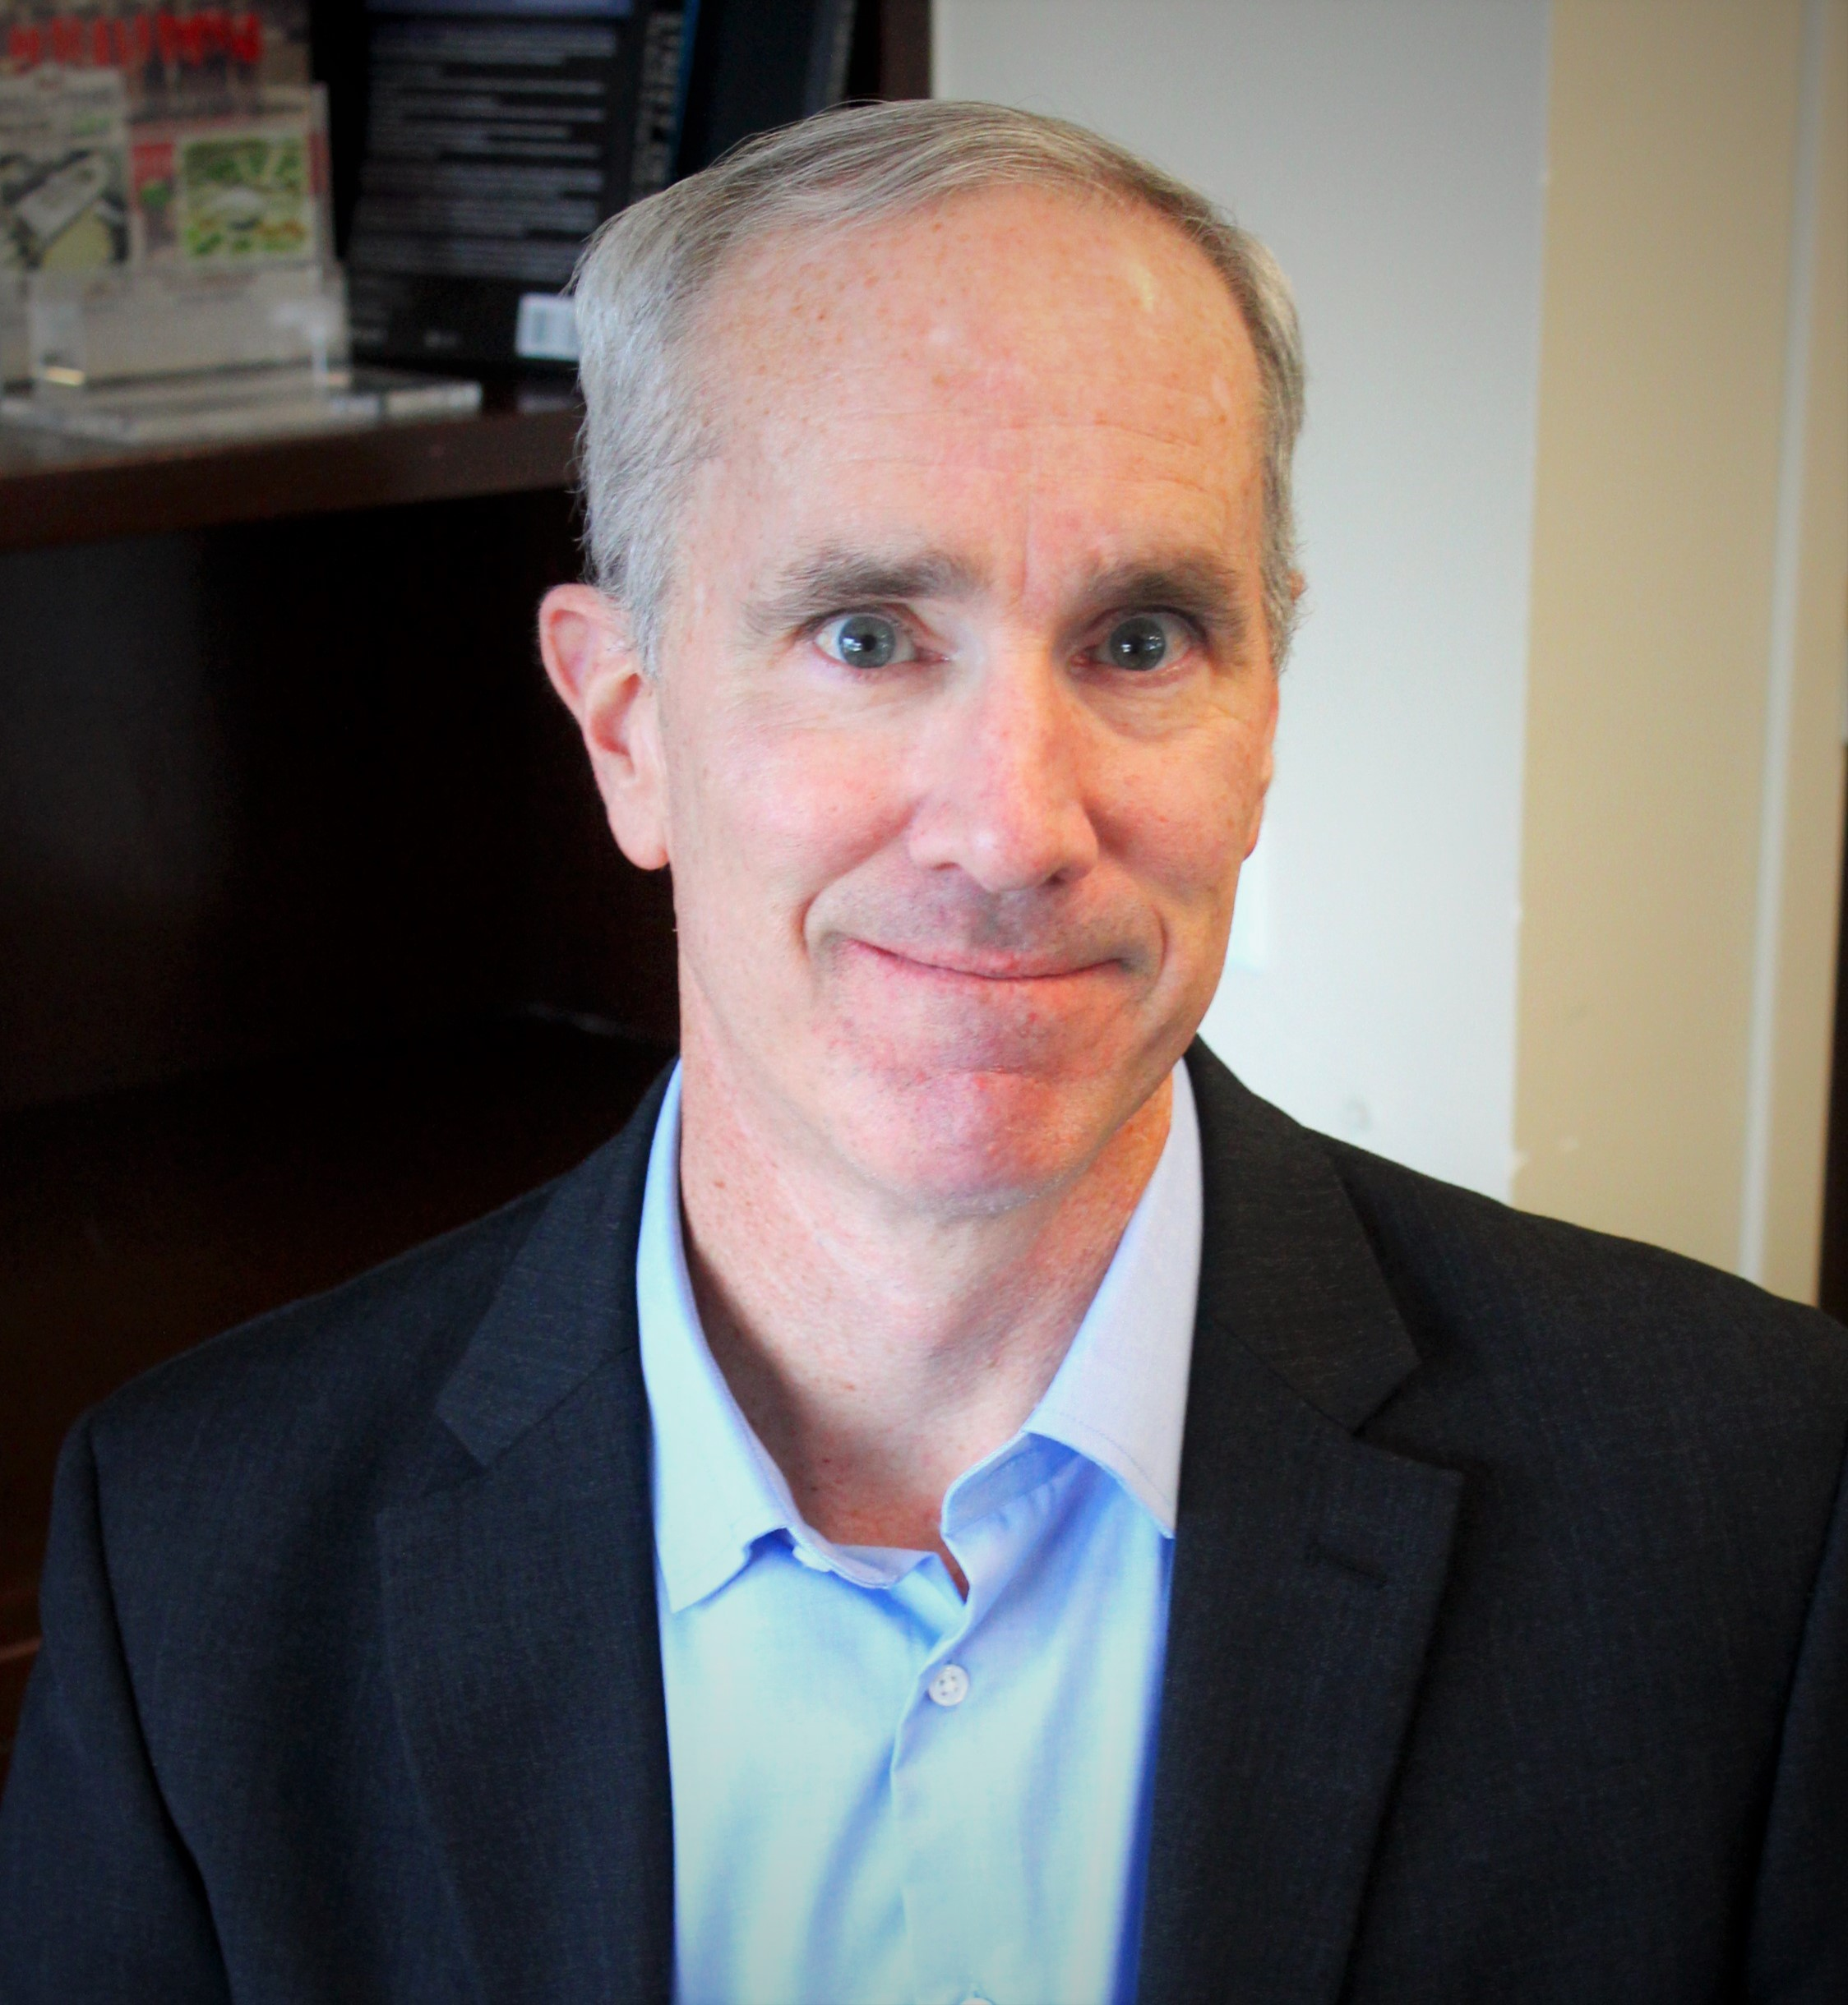
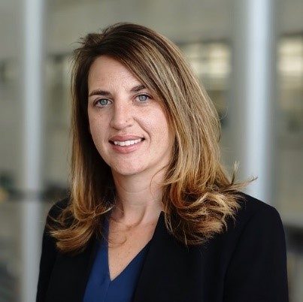
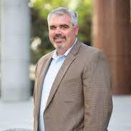
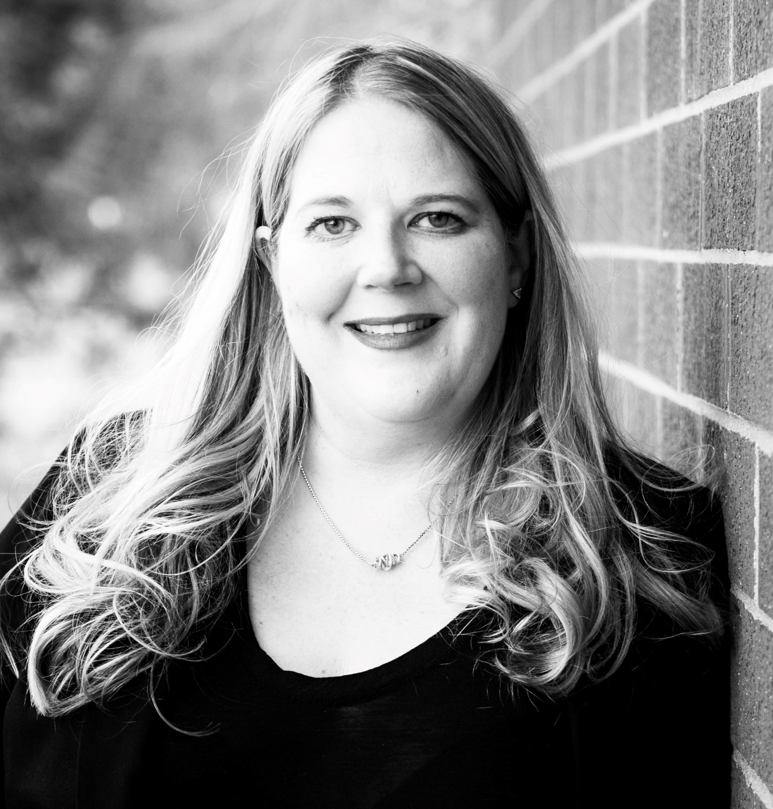
Guest Speakers
Rebecca White, Division Director, CDOT
Bill Van Meter, Assistant General Manager of Planning, RTD
Jen Hillhouse, Director of Transportation Planning, DOTI
James Starling, PE, Chief of Construction and Infrastructure Officer, DEN
Moderator: W. Celeste Stragand, Head of Government Partnerships, TPE/EC, Ford Motor Company

Slide 4
$432M to airports in Colorado for infrastructure
$4B for highways and bridges
$86M to reduce transportation-related emissions
$98M to increase transportation system resiliency
$950M for public transit
$33M in 402 formula funding or highway safety
$57M to support expansion of EV charging
$35M to protect against wildfires
$16M to protect against cyberattacks
$3.5B national investment in weatherization
Source: The Bipartisan Infrastructure Law Will Deliver for Colorado (transportation.gov)

Slide 5
Grants
New funding
Expanded funding
$6B Safe Streets for All
$15B Rebuilding American Infrastructure with Sustainability and Equity (RAISE)
$14B Infrastructure for Rebuilding America (INFRA)
Raises cap 30% multi model projects
$5.6B FTA Low and No Emission Bus Programs
$2.0B FTA Buses + Bus Facilities Competitive Program
$1.75B FTA All Station Accessibility Program
$23B Capital Investment Grants Program
$15B MEGA Projects
$8.7B Promoting Resilient Operations for Transformative, Efficient and Cost-saving Transportation (PROTECT) Program
$12.5B FHWA Bridges
$1B Reconnecting Communities Pilot Program
$1B Strengthening Mobility and Revolutionizing Transportation (SMART) Program
$2B Rural Surface transportation Program
$2.5B Charging and fueling infrastructure discretionary
$5B FAA Terminal Program
Source: The Bipartisan Infrastructure Law Will Deliver for Colorado (transportation.gov)

